Slide 1
Bell Work, Monday 4/20
Today marks the 5th anniversary of what environmental disaster?
Technologies can now track this while you’re online.
What protein can be used for camouflage?

Slide 2
Public Opinion, Public Issues, and Promoting and Inhibiting Change
Essential Standard CE.C&G.1.5 and CE.C&G2.8
Poll Bearers

Slide 3
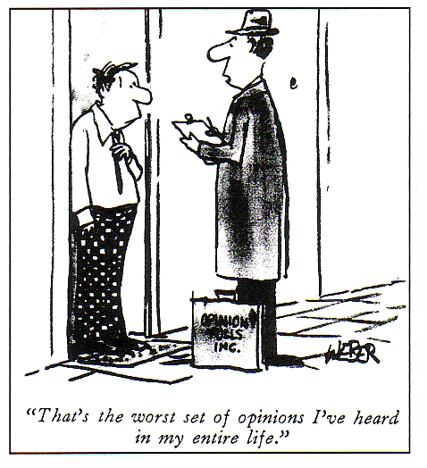
What is Public Opinion?
Public Opinion
Generic term for what the majority of the public may believe about an issue—can be very misleading as a majority may represent only 51%

Slide 4
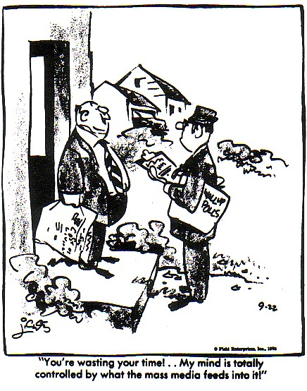
What are Some of the Factors that Can Influence Public Opinion?
Mass media – forms of communication that transmit information to a large number of people
Newspapers and magazines
Television and radio
Internet

Slide 5
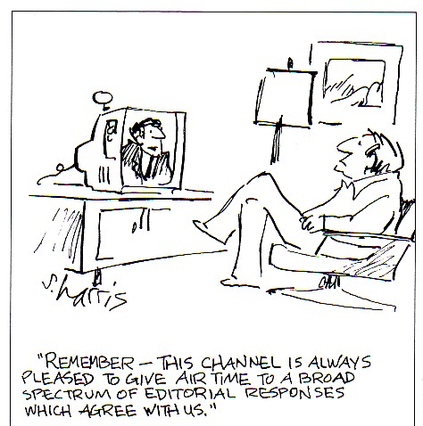
What are Some of the Factors that Can Influence Public Opinion?
Media may be bias
Refers to a one-sided opinion on an issue
Journalists cannot print or speak lies
Libel-written
Slander-spoken

Slide 6
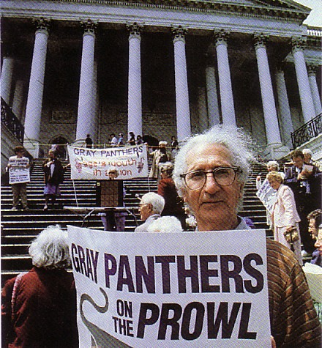
What are Some of the Factors that Can Influence Public Opinion?
Public Officials
Interest Groups
A group of people who have similar interests or concerns about an issue
Different types of interest groups
Economic
Issue-Oriented
Public

Slide 7
What are Some of the Factors that Can Influence Public Opinion?
Economic Interest Groups
Represent economic interests of their members
Examples: National Association of Manufacturers, Labor Unions and United Mine Workers of America

Slide 8
What are Some of the Factors that Can Influence Public Opinion?
Issue-Oriented Interest Groups
Focus on a specific issue or cause
Examples: National Association for the Advancement of Colored People (NAACP) and National Organization for Women (NOW)

Slide 9
What are Some of the Factors that Can Influence Public Opinion?
Public Interest Groups
Promote the interest of the general public rather than one part of it.
Examples: Sierra Club and Common Cause

Slide 10
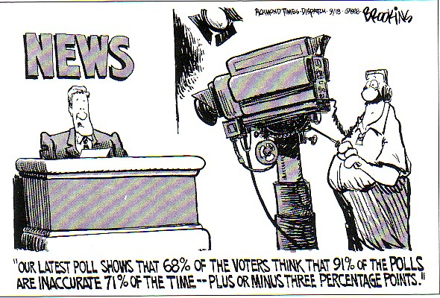
How is Public Opinion Measured?
By conducting scientific public opinion polls
Pollsters will choose a portion of the population with the goal to select a random sample
The way questions are worded is important to prevent bias
By conducting surveys but these are less scientific

Slide 11
How Does Public Opinion Affect the Election Process?
Candidates want to make sure they are supporting issues the voters care about
Public agenda may be created from public opinion polls and meetings with the public
Party platforms often align with public opinion

Slide 12
-Promoting and Inhibiting Change Through Political Action -Participate in Civic Life, Politics, and/or Government

Slide 13
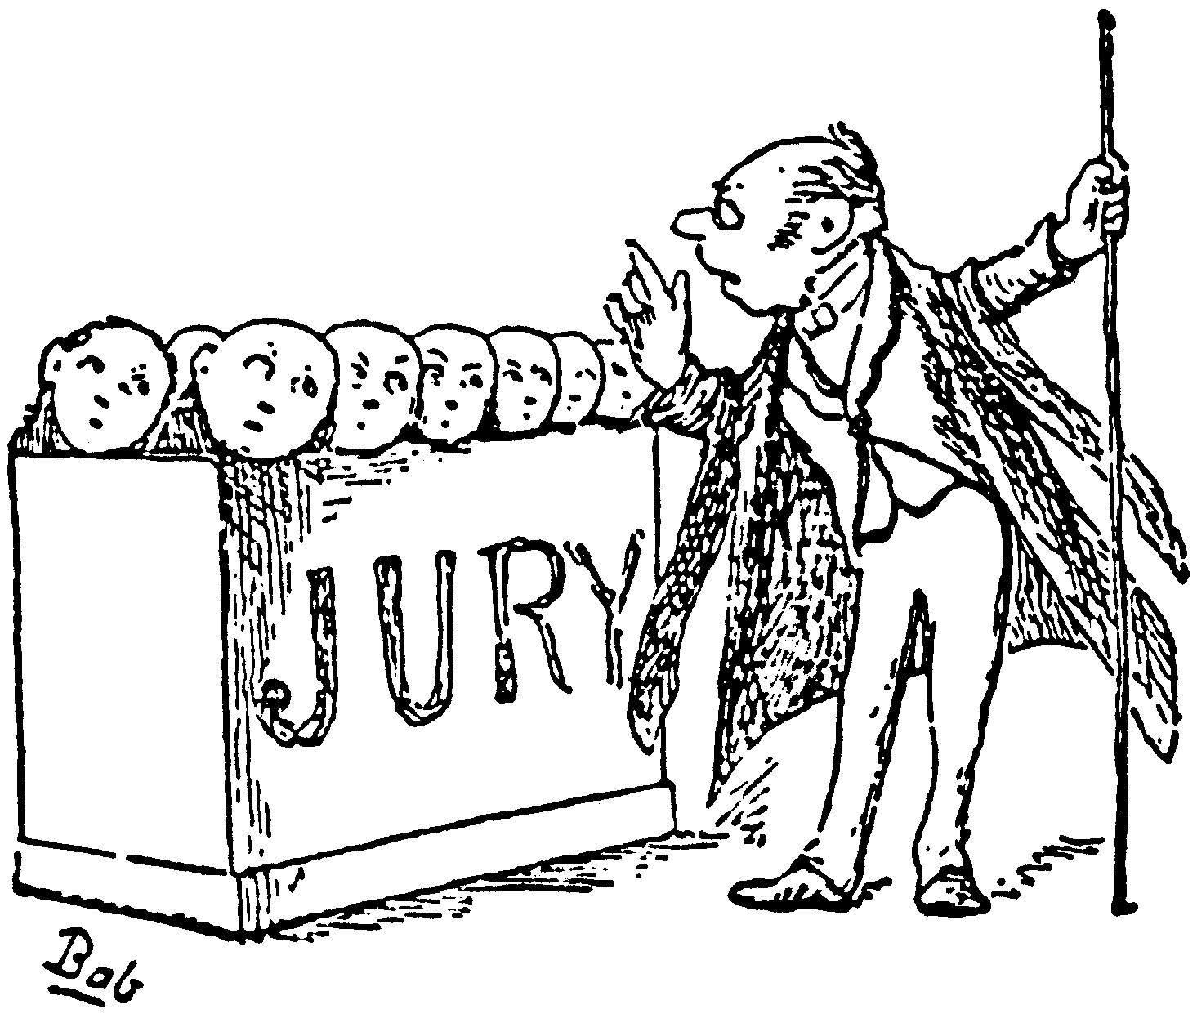
How Can Citizens Bring About Change in their Communities?
Activists or active citizens seek out ways to be involved in their communities
Register to vote
Vote
Become informed
Take part in boycotts or protests
Sign petitions
Write a letter to the editor
Attend city council meetings
Participate in jury duty
Get involved in community service

Slide 14
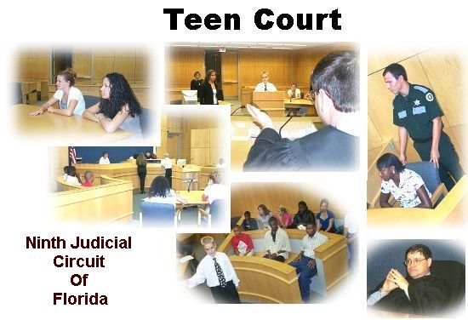
How Can You as a Student Be Involved in Your Community?
Mock Elections
Take part in mock elections in school
Moot Court or Mock Trial
Take part in simulated court trials
Teen Court
Student volunteers take on the roles of the courtroom to provide a trial and sentencing for peers
Community service
Letter-writing campaigns
Being informed

Slide 15
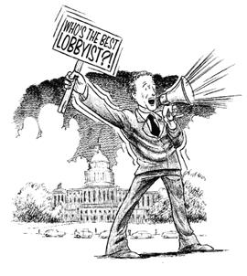
How Can Change be Promoted Through Formal Methods?
Lobbying-the act of trying to influence people on behalf of an interest group
Lobbyists work at all levels of government
Lobbyists provide information to government officials
Lobbying is regulated by the government
Need to be registered

Slide 16
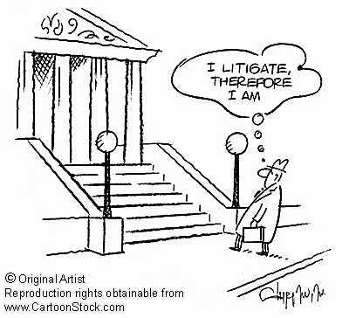
How Can Change be Promoted Through Formal Methods?
Litigation
An attempt to use the court system to achieve a goal and affect public policy
Lawsuit that tries to get the court to rule in favor of a certain policy issue
Example: Brown vs. Board of Education

Slide 17
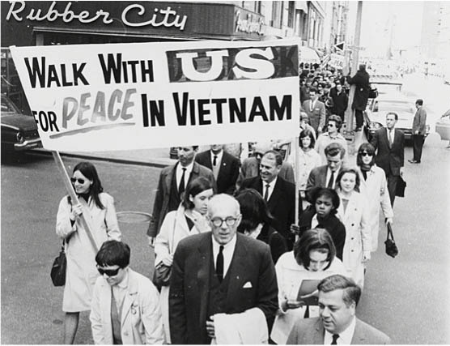
How Can Change be Promoted Through Formal Methods?
Protest
A form of public participation that assembles crowds to confront an elected official or agency about certain issues

Slide 18
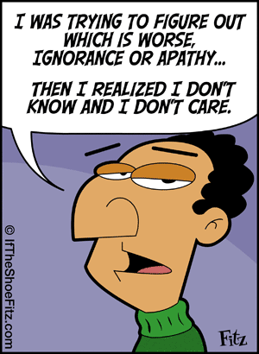
How Can Citizens Inhibit Change?
APATHY or lack of interest or concern
Citizens do not register to vote or vote due to apathy
Do not perform civic responsibilities due to apathy

Slide 19
