Slide 1
Bell Work, Friday 4/17
How much money does SpaceX receive from NASA?
Which former president was assassinated on April 14th, 1865?
What is the name of the campaign to address loneliness?

Slide 2
The Election Process
Voting Rap

Slide 3
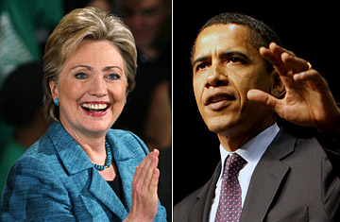
How Are Candidates Elected?
There are three types of elections in the United States
1. Primary Election: Voters select a party’s candidate for the general election
Closed primary-only registered members of the party can vote
Open primary-all registered voters can decide on the primary candidate
North Carolina-each party may allow unaffiliated voters to vote in the primary

Slide 4
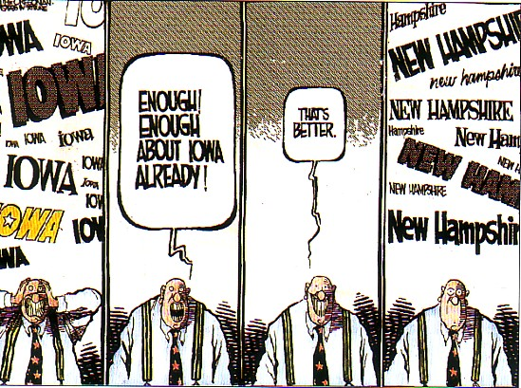
How Are Candidates Elected?
***Instead of a primary election, some states hold a Caucus
A Caucus is a meeting of supporters or members of a political party to name candidates

Slide 5
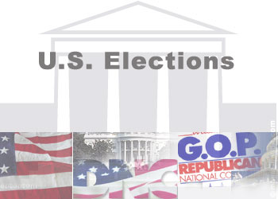
How Are Candidates Elected?
2. General Election: held after the primary election to elect candidates to office
Held the first Tuesday after the first Monday in November
All registered voters may vote
Candidates are elected by “plurality vote”
Whichever candidate has the most votes

Slide 6
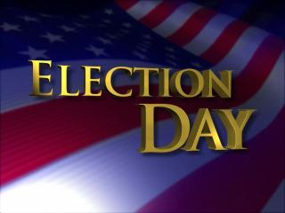
How Are Candidates Elected?
3. Run-off Election: If a candidate does not win a majority of votes in the election
Held between the two candidates who received the most votes
Run-off elections are not held in North Carolina

Slide 7
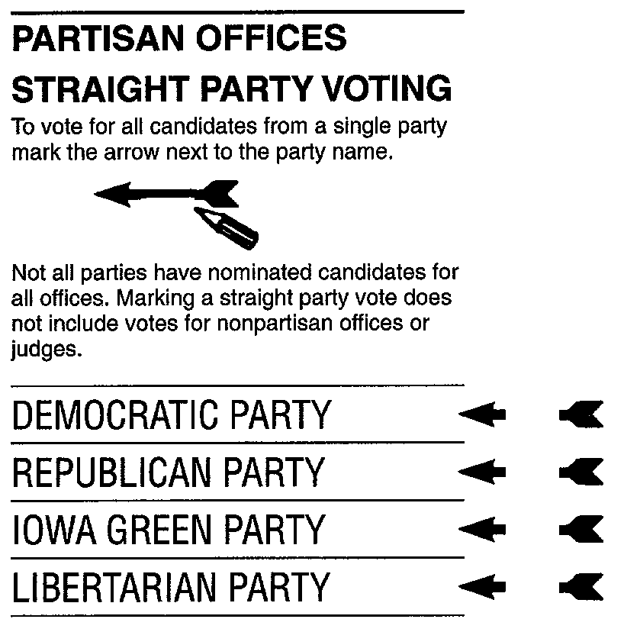
What is the Difference Between a Partisan and Non-Partisan Election?
Partisan Election
Party affiliation of the candidate is listed on the ballot
North Carolina – all state, county, most school board, and some city elections
Straight party ticket – vote the same party affiliation for all candidates
Split party ticket – vote for candidates of any party affiliation

Slide 8
What is the Difference Between a Partisan and Non-Partisan Election?
Non-Partisan
No party affiliation appears on the ballot
North Carolina - all judicial, most city, and some school board elections

Slide 9
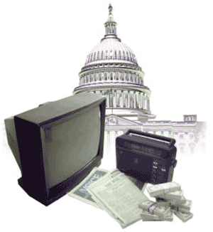
How are Campaigns Financed?
Private Funding: Private Funds can be raised through individual donors, contributions from political action committees, or political parties and candidates’ personal and family resources
Individual donors
Up to $2300
Direct mail fundraising
Internet fundraising
Friends
Family

Slide 10
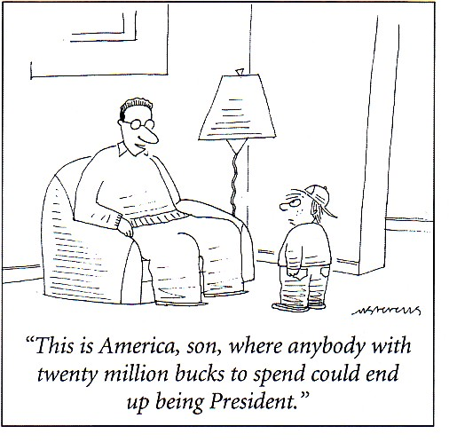
How are Campaigns Financed?
Political Action Committees (PACs)
Private organizations established by corporations, labor unions, trade associations, or interest groups
Raise money and distribute election funds
Donate as much as $5000
Individuals candidates are allowed to spend their own personal money in an election, with no limit to the amount of money they are allowed to contribute
Notes:
http://www.pbs.org/newshour/spc/thenews/thevote/story.php?id=19461&package_id=634

Slide 11
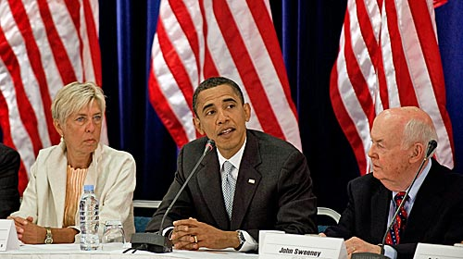
How are Campaigns Financed?
Public Funding: Available for presidential elections
Eligible for funds if a candidate raises $5000 in individual contributions of $250 or less in twenty different states
If eligible can apply for federal funds to match all individual contributions of $250 or less
Third party candidates are only eligible if they receive at least 5% of the vote in the previous election
Candidates who accept public funding are limited to the amount of money – equal funding for candidates

Slide 12
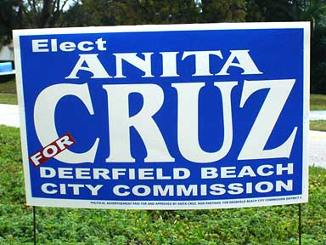
How do Candidates and Parties Publicize Themselves During Campaigns?
Two major strategies to increase public awareness – labor intensive and media intensive
Labor intensive campaigns
Used mostly in local elections and congressional races
Recruiting volunteers to hand out leaflets and organize rallies
Candidates make appearances at local events, receptions, or community meetings
Canvassing - person to person campaigning; going door to door; use of the telephone

Slide 13
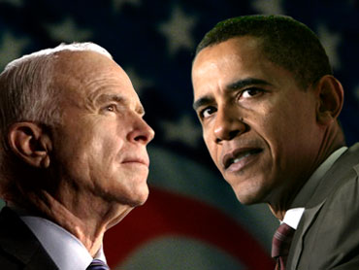
How do Candidates and Parties Publicize Themselves During Campaigns?
Media driven campaigns
Used mostly in statewide campaigns and national elections
Broadcast media to emphasize their issues and personal characteristics
Shorter radio and television ads
Longer infomercials
Televised debates
Websites and podcasts

Slide 14
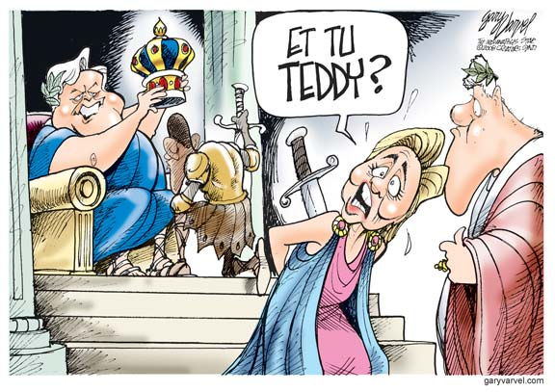
What do Candidates do to Increase Their Support?
Canvassing
Door to door, contacted by telephone
Endorsement
Political endorsement is the public declaration of one’s personal or group support for a candidate
Elected officials
Private companies
Non profit organizations
Other members of society

Slide 15
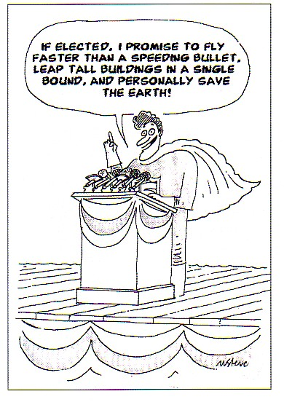
What do Candidates do to Increase Their Support?
Propaganda: Aimed at influencing the opinions of citizens. It is usually misleading and not valid
Glittering Generalities: An appeal to the emotions using vague words, such as peace or freedom
Bandwagon: Using language that makes voters feel they should support an issue just because a majority of citizens do

Slide 16
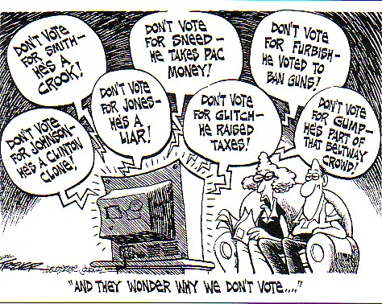
What do Candidates do to Increase Their Support?
Stack Cards: Using only facts that support a candidate’s argument and excluding other important facts
Name Calling: Attaching negative labels to a candidate’s opponent
Negative advertising
“Just Plain Folks”: Telling voters that a candidate is “just like them”
An ordinary person with similar values and ideas
Notes:
The Living Room Candidate campaign videos

