Slide 1
Bell Work, Thursday 4/16
1. What does Al-Shabaab mean in Arabic?
2. What is the problem that has to be cleaned up in Rio de Janiero?
3. What is Kopila Valley?

Slide 2
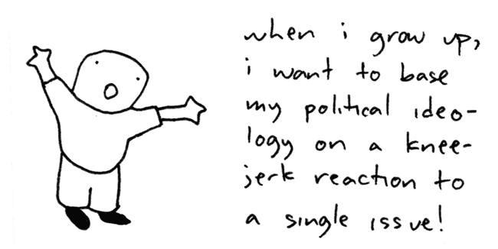
What is the Spectrum of Political Ideology?
Political ideology is a person’s set of underlying ideas and beliefs through which he/she understands politics

Slide 3
Spectrum of Political Ideology
RADICAL----LIBERAL----MODERATE----CONSERVATIVE----REACTIONARY
(Far Left) (Middle) (Far Right)

Slide 4
What is the Spectrum of Political Ideology?
Radical: Ideology that embraces rapid changes in the structure of society
Sometimes use extreme methods like violence or revolution
Considered to be far left of the spectrum

Slide 5
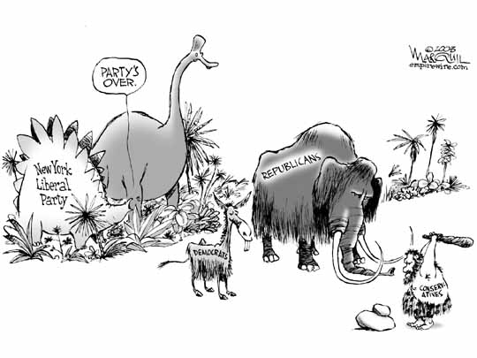
What is the Spectrum of Political Ideology?
Liberal: Ideology that supports:
political and social reform
Expansion of federal social services-welfare
Government intervention in the economy
Efforts of the poor, minorities, women and the environment
The History of the Democratic Party

Slide 6
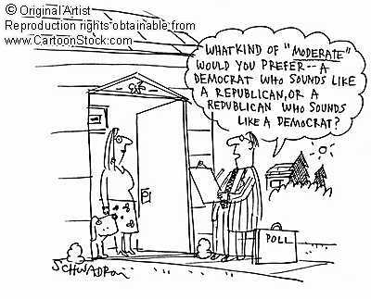
What is the Spectrum of Political Ideology?
Moderate: Ideology shares viewpoints of both liberals and conservatives
Tolerance of other’s views and do not hold extreme views of their own

Slide 7
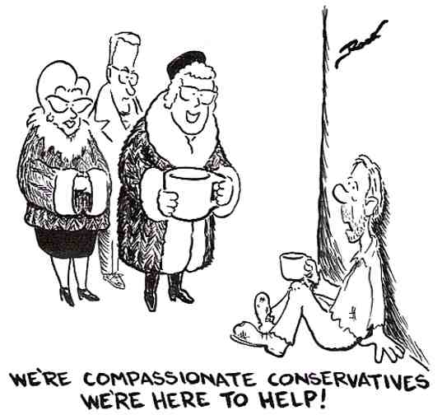
What is the Spectrum of Political Ideology?
Conservative: Ideology that supports:
the social and economic status quo
minimizing the power and control of the government
Value social positions such as school prayer and the traditional family unit
Conservatives are opposed to government regulations on businesses
The History of the Republican Party

Slide 8
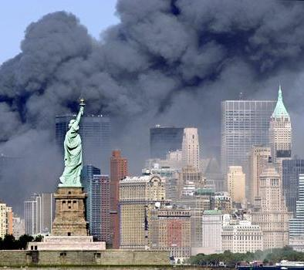
What is the Spectrum of Political Ideology?
Reactionary: Ideology that embraces ideas that focus on the past
Often willing to use extreme methods
Are against the repressive use of government power
Considered on the far right of the ideological spectrum

Slide 9
Qualifications and Procedures for Voting

Slide 10
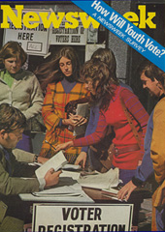
Who can Vote?
Federal Laws
Cannot be denied due to:
15th Amendment- Race
19th Amendment- Gender
26th Amendment- 18 years old

Slide 11
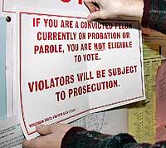
Who can Vote?
North Carolina Laws
18 years old
30-day residency in the county you live in
You must not be registered in another county or state
If you are a convicted felon, your rights of citizenship have been restored
Once a felon completes their sentence, their rights are restored

Slide 12
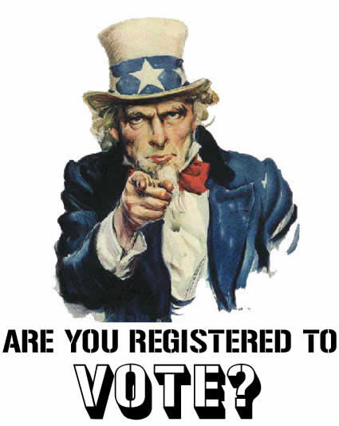
How Does One Register to Vote?
You can register through:
Department of Motor Vehicle
County board of elections
Application is online to mail in
Libraries and public high schools
Mail in registration forms
New Hanover County
Board of Elections

Slide 13
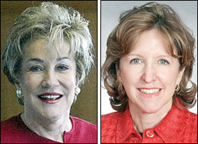
What are Voting Districts and When are They Used?
Some offices are elected across the state at-large, while others are elected within voting districts
At large elections-all voters select from the same group of candidates
Examples:
US Senate
Governor
Lt. Governor
Secretary of State
NC Supreme Court Justices
Dole and Hagan

Slide 14
What are Voting Districts and When are They Used?
In elections involving voting districts, voters will be selecting from different groups of candidates depending on the district they live in
Examples:
US House of Representatives
NC Senate
NC House
Superior Court Judge
District Court Judge
District Attorney

Slide 15
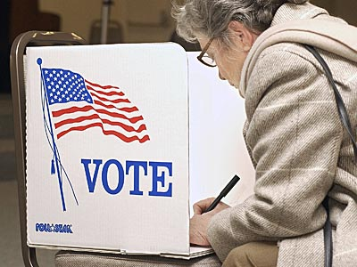
What are Voting Districts and When are They Used?
Depending on where you live in North Carolina, some county commission, city council, and school board elections may be at-large or district
At-large: everyone in the jurisdiction votes for the same person
Voting district: voters will select from a different group of candidates depending where they live
One group of candidates will be running for seat A, one group will be running for seat B

Slide 16
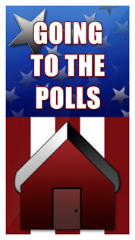
Where Do I Need to Go to Vote?
County board of election divides its county into polling precincts
Each polling precinct has a designated polling site
Your polling site is listed on your registration card
You may cast an absentee ballot before election day
In some states you can go to a designated site and “early vote”

Slide 17
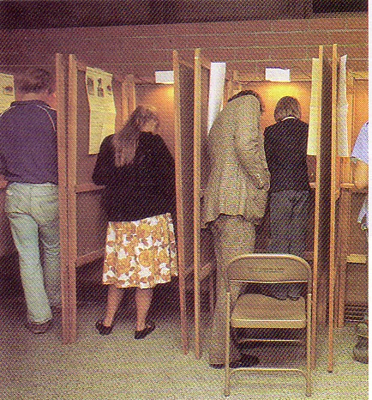
What Happens When I Get to My Polling Place?
I.D. is checked against list of registered voters
Cast your vote
paper ballots
lever machines
punch cards
Computer
You may encounter an exit poll as you leave
Notes:
Lever Machine: https://www.youtube.com/watch?v=6iphiBpgZBM
Onion Lever Machine: https://www.youtube.com/watch?v=MmPtfy9P714

Slide 18
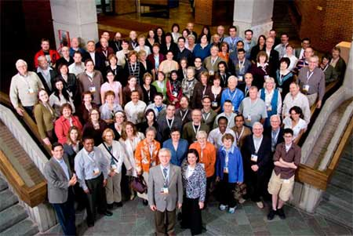
What Other Things Might I Vote on in an Election?
Initiative
Process which citizens can propose laws
Citizens petition the board of elections to put a referendum or a proposition on the ballot
Petition must be signed by a certain number of registered voters

Slide 19
What Other Things Might I Vote on in an Election?
Referendum
Law proposed or passed by the state legislature
Put on the ballot for citizens to approve or reject
A referendum allows citizens to vote directly on a proposed law
NC examples:
Lottery
Line-Item Veto

Slide 20
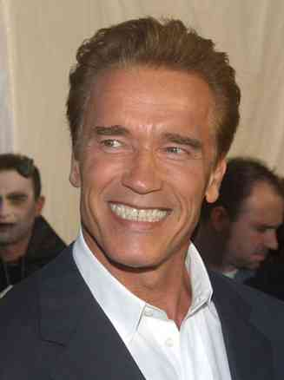
What Other Things Might I Vote on in an Election?
Recall
Registered voters petition the board of elections to have a government official to be removed
Rare in North Carolina
Only 15 cities and one school board in North Carolina have permission from the General Assembly
Example:
California-Schwarzenegger

Slide 21
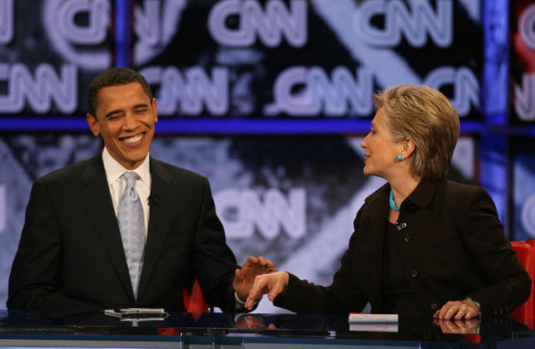
How Does the President Run for Office and Get Elected?
Nomination of the Candidate
Primary election or caucus held in fifty states
After the primary elections are held, the Democratic and Republican national parties hold conventions
At the convention, convention delegates from each state vote for a candidate

Slide 22
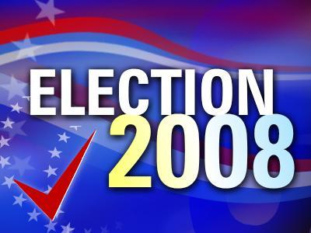
How Does the President Run for Office and Get Elected?
Presidential Elections
Citizens vote on election day for the president
Instead of directly electing the president they elect a slate of members for the Electoral College (electors)
Each state has a number of electoral votes equal to the number of state’s senators and representatives
Washington, D.C. has three

