Slide 1
Writing Assignment
1. Make a T-chart that shows the views of Supporters AND Opposers of funding schools locally.
2. Write a short essay (1-2 SOLID paragraphs) in which you answer the following:
Use the reading and your chart to describe whether you believe schools should be funded locally. Why or why not?

Slide 2
 | Constitution | Legislative Branch | Executive Branch | Judicial Branch
U.S. Govt
Both
State Govt

Slide 3
Constitution
Reserved Powers
14 Articles
Checks & Balances
Framework for Govt
Expressed Powers
Written in 1776
Preamble
List of individual rights
7 Articles
Separation of Powers
Written in 1787
Legislative Branch
Congress
Bicameral legislature
120 Representatives
Senate
50 Senators
100 Senators
House of Reps
435 Representatives
No term limits
General Assembly
Executive Branch
Governor
Vice President
4 year terms
10 departments
Lt. Governor
15 departments
Veto power
Cabinet
President
Council of State
Judicial Branch
Supreme Court
4 levels of courts
3 levels of courts
Serve 8 year terms
Serve life terms
Appeals Courts
Superior Courts
9 Justices
District Courts
Judges elected
7 Justices
Judges appointed

Slide 4


Local Government
County Government
NC County Government
Municipal Government

Slide 5
County Government
There are 100 counties in NC
  New Hanover County: 202,667 in 2010 Census
Run by:
  ElectedCounty Commissioners
    Manage budget
    Levy taxes
  County Commissioners hire a County Manager
    Oversees day to day operation of the county

Slide 6
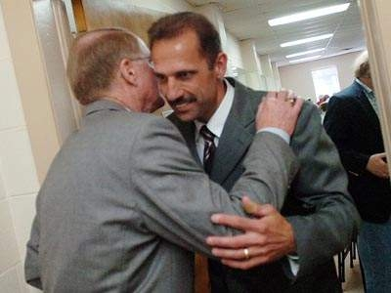

Other Elected County Officials
Sheriff
  Provides law enforcement for ‘unincorporated’ parts of the county
  Maintains county jails
Board of Education - Superintendent
  Sets budgets
  Hires administrators
  Textbook decisions
  Sets school calendar
County Clerk
  - Register of Deeds-official responsible for public records
Edward McMahon
Dr. Tim Markley

Slide 7
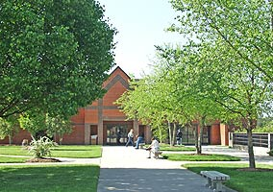
Services Provided by Counties
Community Colleges
Courts
  County Courthouse
Jails
  Overseen by the Sheriff
Soil and Water conservation
  Clean water, solid waste management

Slide 8
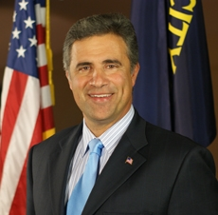
Municipal Government
Municipality:
  ‘Incorporated’ city or town
  Wilmington: 106,476 in 2010 Census
Governed by:
  Mayor
    Elected
  City Council
    Elected
  City Manager
    Hired by City Council
Mayor Bill Saffo

Slide 9
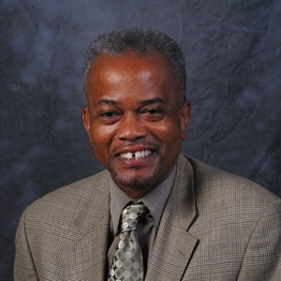
Responsibilities of City Government
Mayor
  Presides over council meetings, leads council
City Council
  Prepares budget, passes municipal laws (ordinances)
City Manager
  Runs the city day to day
  Hires and Fires city employees
  Advises the Council
Sterling Cheatham

Slide 10
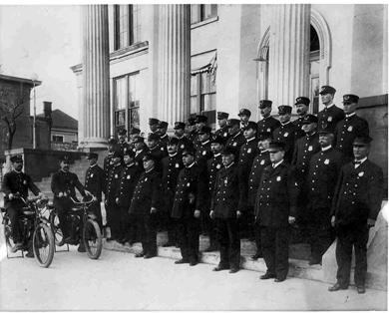
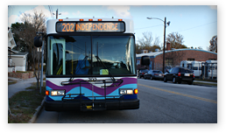

Services provided by cities
Public transportation (WAVE)
Police Protection (WPD)
Public Housing
Public Utilities
  Electricity, gas, cable, telephone
Libraries
Parks and Recreation
  Parks, community centers

Slide 11
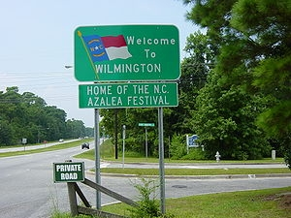
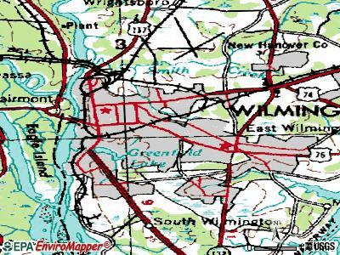
Where do cities come from?
When a group of people who have settled in an unincorporated area want to establish a city, they ask the General Assembly to become incorporated
  Creates city services
  Establishes geographic boundaries
Once incorporated, the town creates a charter
  A document that gives a city or town authority and establishes how it will be governed

Slide 12
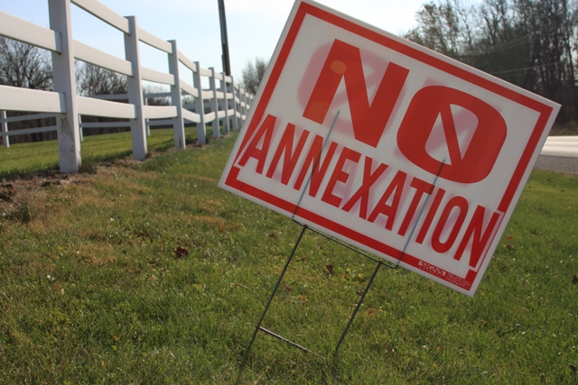
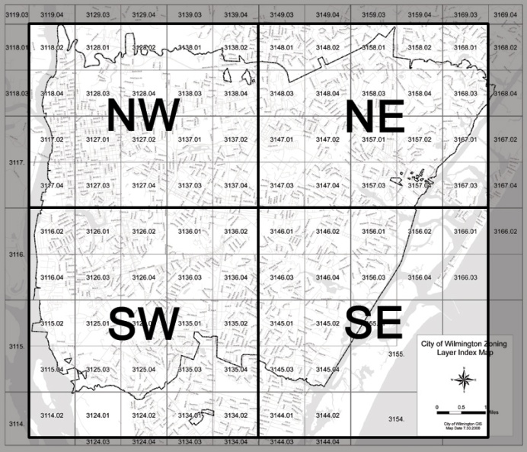
Issues facing cities
Zoning
Annexation

Slide 13

Zoning
City Councils decide the purpose of pieces of land in a city
Zoning restrictions
  Ex: no liquor stores within 500 yards of a school
Typical zoning areas:
  Residential
  Business
  Mixed Use
  Green space

Slide 14
Annexation: when a city extends its boundaries to take in people living in unincorporated areas
Pros:
  New residents get services provided by the city
    Police & Fire protection
    Water
    Waste removal
    Sewer
Cons
  Taxes go up
    City services cost $$$
  New laws and regulations to live by
    City ordinances take effect

Slide 15
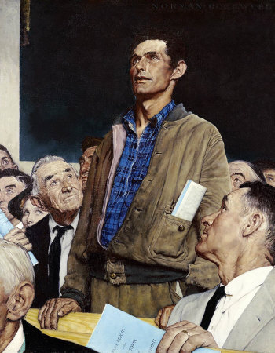
Civic Participation
Voting
Petitioning
Participating in public hearings
  Public hearings give citizens the chance to speak and express opinions about an issue

Slide 16
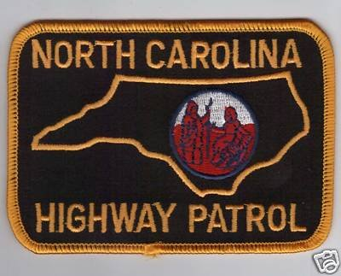


State and Local Law Enforcement
State Police
  Protect interstate highways and assisting motorists
  State Troopers
County Police
  Enforce laws in unincorporated parts of the county
  Sheriff
City Police
  Enforce laws in city limits
  Provide security services
  Chief of Police

Slide 17

Financing State and Local Government
Where does the state get money for its budget?
  Individual Income Tax +/- 50%
  Sales Tax +/- 28%
  Other Taxes +/- 9%
  Corporate Income tax +/- 5.5%
  Non tax revenue +/- 4%
  Special Funds +/- 3%

Slide 18
What does the state spend its money on?
Education: 58%
  K-12: 40% Colleges: 18%
Health and Human Services: 25%
  Medicaid, Public Health
Justice and Public Safety: 11%
  Corrections, Juvenile Justice, Public Safety
Other: 2%

Slide 19
Financing County Government
Where do counties get their money?

Slide 20
What do counties spend their money on?
Education: 29%
Human Services: 28%
  Medicaid, foster care, hospitals, job training, housing, mental health
Public Safety: 13%
  Sheriff’s, EMS, Fire
Other: 13%
  Parks and Rec, solid waste, libraries
Debt: 9%
General: 8%
  Elections, legal, salaries and wages, etc.

Slide 21
Issues in Education
Budgets
  As tax revenues shrink, so does the $$ available for education
Public Policies
  NCLB: Schools not meeting federal standards can be taken over by state governments. President Obamahas exempted N.C. from NCLB. N.C. has adopted Common Core.
Non-educational issues
  Violence, family issues, drop out issues, drugs

Slide 22
What are alternatives to the current system?
Charter Schools ~ public schools that are not held to the same regulations as normal public schools; private businesses and individuals often pay the cost for building these schools
Tuition Vouchers ~ government money order that allows a parent to use the money normally spent through property taxes on education and choose to give that money to public or private schools

Slide 23
NC Association of County Commisioners
Welcome to Your County
  New Hanover County
This Week at the General Assembly

