Slide 1
Bell Work, Wednesday April 8th
Rand Paul is associated with what political party?
How long has the drought in California lasted so far?
What 2 cities is the new underwater tunnel supposed to connect?

Slide 2
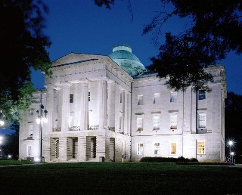
North Carolina State Government
North Carolina State Capitol

Slide 3
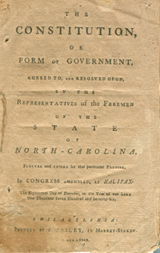
The North Carolina State Constitution
The first North Carolina Constitution was adopted in 1776
Established public schools and colleges
A new Constitution was adopted in 1868
Our current Constitution was adopted in 1970
Simplified the text
Ended segregation in schools

Slide 4
The North Carolina State Constitution
Purposes
Establishes the government of North Carolina
Declaration of Rights
Article 1: List of individual rights
Similarities to the U.S. Constitution
Separation of powers, checks and balances, popular sovereignty
Amendments to the NC Constitution
Lowering voting age, two term governor, veto power, impeaching powers

Slide 5
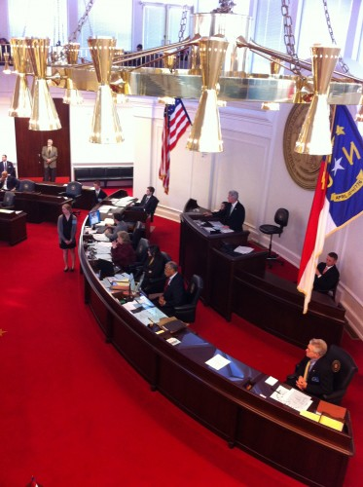
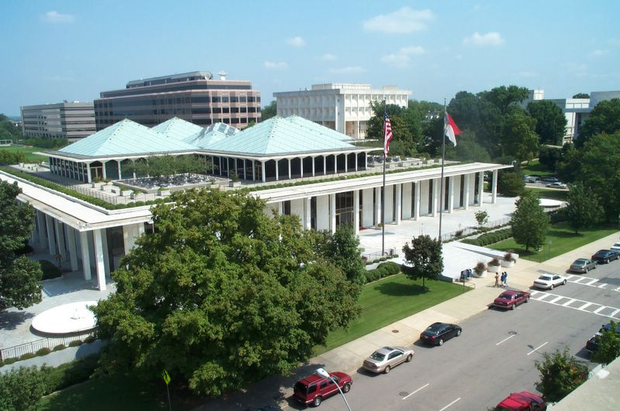
Legislative Branch
North Carolina General Assembly
Bicameral
House of Representatives (120) and Senate (50)
Requirements to Run
House: 21 years old; one year in district
Senate: 25 years old; 2 yrs. in NC, 1 in district
Responsibilities
Pass laws (statutes), passing budget, elect college board members
North Carolina Legislative Building

Slide 6
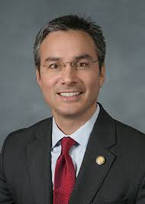
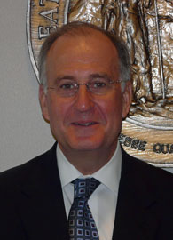
New Hanover County State Assemblymen
House of Representatives
Senate
Susie Hamilton (D)
Rick Catlin (R)
Michael V. Lee (R)
New Hanover County
Representation
Ted Davis Jr. (R)
Bill Rabon (R)

Slide 7
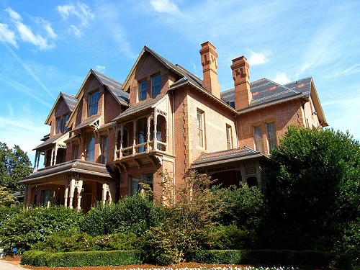
The Executive Branch
The Governor
Similar powers to the President
The Lieutenant Governor
Similar to Vice President
The Council of State
Elected officials
The Governor’s Cabinet
Similar to the President’s Cabinet

Slide 8
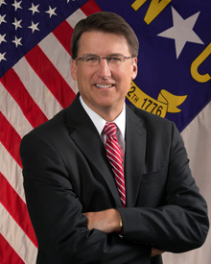
The Governor
4 Year Term (limit of two)
30 years old, 2 year resident of North Carolina
Powers and Responsibilities
Appoints officials
Proposes legislation
Proposes and administers state budget
Veto legislation – Line item veto
Grant clemency (pardons)
Gov. Pat McCrory (R)

Slide 9
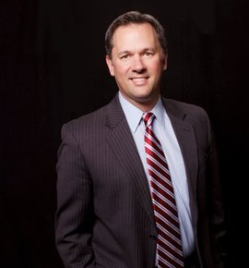
The Lieutenant Governor
4 Year term
Elected independently from the Governor
Duties
Succeeds Governor if necessary
President of the Senate
Only votes to break ties
Serves on committees and boards for the state
Dan Forest (R)

Slide 10
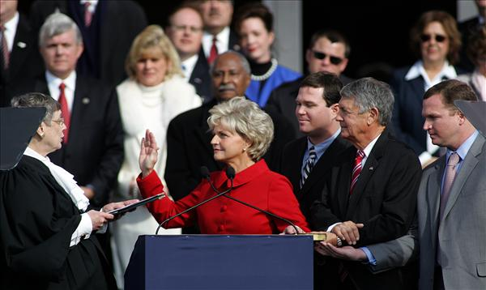
The Council of State
10 people, all elected for four year terms by the people of North Carolina
Governor and Lt. Governor
Attorney General, Commissioners of Agriculture, Insurance, and Labor, Sec. of State, State Auditor and Treasurer, and Superintendent of Public Instruction
The Council of State all work independently
North Carolina
Council of State

Slide 11
The Governor’s Cabinet
10 Departments appointed by the Governor
Departments of:
Administration
Commerce
Correction
Crime and Public Safety
Cultural Resources
Environment and Natural Resources
HHS
Juvenile Justice
Revenue
Transportation

Slide 12
The State Judicial Branch
NC Supreme Court
Court of Appeals
Superior Courts
District Courts
North Carolina Court System

Slide 13
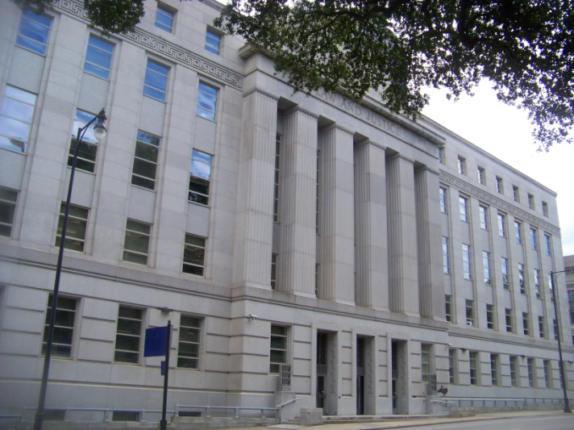
The Judicial Branch
Jurisdiction: cases involving state law- criminal and civil
Original
District: misdemeanors and small civil cases
Superior: felonies and big civil cases
Appellate
State Appellate Court
State Supreme Court

Slide 14
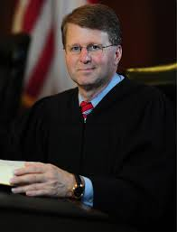
The Judicial Branch
State Judges
Judges in North Carolina are elected by the people
Magistrates
Issue search and arrest warrants, perform preliminary proceedings, but they are not judges
Supreme Court
Chief Justice and Six Associate judges
Elected for 8 year terms
Mark Martin
Chief Justice
NC State Supreme Court

Slide 15
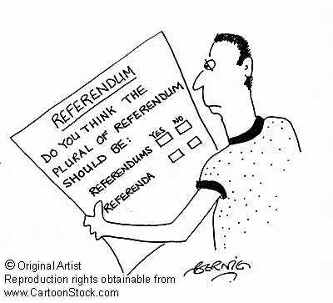
Referendums
Referendum: An election in which citizens vote directly on a public policy question.
State examples:
Governor’s line item veto
Lottery

Slide 16
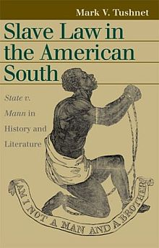
Landmark State Supreme Court Cases
State of North Carolina v. Mann (1830)
Ruled that slavery was legal
State Constitution is the supreme law of the state
Leandro v. State of North Carolina (1994)
Ruled that all children in NC have the right to a basic quality education

Slide 17
Writing Assignment
1. Make a T-chart that shows PROS AND CONS of funding schools locally.
2. Write a short essay (1-2 SOLID paragraphs) in which you answer the following:
Use the reading and your chart to describe whether you believe schools should be funded locally. Why or why not?

