Slide 1
Bell Work, Monday 3/23
1. Who are the Russian’s looking to for support now instead of western countries?
2. How many tigers remain in India today?
3. What was the theme of the student film festival?

Slide 2
$$ Behavior Money $$
I gave out money coupons 6 times..
  2/2-2/6 2/23-2/27
  2/9-2/13 3/9-3/13
  2/16-2/20 3/16-3/20
  $2: drop a classwork/homework grade
  $4: drop a quiz grade
  $6: drop a test grade
  Staple your money to a sheet of paper with the grade you want to drop by THURSDAY

Slide 3
Supreme Court Cases
N.C. 2.05
Judicial Review and
the Elastic Clause

Slide 4
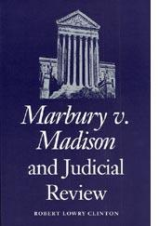
Marbury v. Madison
1803
Issue: Judiciary Act enforcement
Court Ruling: Established the principle of judicial review
  The right of the Supreme Court to declare laws unconstitutional
Marbury vs Madison

Slide 5
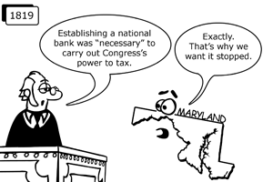
McCulloch v. Maryland
1819
Issue: Implied Powers of National Government and Supremacy Clause
Court Ruling: States could not tax the Federal government
The Supreme Court made it clear that state laws could not contradict federal laws

Slide 6
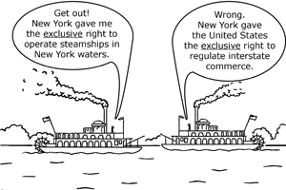
Gibbons v. Ogden
1824
Issue: Federal control over Interstate Commerce
Court Ruling: The Supreme Court ruled that the federal government has the power to regulate interstate commerce
  Stated in Article I, Clause 8 of the Constitution

Slide 7
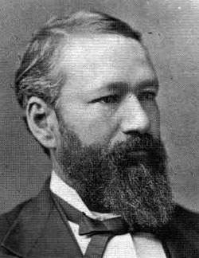
Plessy v. Ferguson
1896
Plessy v. Ferguson
Issue: 14th Amendment and Segregation
Court Ruling: The Supreme Court ruled that segregation was okay by law
  “Separate but equal” doctrine

Slide 8
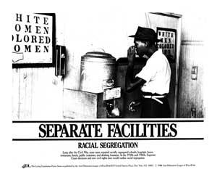

Brown v Board of Education
1954
Issue: Segregation and 14th Amendment
Court Ruling: Supreme Court overturned the separate but equal clause
  Desegregated public schools
Brown v. Board

Slide 9
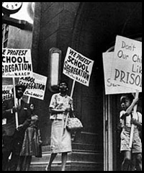
Swann v. Charlotte Mecklenburg - 1969
Issue: Forced Busing of Students
Court Ruling: Supreme Court ruled busing is constitutional

Slide 10
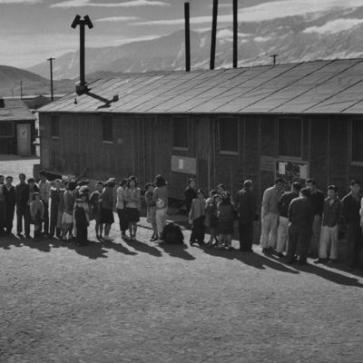
Korematsu v. US
1944
Issue: Detainment of Japanese citizens during WW II
Court Ruling: The Court ruled that the federal government has the power to detain people during times of war

Slide 11
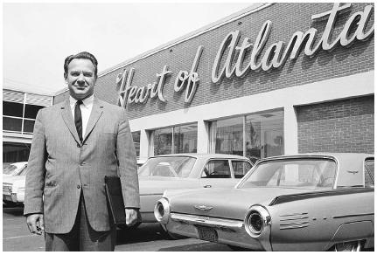
Heart of Atlanta Motel, Inc. v. United States -1964
Issue: Segregation and 14th Amendment
Court Ruling: The Supreme Court ruled that the Civil Rights Act of 1964 was constitutional

Slide 12
Supreme Court Cases
N.C. 2.06
Individual Rights of Citizens

Slide 13
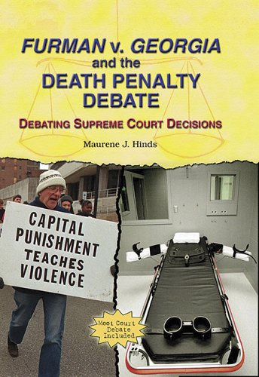
Furman v. Georgia
1972
Issue: Cruel and Unusual Punishment-Legality of the Death Sentence
Court Ruling: The Court ruled that the death penalty was cruel and unusual under certain circumstances

Slide 14

Gregg v. Georgia
1976
Issue: Cruel and Unusual Punishment-Legality of the Death Sentence
Court Ruling: The Court upheld that the death penalty is constitutional under certain circumstances

Slide 15
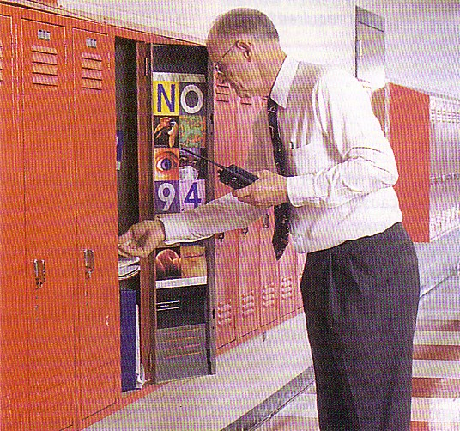
New Jersey v. TLO
1985
Issue: Students and Searches
Court Ruling: Students give up their 4th Amendment right (search & seizure) while on school property

Slide 16

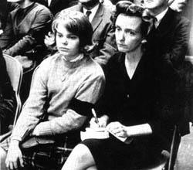
Tinker v. Des Moines Schools
1969
Issue: Students and Free Speech
Court Ruling: Students are allowed to express themselves in other ways besides just speech
  Black armbands were considered “symbolic speech” and weren’t disrupting school
Tinker v Des Moines

Slide 17

Bethel School District v. Fraser - 1986
Issue: Student and Free Speech
Court Ruling: Students’ freedom of speech is limited while on school grounds
  Disruptive or inappropriate speech is not acceptable

Slide 18
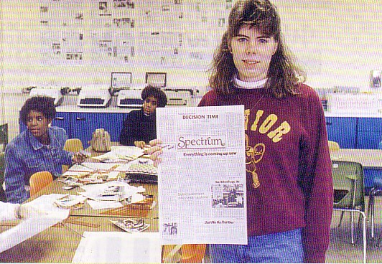
Hazelwood Schools v. Kuhlmeier
1988
Issue: Free Speech of Students
Court Ruling: School officials have the right to edit student newspapers

Slide 19
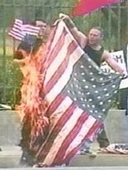
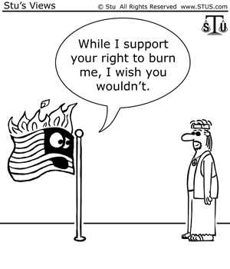
Texas v. Johnson
1989
Issue: Free Speech and Flag Burning
Court Ruling: Flag burning is constitutional
  It is covered by freedom of speech

Slide 20
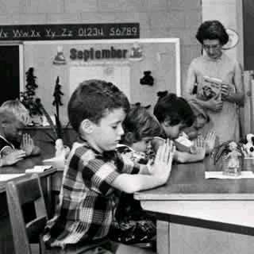
Engel v. Vitale
1962
Issue: Freedom of
Religion and Schools
Court Ruling: Prayer is not allowed in public schools

Slide 21
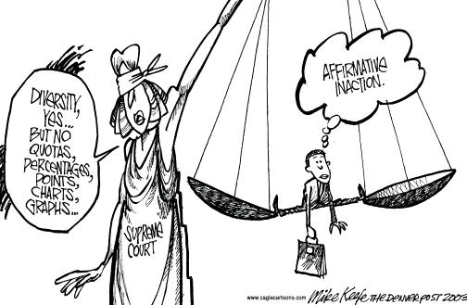
Regents of Univ. of California v. Bakke - 1978
Issue: Legality of Affirmative Action
Court Ruling: Affirmative action is okay as long as another group doesn’t suffer from reverse discrimination

Slide 22
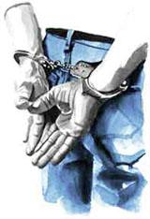
Miranda v. Arizona
1966
Issue: Rights of Suspected Criminals
Court Ruling: Police have to read an accused person his rights
  Accused people do not have to testify against themselves
Miranda v. Arizona

Slide 23

Gideon v. Wainwright
1963
Issue: Right to an Attorney
Court Ruling: Lawyers are not luxuries
  All people are entitled to an attorney for all crimes
Gideon v Wainwright

Slide 24
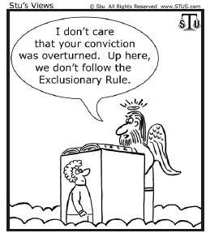
Mapp v. Ohio
1961
Issue: Search Warrants
Court Ruling: Any evidence obtained illegally is not allowed to be used against the accused

