Slide 1
Bell Work, Friday 3/20
1. What executive order did President Obama announce yesterday?
2. In the 2012 election, what percentage of Americans voted?
3. How many satellites does this San Francisco company hope to have by 2016?

Slide 2
U.S. Supreme Court
Supreme Court Justices

Slide 3
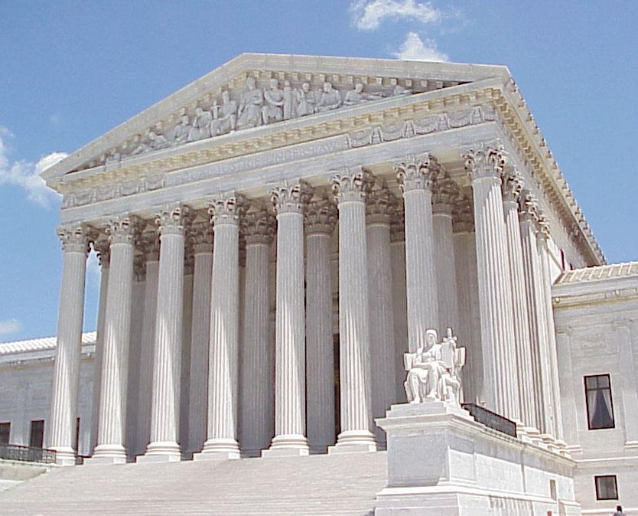
Supreme Court& Its Justices
The main job of the nation’s top court is to decide whether laws are allowable under the Constitution.
The Supreme Court has original jurisdiction only in cases involving foreign diplomats or a state.
All other cases come to the Court on appeal.
CNN: Inside the Supreme Court

Slide 4
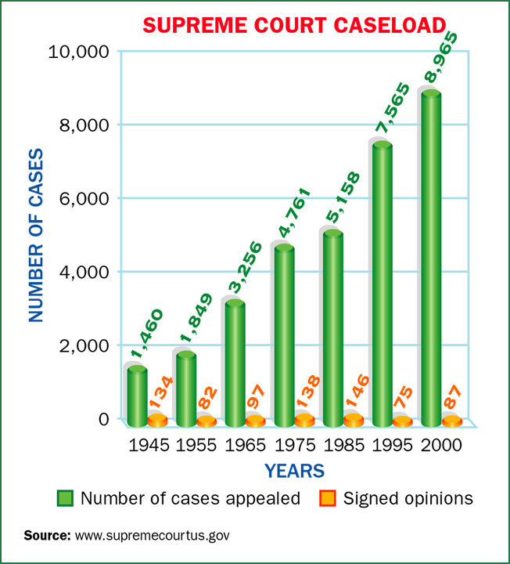
Supreme Court& Its Justices
The Court chooses the cases it hears.
In cases the Court refuses to hear, the decision of the lower court stands.
The Court has final authority on cases involving the Constitution, acts of Congress, and treaties.
Eight associate justices and one chief justice make up the Supreme Court.
After deciding a case, the justices issue a written explanation, called the Court’s opinion.

Slide 5
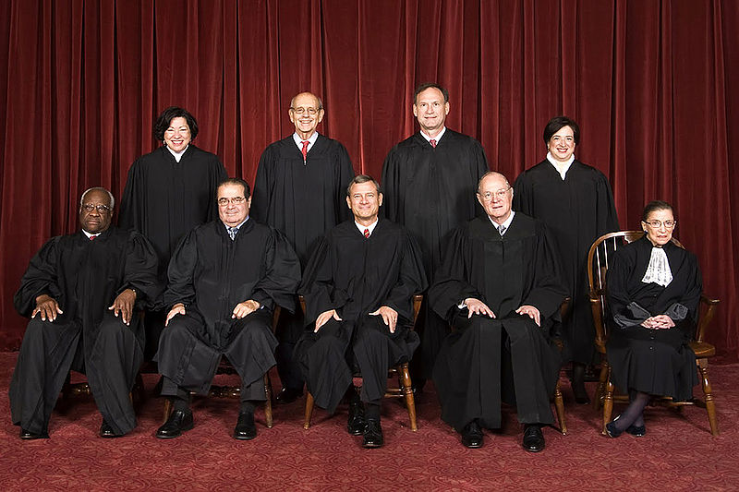
Supreme Court Justices
The president appoints Supreme Court justices, with Senate approval.
Supreme Court justices are always lawyers.
A successful law career, political support, and agreement with the president’s ideas are factors in who gets appointed.
Biographies of Current Supreme Court Justices

Slide 6
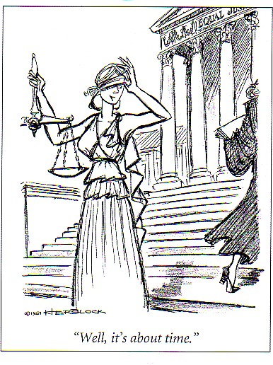
Powers of the Court
The legislative and executive branches must follow Supreme Court rulings.
Because the Court is removed from politics and the influences of special-interest groups, the parties involved in a case are likely to get a fair hearing.

Slide 7
Powers of the Court
The Court’s main job is to decide whether laws and government actions are constitutional, or allowed by the Constitution.
It does this through judicial review–the power to say whether any law or government action goes against the Constitution.
The Constitution does not give the Supreme Court the power of judicial review.
The Court claimed the power when it decided the case Marbury v. Madison.

Slide 8
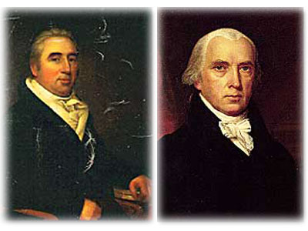
Powers of the Court
In the Court’s opinion, Chief Justice John Marshall set forth three principles of judicial review:
(1) The Constitution is the supreme law of the land.
(2) If a law conflicts with the Constitution, the Constitution rules.
(3) The judicial branch has a duty to uphold the Constitution.
Thus, it must be able to determine when a law conflicts with the Constitution and nullify that law.
The power of judicial review serves as a check on the actions of the executive and legislative branches.

Slide 9
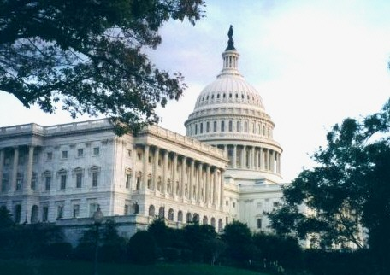
Limits on the Courts’ Power
The Court depends on the executive branch and state and local officials to enforce its decisions. Usually they do.
Congress can get around a Court ruling by passing a new law, changing a law ruled unconstitutional, or amending the Constitution.
The president’s power to appoint justices and Congress’s power to approve appointments and to impeach and remove justices serve to check the power of the Court.

Slide 10
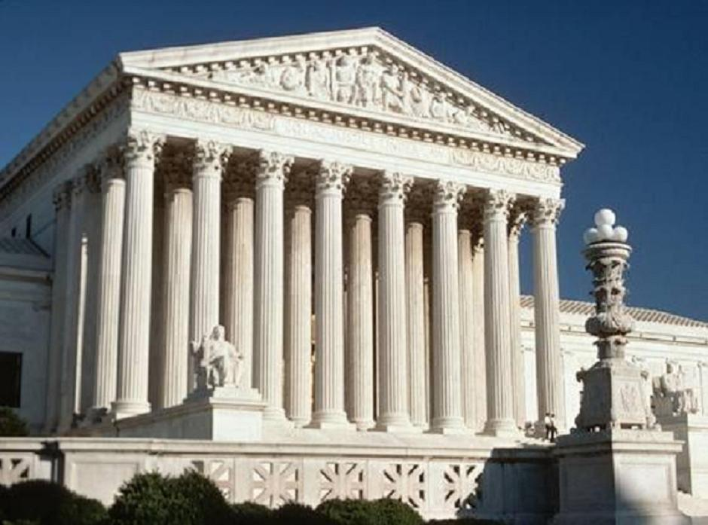
Limits on the Courts’ Power
The Court cannot decide that a law is unconstitutional unless the law has been challenged in a lower court and the case comes to it on appeal.
The Court accepts only cases that involve a federal question.
It usually stays out of political questions.

Slide 11
How do Cases Reach the Court?
The Court receives most cases on appeal from a lower court, but sometimes a lower court asks for a ruling because it is not sure how to apply the law in a case.
The Court accepts cases that four of the nine justices agree the Court should review.
“Rule of Four”
They usually select cases that involve important constitutional issues and cases that affect the entire nation.
Accepted cases go on the Court docket, or calendar.

Slide 12
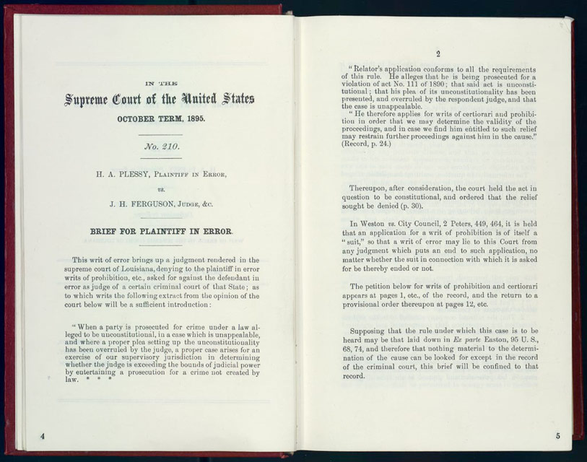
What are the Steps in Decision Making?
Each accepted case goes through five steps: written arguments, oral arguments, conference, opinion writing, and announcement.
The lawyers first prepare a written brief that explains their side of the case.
The justices study the briefs.
Next, each side gets 30 minutes to present its case orally.
Then the justices ask tough questions.

Slide 13
What are the Steps in Decision Making?
On Fridays, the justices meet privately to discuss the case.
A majority vote decides the case.
After the Court reaches a decision, one justice writes a majority opinion.
It presents the views of the majority of justices.
The opinion states the facts, announces the ruling, and explains the Court’s reasoning in reaching the decision.

Slide 14
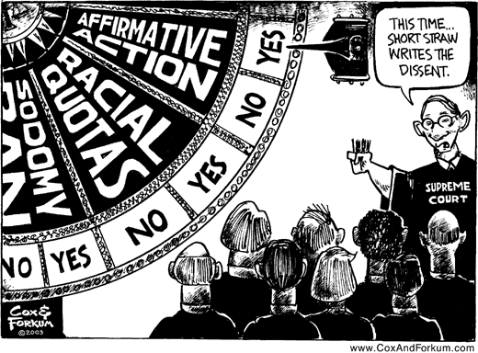
What are the Steps in Decision Making?
The Court may also write a unanimous opinion when all the justices vote the same way.
One or more justices who disagree with the majority may write dissenting opinions.
A justice who votes with the majority, but for different reasons, may write a concurring opinion.

Slide 15
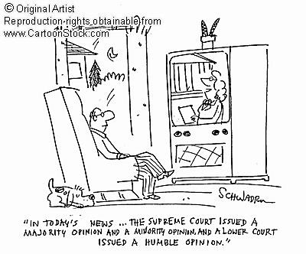
What are the Steps in Decision Making?
Finally, the Court announces its decision.
Printed copies of the opinion go to news reporters.
A copy is posted on the Court’s Web site.

Slide 16
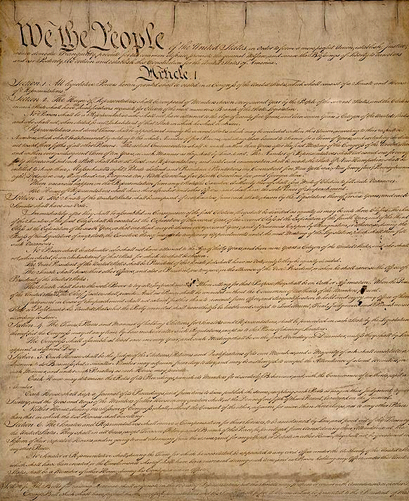
What are the Reasons for Court Decisions?
The law is supposed to be the most important influence on a justice’s decision.
Justices consider how the language of the Constitution applies to the case.
They rely heavily on precedents, following the principle of stare decisis–“let the decision stand.”
By following precedents, courts make the law predictable and consistent.

Slide 17
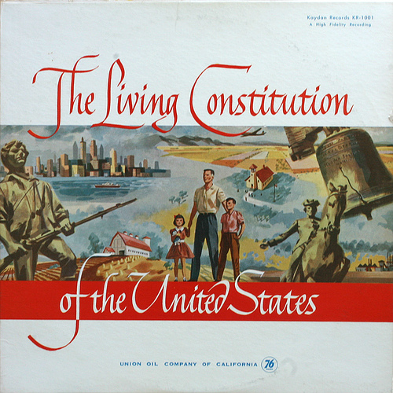
What are the Steps in Decision Making?
At the same time, the law must be flexible to adapt to changing times.
The justices can overrule outdated precedents.
Social conditions also influence Court decisions.
When social conditions change, the Court may make new interpretations of the law.
Example:
Plessy v. Ferguson (1896)
Brown v. Board of Education(1954)
Their personal views and relationships influence their decisions.

