Slide 1
Bell Work, Thursday 3/19
1. What is a key part of Tunisia’s economy?
2. Why won’t solar eclipses last forever?
3. What are a person’s chances of picking a perfect NCAA March Madness bracket?

Slide 2
Federal Court System

Slide 3
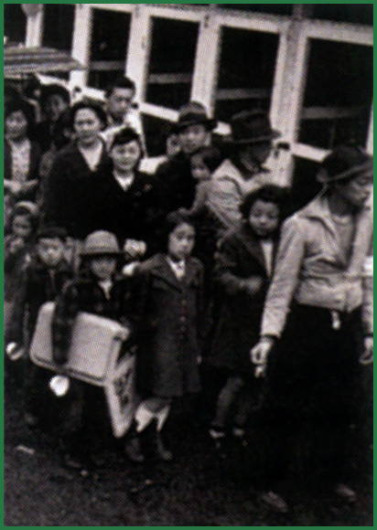
Japanese Americans were locked up in internment camps during World War II.

Slide 4
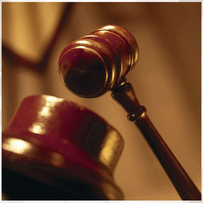
Equal Justice For All
The goal of the legal system is equal justice under the law.
This goal is difficult to achieve.
All accused people have the right to a public trial and a lawyer.
If they cannot afford a lawyer, the court will appoint and pay for one.
Accused people are considered innocent until proven guilty.
They may ask for a review of their case if they think the court has made a mistake.

Slide 5
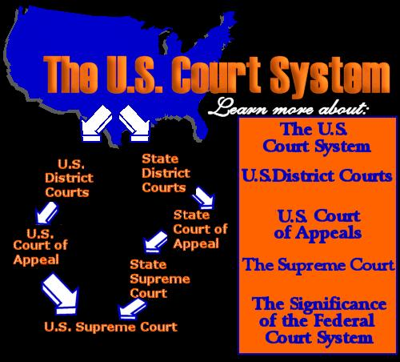
The Federal Court Systems
Article III established a national Supreme Court and gave Congress the power to establish lower federal courts.
The Judiciary Act of 1789 established federal district courts and circuit courts of appeal.
Over the years, Congress set up three levels in the federal court system–district courts at the bottom, appeals courts in the middle, and the Supreme Court at the top.
Each state also has its own laws and court system.

Slide 7
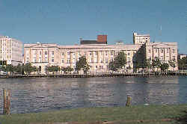
Judges
Each district court has at least 2 judges.
Each appeals court has 6 to 27 judges.
The Supreme Court has 9 justices.

Slide 8
Jurisdiction
Jurisdiction is a court’s authority to hear and decide cases.
Original Jurisdiction
This belongs to the court which has the initial authority to hear a case
Exclusive Jurisdiction
This means that jurisdiction belongs to only one group
Concurrent Jurisdiction
This means that a case can be heard in one of several courts

Slide 9
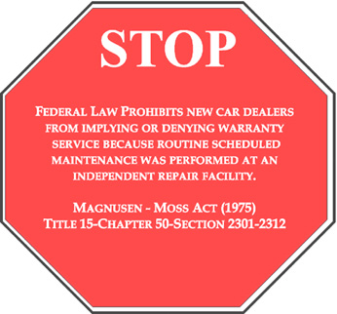
The Federal Court and Jurisdiction
The Constitution gives federal courts jurisdiction over eight kinds of cases.
If the law in question applies to the U.S. Constitution, a federal court hears the case.
Federal courts hear cases involving violation of federal laws.

Slide 10
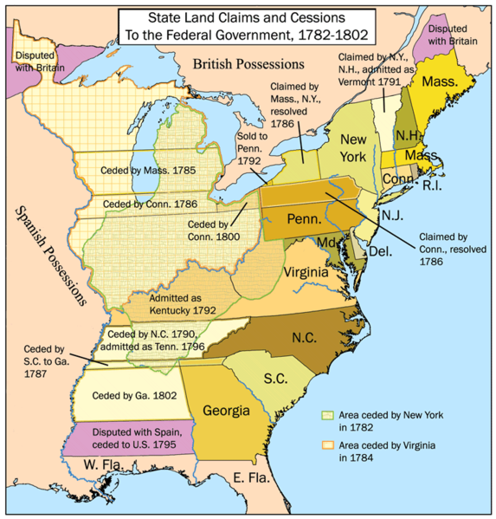
The Federal Court and Jurisdiction
Any disagreement between state governments winds up in federal court.
Federal courts hear lawsuits between citizens of different states.
If the U.S. government sues someone or someone sues the U.S. government, a federal court hears the case.
Federal courts hear disputes between a foreign government and either the U.S. government or an American private party.

Slide 11
The Federal Court and Jurisdiction
Admiralty and maritime laws concern accidents or crimes on the high seas.
Federal courts hear cases involving these laws.
Written in the Constitution
Federal courts hear cases involving U.S. diplomats.

Slide 12
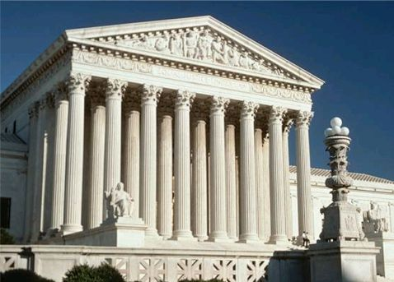
The Federal Court and Jurisdiction
For most of these eight areas, federal courts have exclusive jurisdiction–only they may hear and decide such cases.
Most U.S. court cases involve state law and are tried in state courts.

Slide 13
Lower Federal Courts

Slide 14
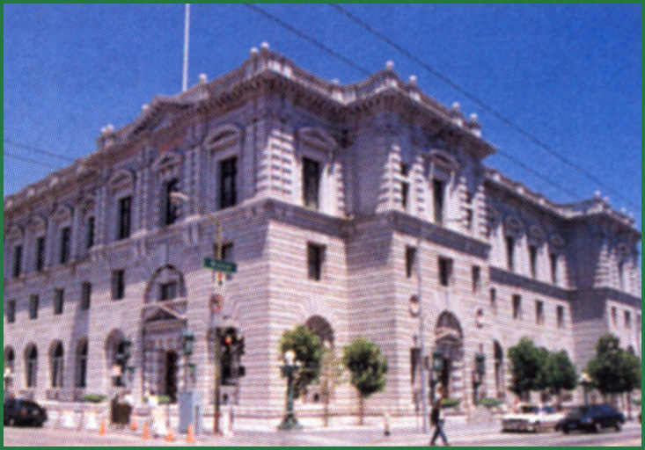
The Ninth U.S. Circuit Court of Appeals

Slide 15
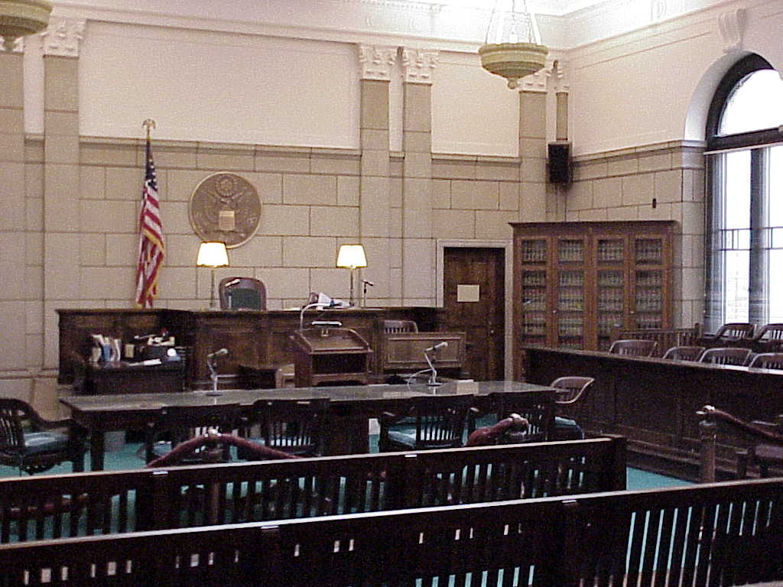
U.S District Court
District courts are the federal courts where trials are held and lawsuits are begun.
All states have at least one.
For all federal cases, district courts have original jurisdiction, the authority to hear the case for the first time.

Slide 16
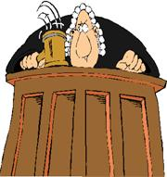
U.S District Court
District courts hear both civil and criminal cases.
They are the only federal courts that involve witnesses and juries.
Judges are to interpret the law and determine punishments

Slide 17
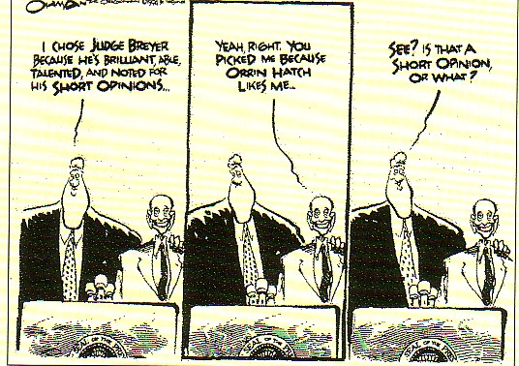
U.S District Court
Judges are appointed by the President with Senate approval
As a senatorial courtesy, presidents submit their nominations for judge to the senators from the nominee’s state.
If either senator objects, the president withdraws the name and nominates someone else.
Judges serve a life-time term
A judge can be removed only through impeachment.

Slide 18
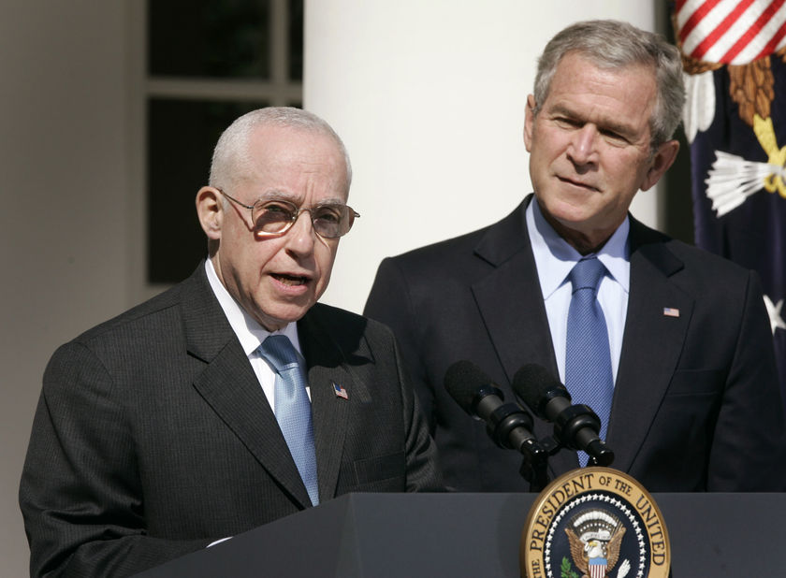
U.S. District Court
U.S. Attorneys represent the government in all cases
U.S. Marshals make arrests, collect fines, and take convicted people to prison. They protect jurors, keep order in the court, and serve subpoenas ordering people to appear in court.

Slide 19
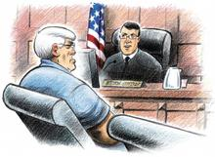
U.S District Court
Magistrates do much of the judge’s routine work.
They hear preliminary evidence and determine whether the case should go to trial.
They decide whether accused people should be held in jail or released on bail.

Slide 20
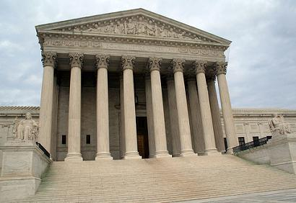
U.S. Appeals Court
People who lose in a district court often appeal to the next highest level–a U.S. court of appeals.
Appeals courts review decisions made in lower district courts.
This is appellate jurisdiction–the authority to hear a case appealed from a lower court.

Slide 21
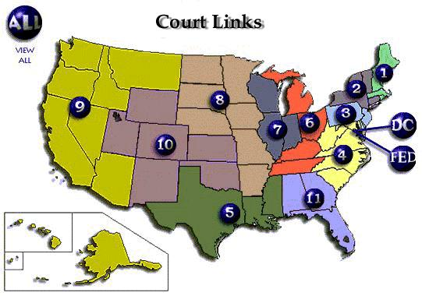
U.S. Appeals Court
Each of the 12 U.S. courts of appeals covers a particular geographic area called a circuit.
A thirteenth appeals court, the Court of Appeals for the Federal Circuit, has nationwide jurisdiction.
Appeals courts do not hold trials.
Instead, a panel of judges reviews the case records and listens to arguments from lawyers on both sides.

Slide 23
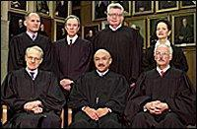
U.S. Appeals Court
Appeals courts do not decide guilt or innocence or which side should win a suit.
3 options for rulings:
Uphold: confirm lower court’s decision
Overturn: reverse the previous court’s decision
Remand: send the case back down to a lower court for retrial
They rule only on whether the original trial was fair and protected the person’s rights.
Most appeals court decisions are final.
A few cases are appealed to the Supreme Court.

Slide 24
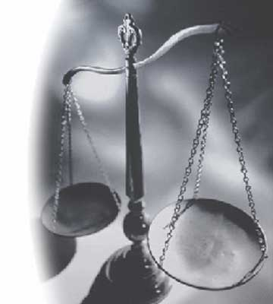
U.S. Appeals Court
One appellate judge writes an opinion that explains the legal thinking behind the court’s decision in the case.
The opinion sets a precedent or model for other judges to follow in making their own decisions on similar cases.

