Slide 1
Bell Work, Tuesday 3/17
1. How many islands make up Vanuatu?
2. How many chemical weapons does the US plan to destroy?
3. What cities turn their rivers green for Saint Patrick’s Day?

Slide 2
Independent Agencies

Slide 3
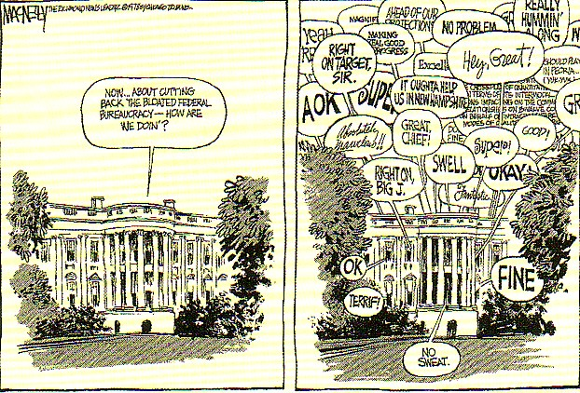
Independent Agencies
15 Executive Departments handle only a portion of the government’s functions
Special parts of government were formed to meet special needs
Three types:
Executive Agencies
Regulatory Commissions
Government Corporations

Slide 4
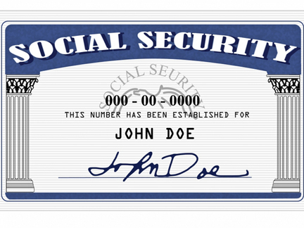
Executive Agencies
These are agencies that are under the direct control of the Presidency
Social Security Administration
oversees pension system for elderly and disabled
Central Intelligence Agency
in charge of collecting and interpreting information about foreign nations
Small Business Administration
promotes the growth of small business
FDR Signs the Social Security Act

Slide 5
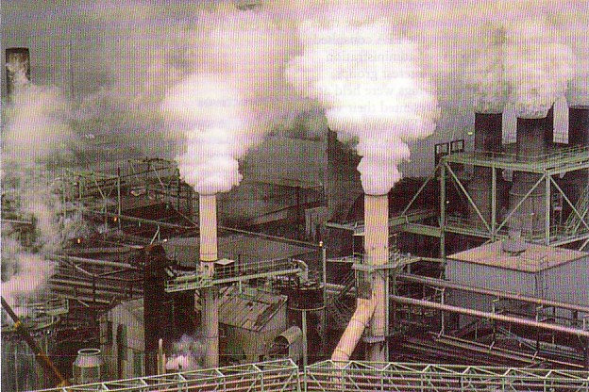
Executive Agencies
NASA
created to develop and administer the nation’s space program
National Foundation on the Arts and Humanities
created to promote the growth of the arts
Environmental Protection Agency-EPA
enforces environmental protection laws
Commission on Civil Rights
Agencies and Contemporary Issues

Slide 6
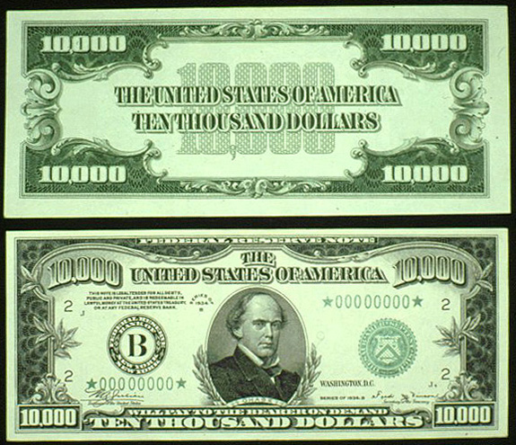
Regulatory Commissions
These groups are given powers to regulate or control a certain industry or activity
Federal Reserve
controls the nation’s system of banks
Federal Trade Commission
regulates the affairs of businesses to ensure fair business practices
National Transportation Safety Board
oversees the investigation of transportation accidents and affairs

Slide 7
Regulatory Commissions
Securities and Exchange Commission
regulates the activities of the Stock Market
Federal Communications Commission
regulates the telecommunication industries
National Labor Relations Board
oversees the practices of labor unions and employers
Consumer Product Safety Commission
oversees the safety of products sold to the public

Slide 8
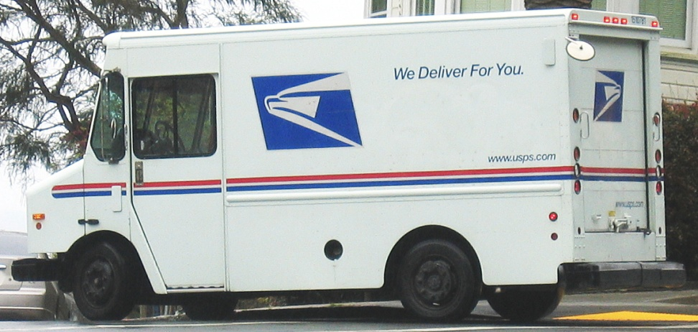
Government Corporations
Government Corporations
government agencies that are operated and run as though they were a profit oriented business
Usually these are groups that provide a service to the public but want to do so at a minimal cost to the government’s budget constraints
U.S. Postal Service
AMTRAK
U.S. Postal Timeline
U.S Postal Chart
Postal Mail Plans to
Stop Mail on Saturdays

Slide 9
Federal Bureaucracy
Roots of Bureaucracy

Slide 10
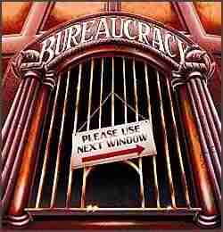
Bureaucracy
U.S. population has grown to over 300 million people
Need for larger and larger government
citizens demand greater services
government involved in more areas than ever before
Bureaucracy / Civil Service
those people who work permanently for the government

Slide 11
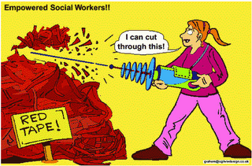
Red Tape
Red Tape
This refers to the extra hassle and paperwork that is required to get things done in a bureaucracy
Why is Red Tape needed?
Although a hassle, the procedures which cause red tape also reduce the number of decision makers in the bureaucracy. This hopefully creates a system which is absolutely equal for all involved.

Slide 12
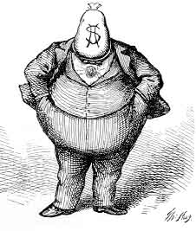
Spoils System
Presidents have the responsibility of appointing many people to lead the executive departments and agencies.
Current Administrations have over 2,000 positions to lead the bureaucracy
Who would President’s choose to fill these positions?
party members, advisors, supporters
Spoils System—Patronage
gave government positions as political rewards. This often led to graft and corruption.

Slide 13
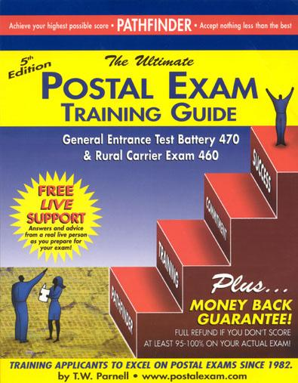
Civil Service System
Attempts to end the Spoils System
citizens began to tire of the corrupt government in the late 1800’s
Pendleton Act, 1883
also called the merit system
sets up a commission to determine the availability of certain government positions
Civil Service Commission
set up a testing procedure to give jobs to the most qualified applicants
Sample
Questions

Slide 14
Government Revenue and Expenditures
Debt Clock
14 Million in Debt

Slide 15
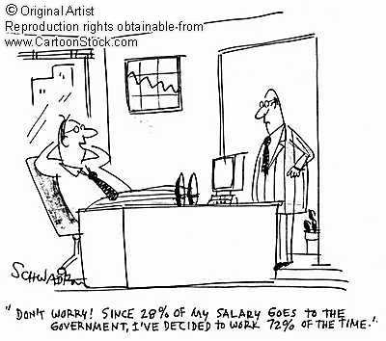
Fiscal Policy
Fiscal policy is government policy that attempts to influence the direction of the economy through changes in government taxes, or through some spending

Slide 16
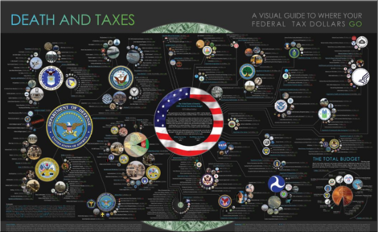
Budgets
Budgets are a plan for spending the government’s money
Revenue or receipts-- Economic term for the money that is received
Expenditures-- Economic term for the money that is spent
Most budgets are one year budgets
fiscal year

Slide 18
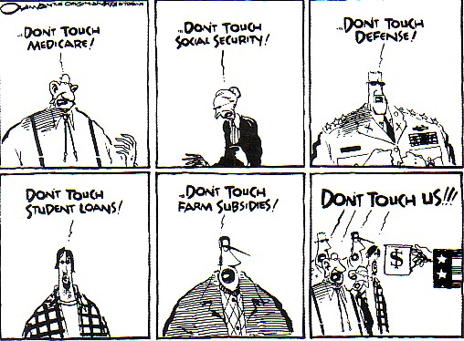
Budgets
Drafting a budget is a long process
The Executive branch prepares most of the budget
Expenditures are often based upon the President’s goals

Slide 19
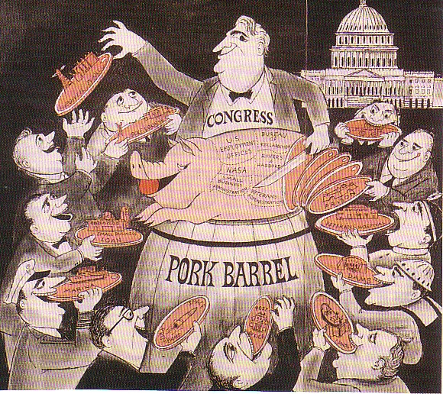
Budgets
Budgets must be passed by the legislative branch
Serves as a check on the government’s spending power
Goals of Congressmen may conflict with budget proposals
Final version is often a series of compromises

Slide 20
Sources of Revenue
Taxes
All Tax bills must begin in House of Representatives
Cannot tax interstate trade or exports
User fees
Tariffs
Fines
Government bonds

Slide 21
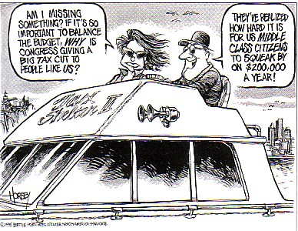
Taxation Principles
Progressive Tax-- Tax that is based on the ability of a person to pay and people who make more money pay a greater percentage
Example-Income tax
Regressive Tax-- Tax that is paid on an equal percentage by everyone---can be unfair to those with less of a disposable income
Example-Sales tax
Proportional Tax-- Tax whose burden is applied equally to the poor and to the wealthy
Example-Property tax

Slide 22
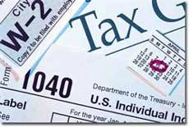
Types of Taxes
Personal Income Tax provides most of the Federal Revenue
Taxes based on Taxable Income
Exemptions
Deductions
Tax Returns must be filed with the IRS-Internal Revenue Service
Corporate Income Tax -a tax levied by various jurisdictions on the profits made by companies or associations.

Slide 23
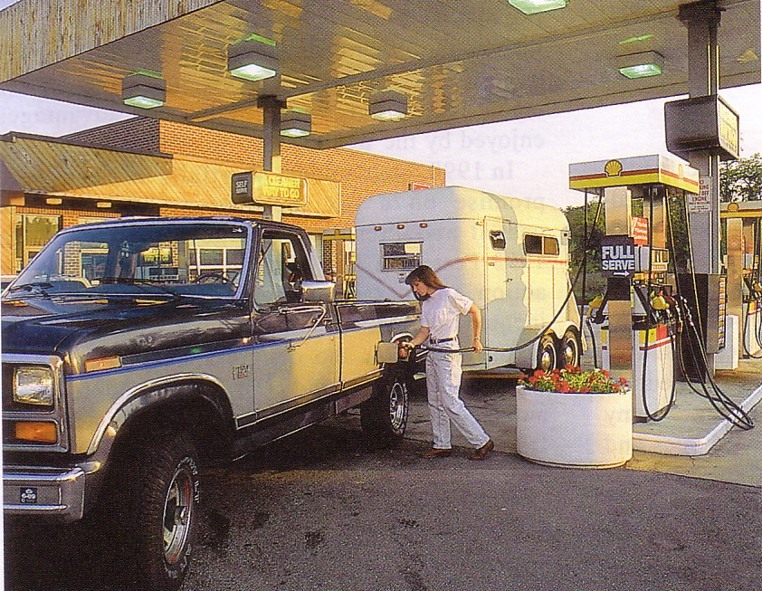
Types of Taxes
Estate tax--paid upon the transfer of property through inheritance
Excise tax--charged on the production and consumption of goods and services (telephone, gas, cigarettes, alcohol)
Sometimes called a luxury tax
Tariffs--tax on imports
Encourages Americans to purchase domestic goods

Slide 24
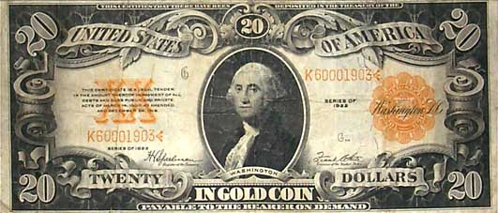
Non-Tax Revenue
Fines--penalties for breaking laws
Government bonds--a government issued certificate purchased by an individual or corporation
Allows the government to borrow money on the promise to repay plus interest
User Fees—fees paid to use of many public services and facilities
National Parks
Statue of Liberty

Slide 25
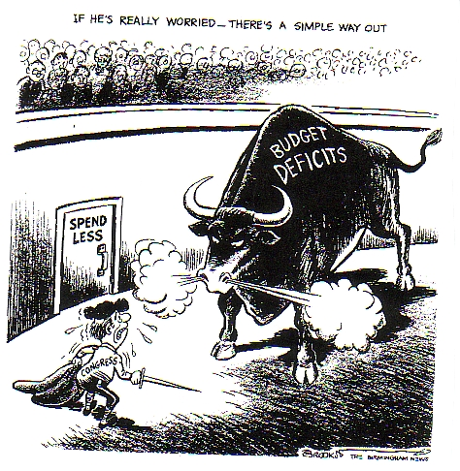
Expenditures
Revenue is limited, so government must make choices about spending
Setting priorities
Political Party goals

Slide 26
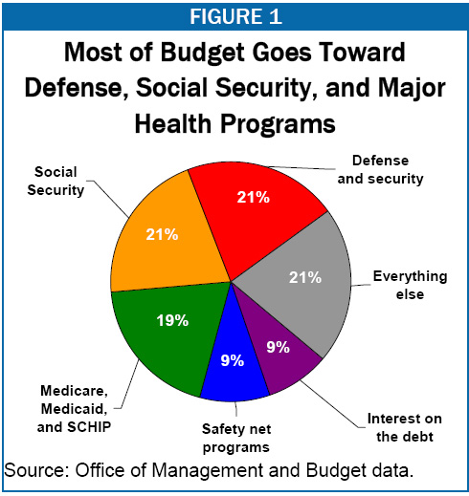
Expenditures
Expenses change each year
Most larges expenses change very little
Social Security, National Defense, Medicare, and Interest on National Debt
-

Slide 27
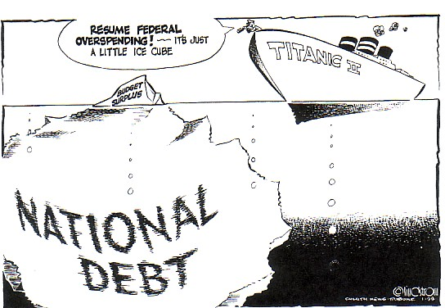
Budget Deficits
Limited Revenues, but unlimited places to spend money
Some spending is actually borrowed money to pay for expenses
Bonds
When the government’s expenditures are more than their revenues there is a budget deficit
Deficit spending adds to the national debt
When the government’s revenues are more than their expenditures, there is a budget surplus

Slide 28
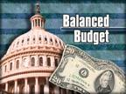
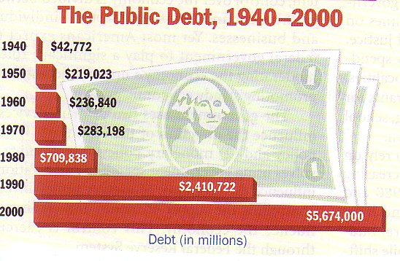
Balancing Budgets
Balanced Budget-- Idea that a budget should never spend more money than it has received
The federal government is not required to have a balanced budget
Federal Government has a history of high budget deficits since the 1980’s leading to a high national debt
-

