Slide 1
Executive Offices

Slide 2
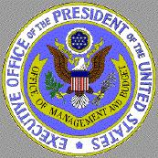
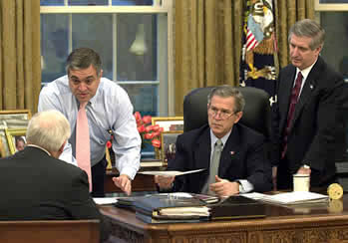
Administration
Administration
General term applied to those people who work the closest to the President
The Administration is in charge of the very large Federal Bureaucracy that works for the Office of the President

Slide 3
Federal Bureaucracy
President
Congress
Executive
Office
of the
President
(Ex: OMB, NSC)
Independent
Regulatory
Commissions
(Ex: FCC, SEC)
Cabinet
Departments
(Ex: State, Defense)
Independent
Executive
Agencies
(Ex: CIA, NASA)
Government Corporations
(Ex: Amtrack, Postal Service)

Slide 4
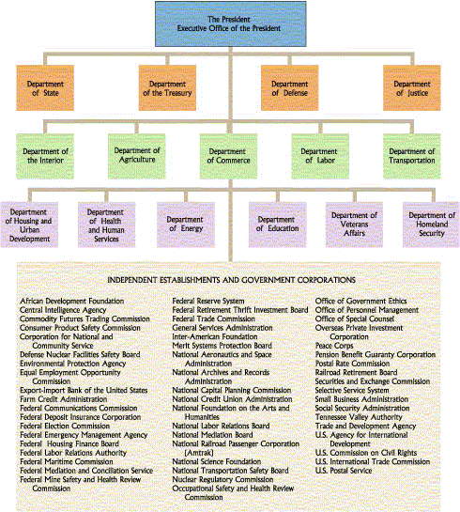
Organization of the Federal Bureaucracy
Source: www.edmonds.wednet.edu/mths/ClassActivities/ Brzovic/policeymakersChapters12-16/

Slide 5
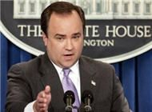
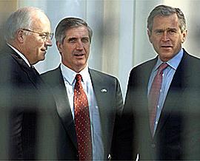
White House Staff
White House Staff
Those people who work directly with the President in the White House Complex
Chief of Staff
Person who works closest to the President and serves as the main advisor to the President
Press Secretary
Person who works closely with the media on behalf of the President

Slide 6
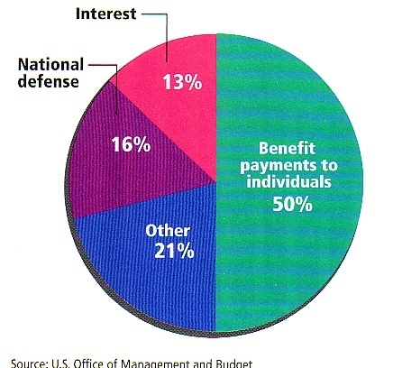
OMB
Office of Budget and Management
Separate Office whose job is to prepare the Federal Budget
Budget prepared according to the goals set forth by the President
Budget must then be approved and/or changed by Congress

Slide 7
National Security Council
Small Group whose job is to discuss and advise the President on issues of National Security
Members usually include
President
Vice-President
Secretary of State
Secretary of Defense
Chief of Staff

Slide 8
Other Offices
Economic Advisors
Science and Technology
Administration
U.S. Trade Representatives
Policy Development

Slide 9
Executive Departments
These offices still complete only a small part of the executive branches work
As of 2013 there are 15 separate departments and many independent agencies to complete the executive branches work
All of these are also under the control of the President
The Executive Office of the President
and the Vice Presidency
Executive Office of the President Web Site

Slide 10
Executive Departments
The Presidential Cabinet

Slide 11
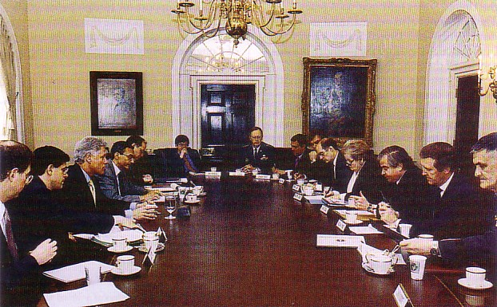
Departments
Part of the Executive Branch
15 Different Departments who are responsible for different areas of government
Each department is led by a Secretary except the Justice Department
The Justice Department is led by the Attorney General
All Secretaries make up an advisory group known as the Cabinet

Slide 12
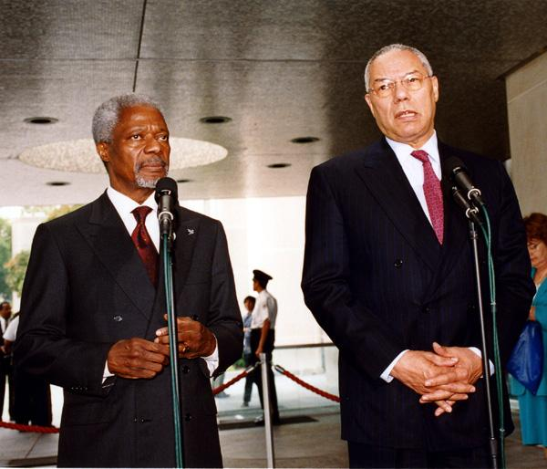
State Department
(1789)
Plans the nation’s foreign policy
goals of the U.S. towards foreign Sets up Embassies in foreign nations
embassies are our government’s representatives in foreign nations
Sets up Consulates
Government offices that are set up to help Americans in foreign nations
Issues Visas to foreigners
foreigner’s permission to visit the U.S.
Issues Passports to citizens
identification for nations
U.S. citizens in foreign nations
Former UN leader Koffi Annan and Secretary of State Colin Powell

Slide 13
Treasury Department
(1789)
Collects and Spends all the nations tax money
IRS-Internal Revenue Service
collects U.S. taxes
Bureau of Mint, Printing and Engraving
Bureau of Public Debt
borrows the money used by the government to operate deficits
Alcohol and Tobacco Tax Agency

Slide 14
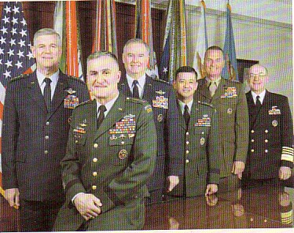
Defense Department
(1947---formerly the Dept of War)
Protects the Nation
Three Branches
Army
Navy / Marines
Air Force
Each branch is led by a civilian
Joint Chiefs of Staff
Group made up of the highest ranking officers in each of the military branches who advise the President on military matters

