Slide 1
Bell Work, Wednesday 3/11
What type of government does Iran have?
Listening to 100 decibels of sound for how long can be unsafe.
List 2 occupations that still use typewriters today.

Slide 2
The President and The Vice President
Animaniacs - The Presidents Song

Slide 3
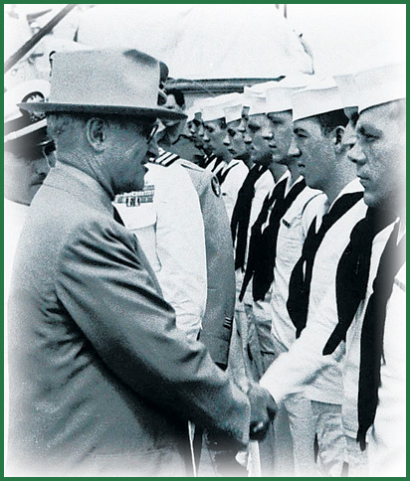
President Truman

Slide 4
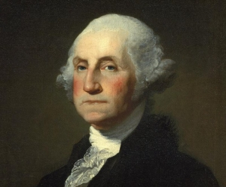
Qualifications
The president heads the executive branch–the top political job in the country and possibly the world.
George Washington was the first to hold the office.
To become president, a person must be: (1) at least 35, (2) a native-born American citizen, and (3) a resident of the United States for at least 14 years.
Qualifications and Qualities

Slide 5
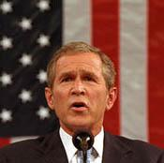
Qualifications
Up until 2008, every U.S. president has been a white male.
All but one has been Protestant Christian.
Most have had a college education.
Many were lawyers.
Most came from states with large populations.

Slide 6
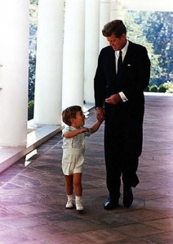
Qualifications
Things are changing.
In recent decades, we’ve had a Catholic president (John F. Kennedy), two female vice-presidential candidate (Geraldine Ferraro and Sarah Palin), the first African American contender for the Democratic nomination for president (Jesse Jackson), and a Jewish candidate for vice president (Joseph Lieberman).
Today we have an African-American President
America The Story of Us

Slide 7
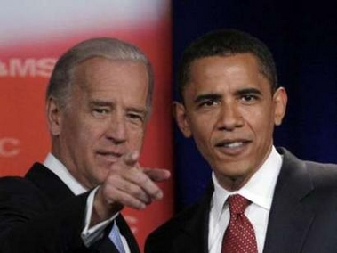
Romney and Ryan
Republican Presidential Candidates
Obama and Biden
Democrat Presidential Candidates

Slide 8
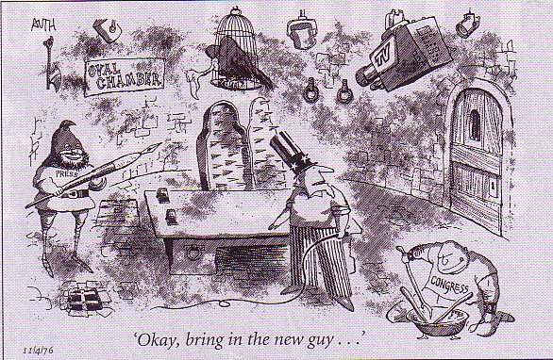
Electing a President
Presidential elections take place every four years in years evenly divisible by 4.
The Constitution set up an indirect method of election called the Electoral College.
By marking their ballots for a particular candidate, voters are actually selecting their state’s electors.
The electors are pledged to vote for the chosen candidate.

Slide 9
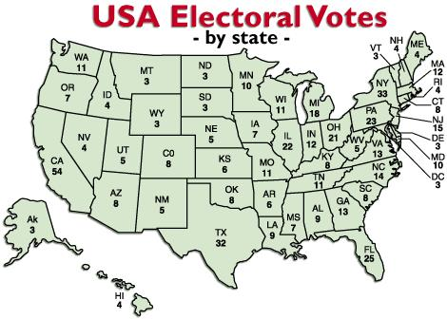
Electing a President
Each state has as many electoral votes as the total of its members in Congress.
This means that states with larger populations have more electoral votes.
In almost all states, the winning candidate receives all the electoral votes, even if the person wins by only a small majority-”winner takes all” system.
What's the Electoral College?

Slide 10
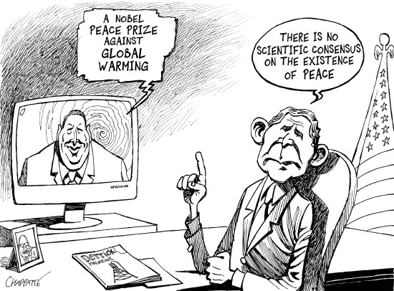
Electing a President
As a result, candidates focus their campaign on states with the most electoral votes.
It takes 270 of the 538 electoral votes to win.
The media announces the winner the evening of the election.
However, the outcome is not official until the Electoral College casts ballots and Congress counts them.
Electoral College-In plain Language

Slide 11
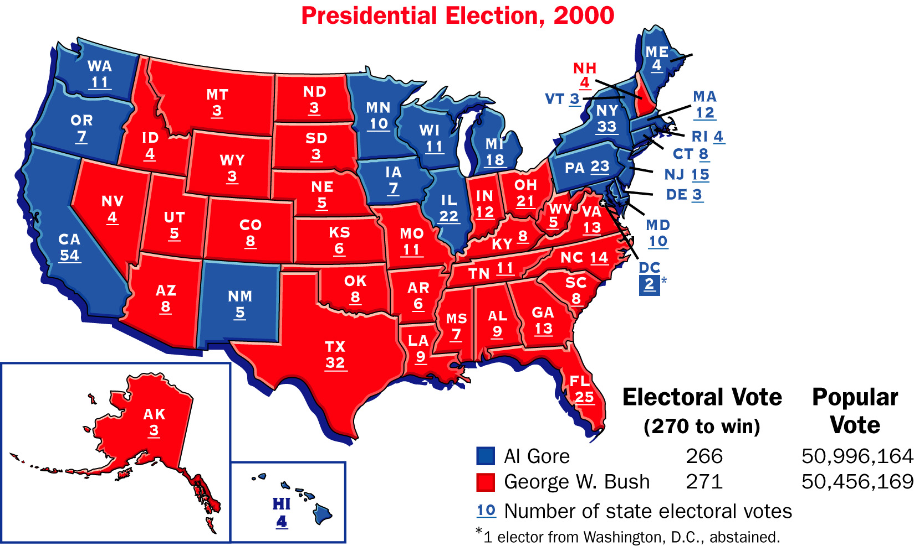
CNN: Flashback to 2000, U.S. Presidential Election Recount

Slide 12
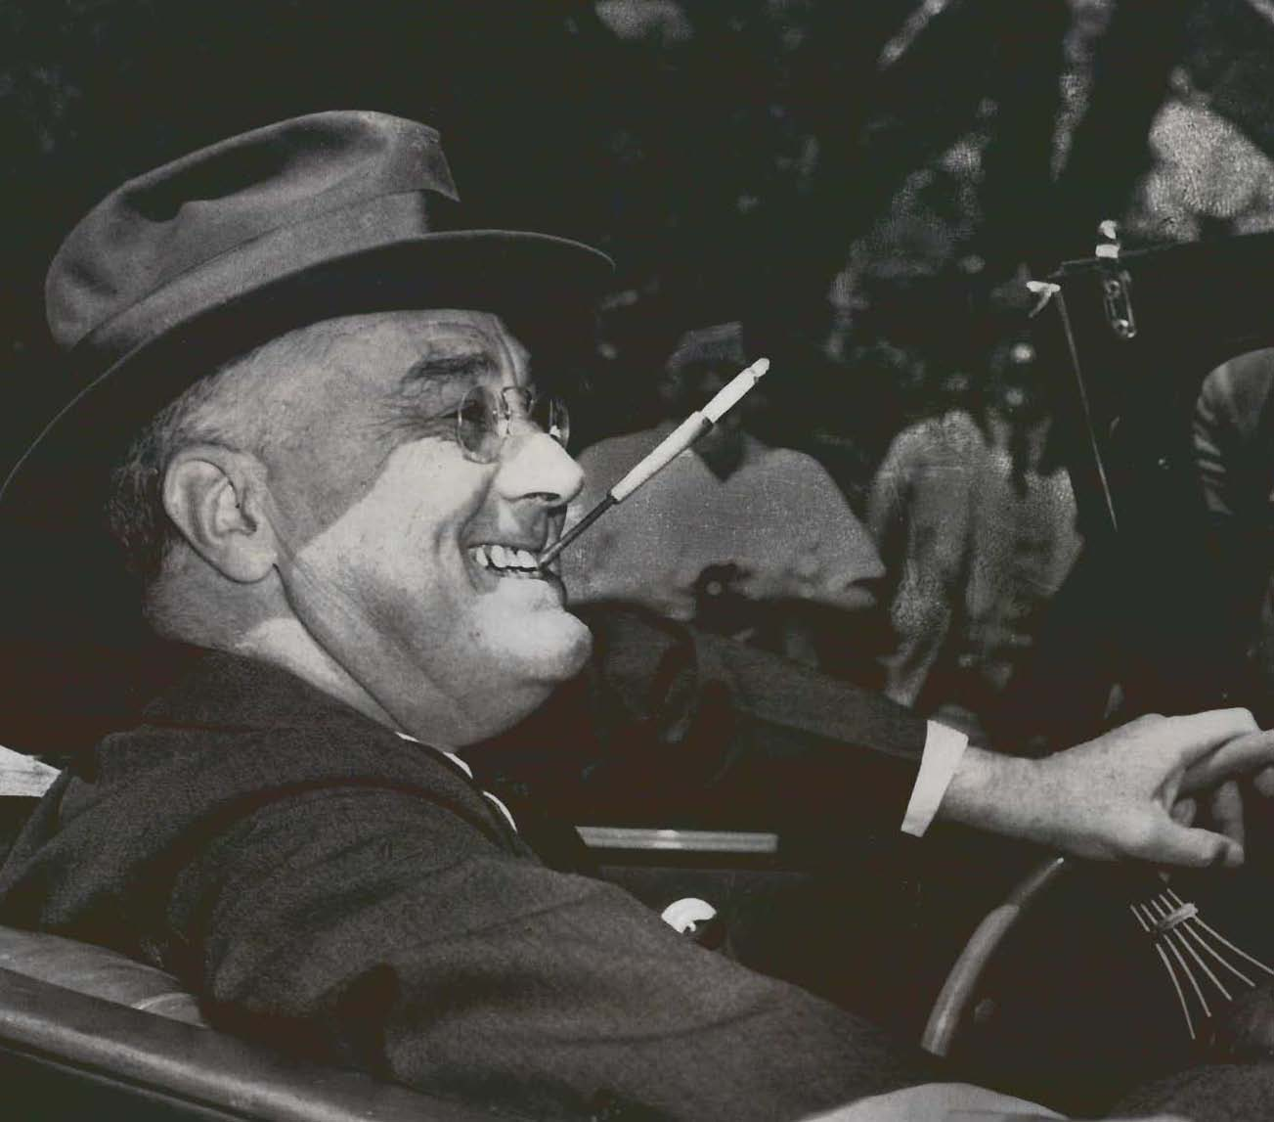
Terms of Office
Presidents serve four-year terms.
The Twenty-second Amendment limits each president to two elected terms, or a maximum of 10 years if the president took office during another president’s term.

Slide 13
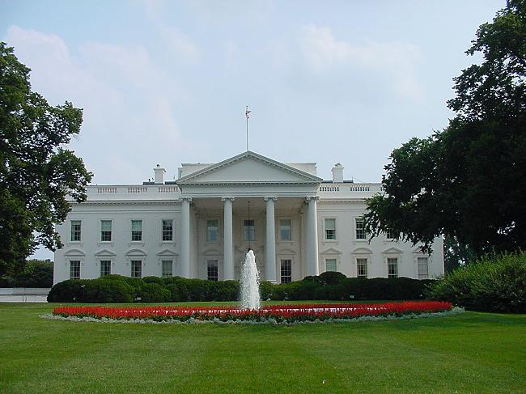
Terms of Office
The president receives a yearly salary of $400,000, plus expenses.
The president lives and works at the White House.
A staff tends to the needs of the president’s family.
Camp David, a beautiful estate in Maryland, serves as the president’s retreat and a place to host foreign leaders.
Presidents travel in special cars, helicopters, and airplanes, such as Air Force One.
Welcome Home President

Slide 14
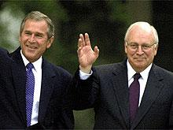
Vice- President
The vice president is elected with the president, and the qualifications are the same for both jobs.
The vice president votes in the Senate in case of a tie, but otherwise has little authority.
Yet if the president dies, is removed from office, becomes seriously ill, or resigns, the vice president becomes president.

Slide 15
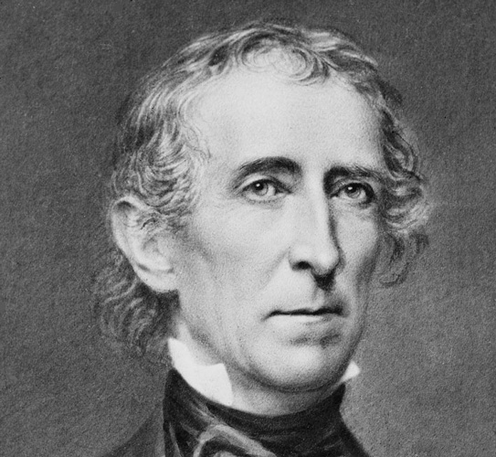
Presidential Succession
The Constitution was not clear about whether the vice president would become president or just take over the president’s duties if the president could no longer serve.
Vice President John Tyler settled the question.
He took the oath as president when William Henry Harrison died in office.

Slide 16
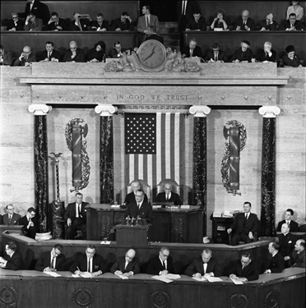
Presidential Succession
The Presidential Succession Act of 1947 established the line of succession.
If both the president and vice president die or leave office, the Speaker of the House would be next, followed by the president pro tempore, and then the secretary of state.
Harry Truman’s Speech on Presidential Succession

Slide 18
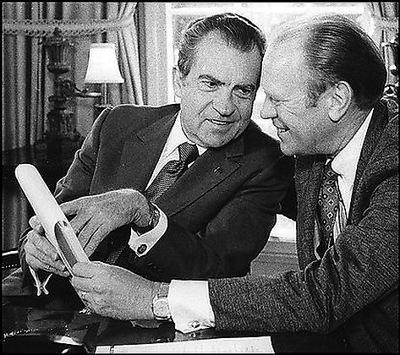
Presidential Succession
Later the Twenty-fifth Amendment further established that the vice president, after becoming president, would choose another vice president.
Both houses of Congress must approve the choice.
The vice president would then act as president until the president is able to go back to work.
Presidents Rap

