Slide 1
Bell Work, Thursday 3/5

Slide 2
How a Bill Becomes a Law
Mr. Smith Goes to Washington

Slide 3
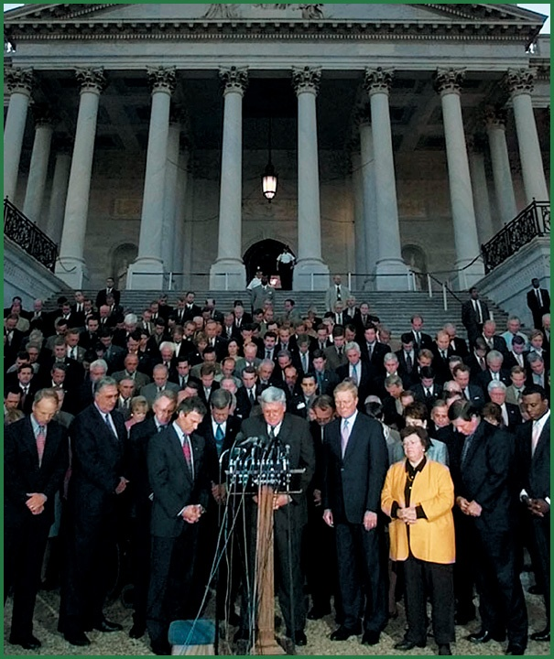
Members of Congress honor the memory of victims of the 2001 terrorist attacks.

Slide 4
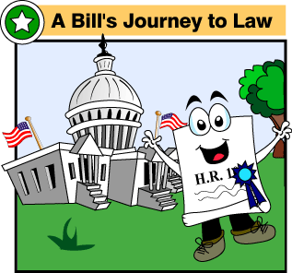
Types of Bills
Of the more than 10,000 bills introduced each congressional term, only several hundred become law.
Bills fall into two categories
Private bills concern individual people or places.
Public bills apply to the entire nation and involve general matters like taxation, civil rights, or terrorism.
Congressional Record

Slide 5
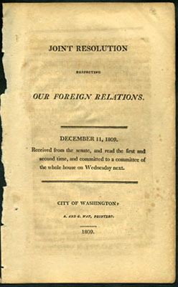
Types of Bills
Congress also considers different kinds of resolutions, or formal statements expressing lawmakers’ opinions or decisions.
Many resolutions do not have the force of law.
Joint resolutions are passed by both houses of Congress and do become law if signed by the president.

Slide 6
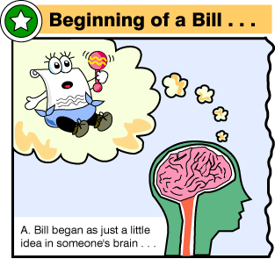
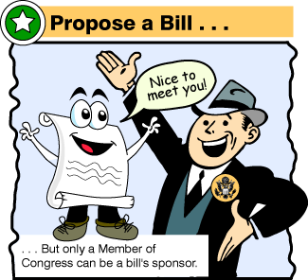
Introduction of the Bill
The bill can come from a variety of sources:
Individual citizens,
Special interest groups
Corporations,
Non-governmental organizations (NGOs)
Only a member of Congress can introduce the bill
A bill can start in either House.

Slide 7
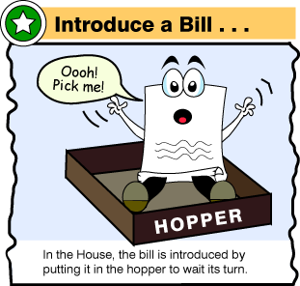
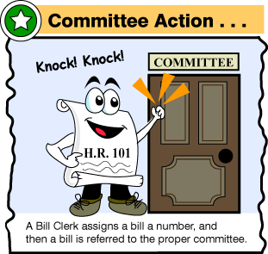
The Bill is Assigned to Committee
Each House has standing committees that consider their bills.
Each committee has a chair (from the Majority) and a ranking member (from the minority).
They “mark-up” (edit) the bill so it will pass on the floor.
They can also “pigeonhole” or kill the bill in committee.
The bill must also pass through the House Rules Committee.

Slide 8
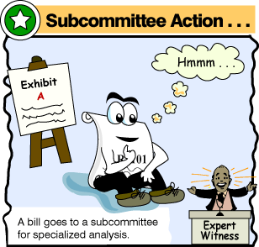
The Bill is Assigned to Committee
All revenue (tax) bills must be introduced in the House of Representatives
Those that merit attention are often researched by a subcommittee.
Experts and citizens may voice opinions about a bill in public hearings or written statements.

Slide 9
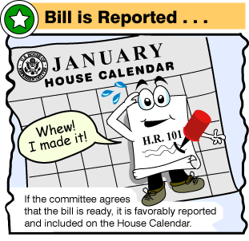
The Bill is Reported to the Floor
If the bill is passed by the committee, it is sent to the whole House for debate and vote.
The committee has “reported the bill favorably to the floor.”
The Speaker determines which bills are discussed and for how long.

Slide 10
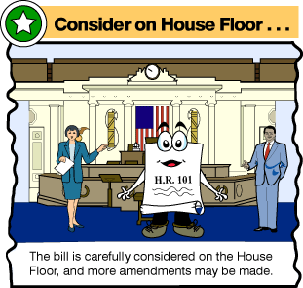
The Bill is Debated in the House
The Rules Committee & Committee chairs and ranking members give out time(usually limited to speed up action) to debate to other members.
Bills can be considered by the whole House at once: called “Committee of the Whole”
The House accepts only relevant amendments.
The Senate allows riders–completely unrelated amendments–to be tacked onto the bill.

Slide 11
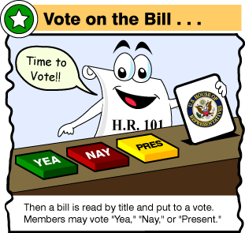
The Bill is Voted on in the House
Votes are done electronically in the House. This is a role call vote.
A tote board on the wall shows the tally.
Red = oppose. Green = Agree Yellow = Abstain
Votes can be taken by voice “yeas and nays” or a “teller vote” where members file past the sergeant of arms

Slide 12
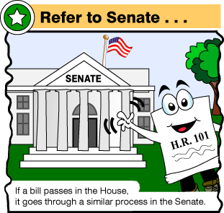
The Bill Goes to the Senate
The bill is sent to the US Senate.
A Senate version is written with the letter S. and a number. House bills have HR.
As in the House, the bill must be referred to the appropriate standing committee.
Committees hold hearings and make changes to the bill.
The committee can ‘report” the bill to the Senate floor.

Slide 13
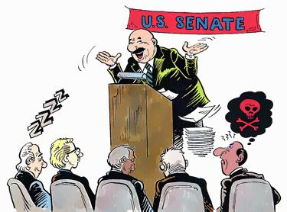
The Bill is Debated
The Senate Majority Leader determines which bills are scheduled, when and for how long.
As in the House, the bill must be referred to the appropriate standing committee.
Debate in the Senate is unlimited. Filibusters (talking the bill to death) can be used by the minority to block bills.
3/5 (60) of the Senate must agree to end a filibuster (this is called “cloture”)
The Senate Rules committee is much weaker than the House’s.
Mr. Smith Goes to Washington-Filibuster

Slide 14
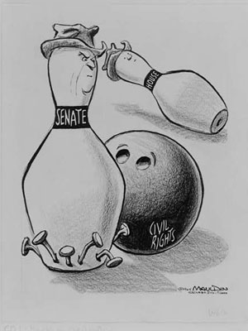
Although the Civil Rights Act had been passed by the House of Representatives on February 10, 1964, it was subjected to 75 days of Southern filibuster and hundreds of proposed amendments in the Senate. The Senate did not approve the bill until June 19, 1964.
Five Longest Fillibusters

Slide 15
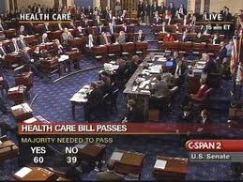
Both Houses Must Pass the Bill
A simple majority in both houses is needed to pass the bill (51%).
In the House: 218 needed to control the House.
In the Senate: 51 senators needed to pass the bill (and control the Senate).

Slide 16
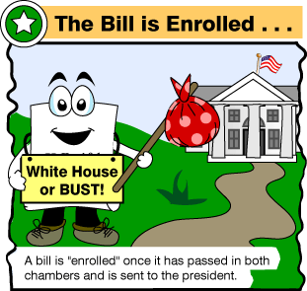
Differences Between Houses Must Be Reconciled
Each house passes its own bill.
Any differences must be ironed out and made into one bill.
The bill is considered by a conference committee, made up of both House and Senate members.
They negotiate and compromise and send the combined bill back to both houses.
A vote on the “conference report” must be taken and passed by both Houses.

Slide 17
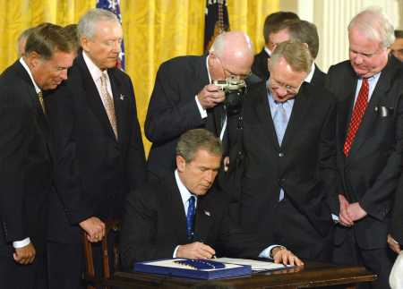
The Bill is Sent to the President
The president can sign the bill if he wants it to become law.
He can include “signing statements” that say how the law should be enforced or if parts will not be enforced.
The president can veto or reject the bill. He must include his reasons and recommendations for correction.
The president can choose not to act on the bill. If Congress is in session, the bill becomes law after 10 days.
If Congress is not in session, the bill dies after 10 days. This is called a “pocket veto.”
President Bush signing
the anti-terrorism bills after 9/11

Slide 18
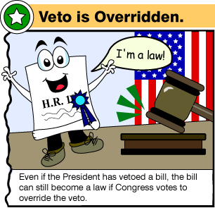
The Bill Becomes Law
If the president vetoes the bill, both Houses can reconsider the bill.
Two-thirds (67%) of both Houses are needed to override the President’s veto.
In the House: 369 needed for override. Senate: 67.
If president signs the bill, it is a federal law that each state must follow.

Slide 19
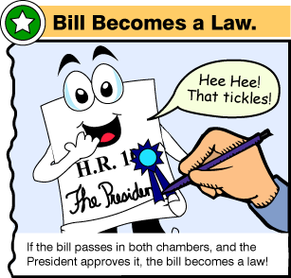
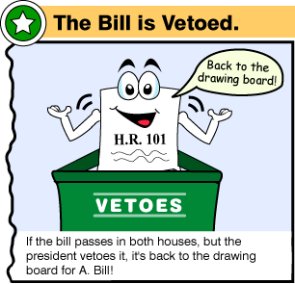
OR
List of United States Presidential Vetoes

Slide 20
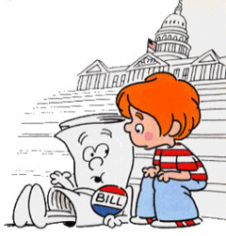
I'm Just a Bill

