Slide 1
Bell Work, Wed. 3/4
1. What is the disagreement between Israel and the US about Iran’s nuclear program?
2. What is the name of the safe driving advocacy group created by Jacy Good?
3. What type of unusual weather struck Orange County, California?

Slide 2
Powers of Congress

Slide 3
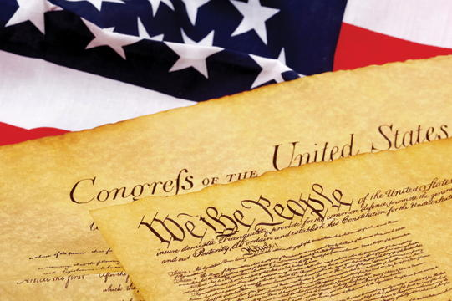
Legislative Powers
Article I, Section 8 of the Constitution lists Congress’s specific or expressed powers.
Expressed, Delegated, Enumerated, Exclusive
Clause 18
gives Congress Implied powers (not stated explicitly) to do whatever is “necessary and proper” to carry out the expressed powers
called the elastic clause

Slide 4
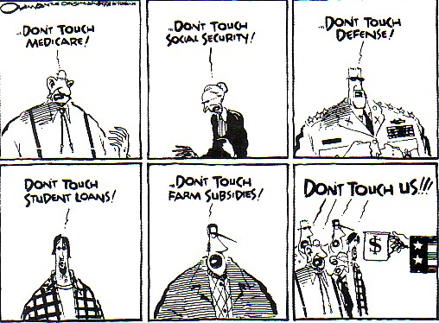
Legislative Powers
Congress can collect taxes to pay for government and its services.
All revenue bills must start in the House of Representatives and be approved by the Senate.
Congress spends money by means of a two-step process.
Authorization bills create projects
Appropriations bills actually provide the money for each program.

Slide 5
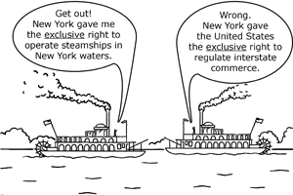
Legislative Powers
The “commerce clause,” gives Congress the power to regulate foreign and interstate commerce.
Making laws dealing with air traffic, television, and air pollution are all based on this clause.

Slide 6
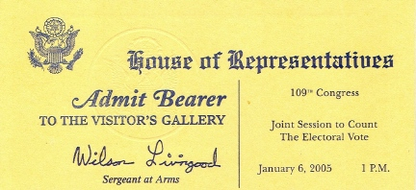
Non legislative Powers
Powers not related to making laws:
proposal of constitutional amendments
counting of electoral votes in presidential elections
breaks ties in the electoral college
if a president dies, resigns, or is too ill to serve, Congress settles the matter.

Slide 7
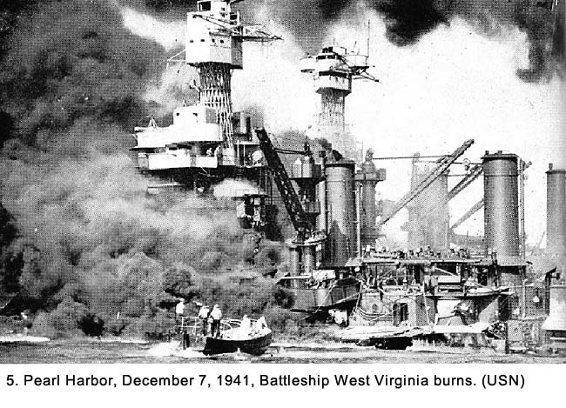
Non-Legislative Powers
Can declare war
Creates, maintains, and oversees an army and navy
The Senate must approve all treaties with other countries.
Congress and the Wars
Of the Twentieth Century

Slide 8
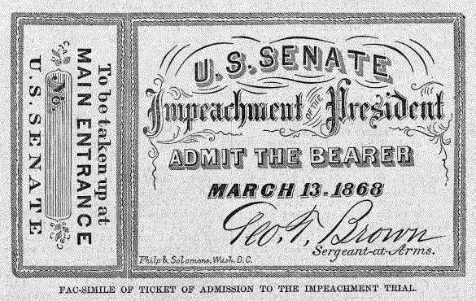
Non legislative Powers
The House may impeach, or accuse officials of misconduct.
If the majority of House members vote to impeach, the matter goes to the Senate to be tried.
The Senate must approve all Presidential appointments (Supreme Court Justices, ambassadors, Cabinet members)
Clinton-Impeachment by the
House of Representatives

Slide 9
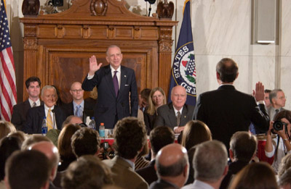
Non legislative Powers
Congress has taken on the role of overseeing government activities.
Standing committees review how well the executive branch has put laws into practice.
Congress conducts special investigations that may lead to criminal charges or new laws to deal with the problem.
The Powers of the Legislative Branch

Slide 10
How Congress Works

Slide 11
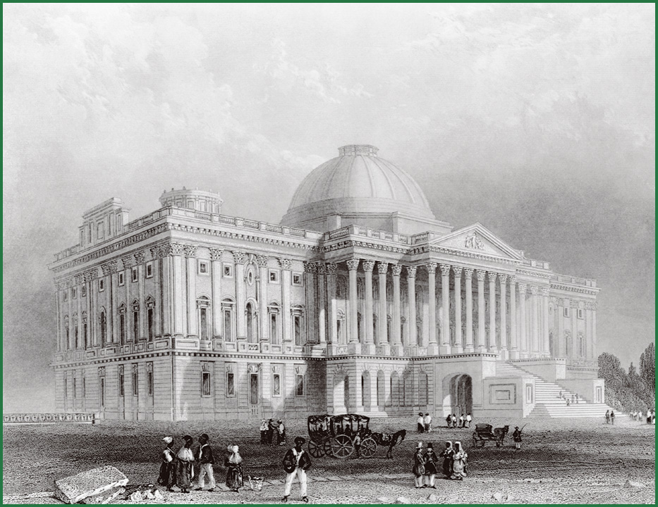
The U.S. Capitol in the 1800s

Slide 12
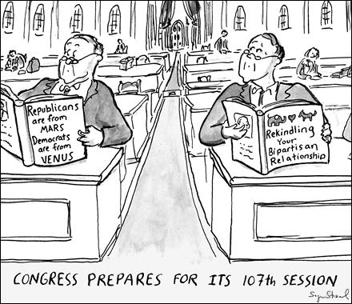
Congressional Rules
Developed to help Congress operate
House has more rules than Senate
Rules Committee
why???
Parliamentary Procedures
Both Houses of Congress use a formal system of debate which keeps the debate orderly

Slide 13
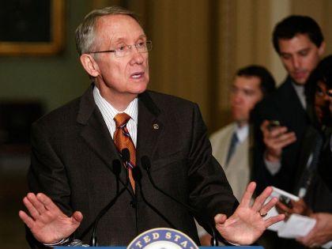
Congressional Leaders
In both houses, the political party to which more than half the members belong is the majority party.
The other party is the minority party.
Party members choose their leaders at the beginning of each term.
-
U.S. Senate Majority Leader Harry Reid

Slide 14
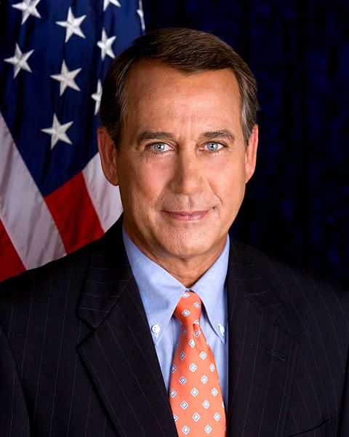
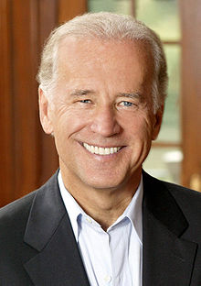
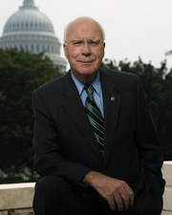
Congressional Leaders
The leader of the House is called the Speaker of the House.
The leader of the Senate is technically the vice president, who rarely attends and votes only in case of a tie.
The person who actually acts as chairperson is the president pro tempore.
Speaker of the House
John Boehner
R-Ohio
Vice President Joe Biden
Senate President Pro Tempore Patrick J. Leahy

Slide 15
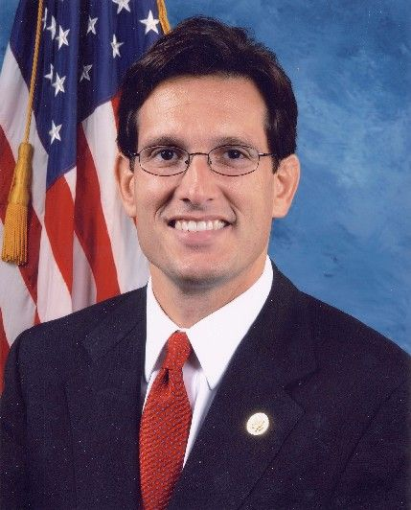
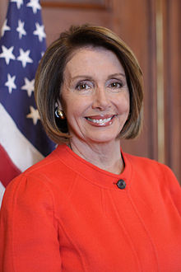
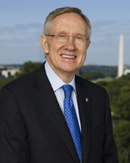
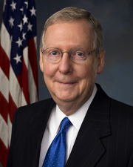
Congressional Leaders
Both houses have a majority leader and a minority leader.
House Majority Leader – Eric Cantor
House Minority Leader – Nancy Pelosi
Senate Majority Leader – Harry Reid
Senate Minority Leader – Mitch McConnell

Slide 16
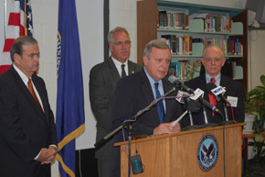
Congressional Leaders
Hierarchy of the House
Hierarchy of the Senate
Powerful floor leaders try to make sure the laws Congress passes are in the best interest of their own party.
They speak for their parties on the issues and try to sway votes.
Party “whips” help by keeping track of where their party members stand on issues and rounding them up for key votes.
)
Majority Whip
Dick Durbin
Illinois

Slide 17
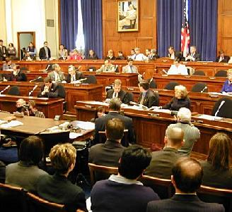
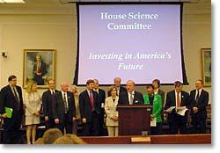
Committees: Little Legislatures
The detailed work of lawmaking is done in committees.
Each house has permanent standing committees that continue their work from session to session.
Most are divided into smaller subcommittees that deal with specialized issues.

Slide 18
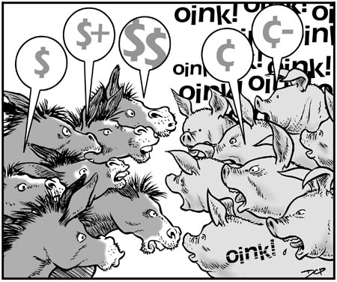
Committees: Little Legislatures
Both houses also have select committees that are created to do a special job for a limited period.
They disband after completing their task.
Joint committees include members of both houses.
Temporary conference committees help the House and Senate agree on the details of a proposed law.
Congressional Committees

Slide 20
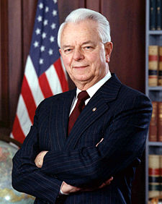
Committees: Little Legislatures
Members of Congress try to get assigned to important committees that affect the people who elected them.
Party leaders make committee assignments based on members’ preferences, expertise, party loyalty, and seniority, or years of service.
Senator
Robert Byrd
West Virginia
Jan. 3 1959

Slide 21
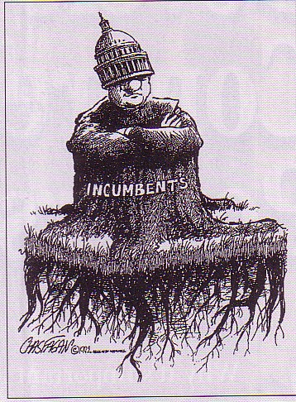
Committees: Little Legislatures
Members with the most seniority usually get the preferred committee spots.
The most senior members from the majority party traditionally become chairpersons.
Chairpersons of standing committees are the most powerful members of Congress.

Slide 22
Removal of “The People” from the Legislative Process
Discussion

