Slide 1
Bell Work, Mon. 3/2
Story 1: Iran/Israel
Problem:
Solution:
Story 2: US approach to ISIS
Problem:
Solution:
Story 3: “The Dress” :0
Problem:
Solution:

Slide 2
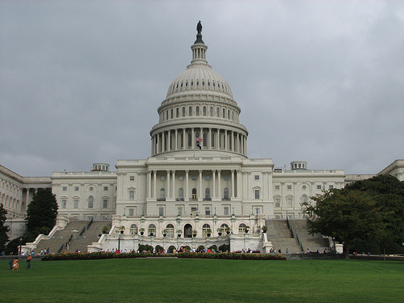
U.S. Congress

Slide 3
Each term starts January 3 of odd-numbered years and lasts two years. Each term has two sessions.
Congress holds special sessions in times of crisis.
A joint session occurs when both houses meet together, such as for the president’s State of the Union address.

Slide 4
A Bicameral Legislature
The Great Compromise established Congress as a two-part, or bicameral, body.
The House of Representatives has 435 voting members, allotted to the states by population.
After each census, or population count taken by the Census Bureau, Congress adjusts the number of representatives given to each state.
-
The House of Representatives

Slide 5
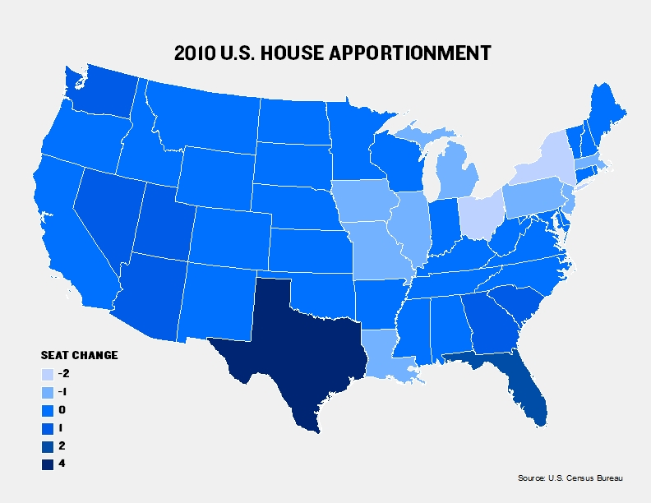
A Bicameral Legislature
States are divided into districts, with one representative elected from each district.
The states draw districts to include roughly the same number of constituents, or people represented.
This is call apportionment

Slide 6
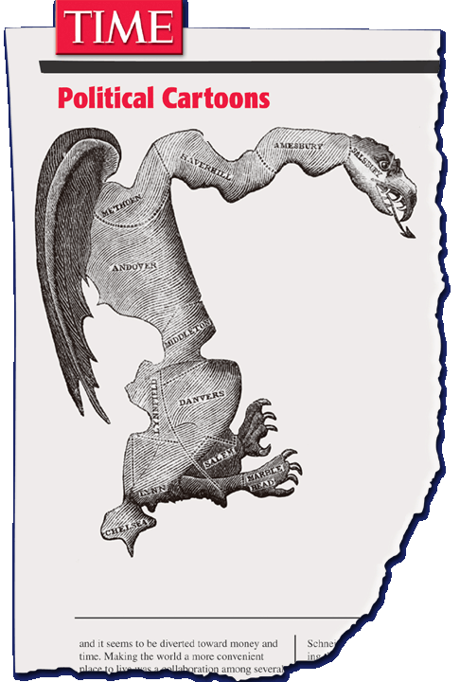
A Bicameral Legislature
Some abuse the process by drawing a gerrymander, or oddly shaped district, designed to increase the voting strength of a particular group.
Baker v. Carr
Redistricting Game

Slide 9
A Bicameral Legislature
The Senate has 100 members–two from each state.
Senators represent their entire states.
They serve six-year terms.
Elections are staggered to ensure some stability.
-
The Senate

Slide 10
114th Congress of the United States
Partisan Composition of the 114th Congress
U.S. House | U.S. Senate
Membership 435 Members | Membership 100 Senators (Vice President votes in case of a tie)
Party Divisions 247 Republicans 188 Democrats | Party Divisions 54 Democrats 44 Republicans 2 Independents

Slide 11
114th Congress of the United States
Gender Composition of the 114th Congress
U.S. House | U.S. Senate
80.6%Men 19.4%Women | 80%Men 20% Women

Slide 12
114th Congress of the United States Racial Composition
 | U.S. House | U.S. Senate
White | 79.8% | 94%
Black | 10.1% | 2%
Hispanic | 7.8% | 3%
Asian | 2.3% | 1%
American Indian | 0 | 0

Slide 13
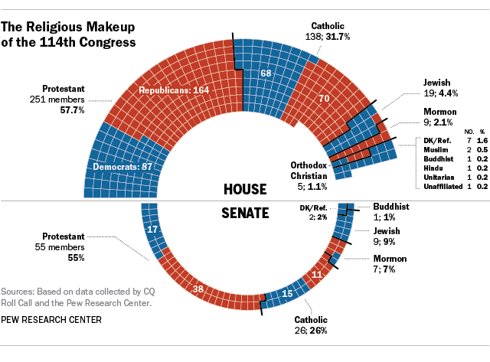

Slide 15
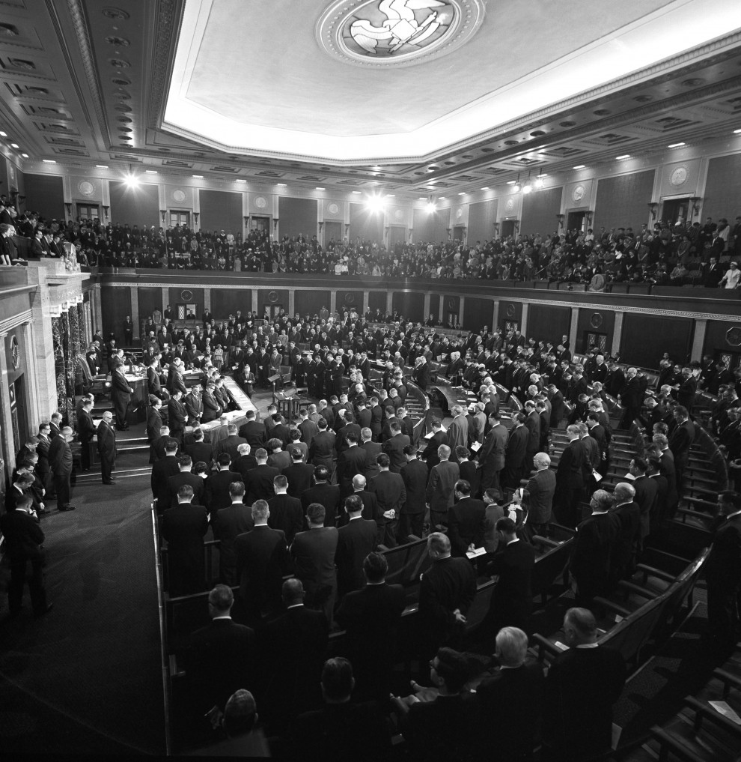
88th Congress
1963

Slide 16
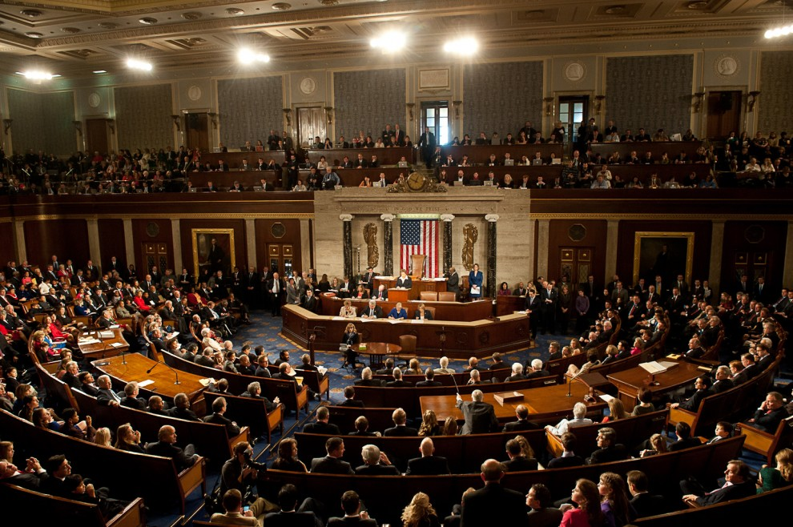
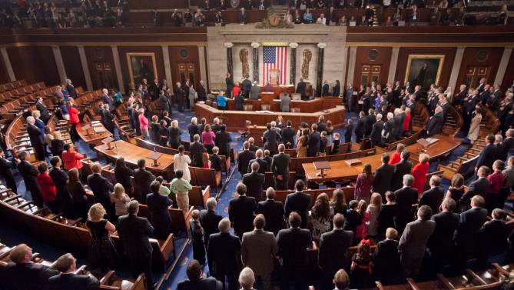
114th Congress
2015
Congress Over 50 Years

Slide 17
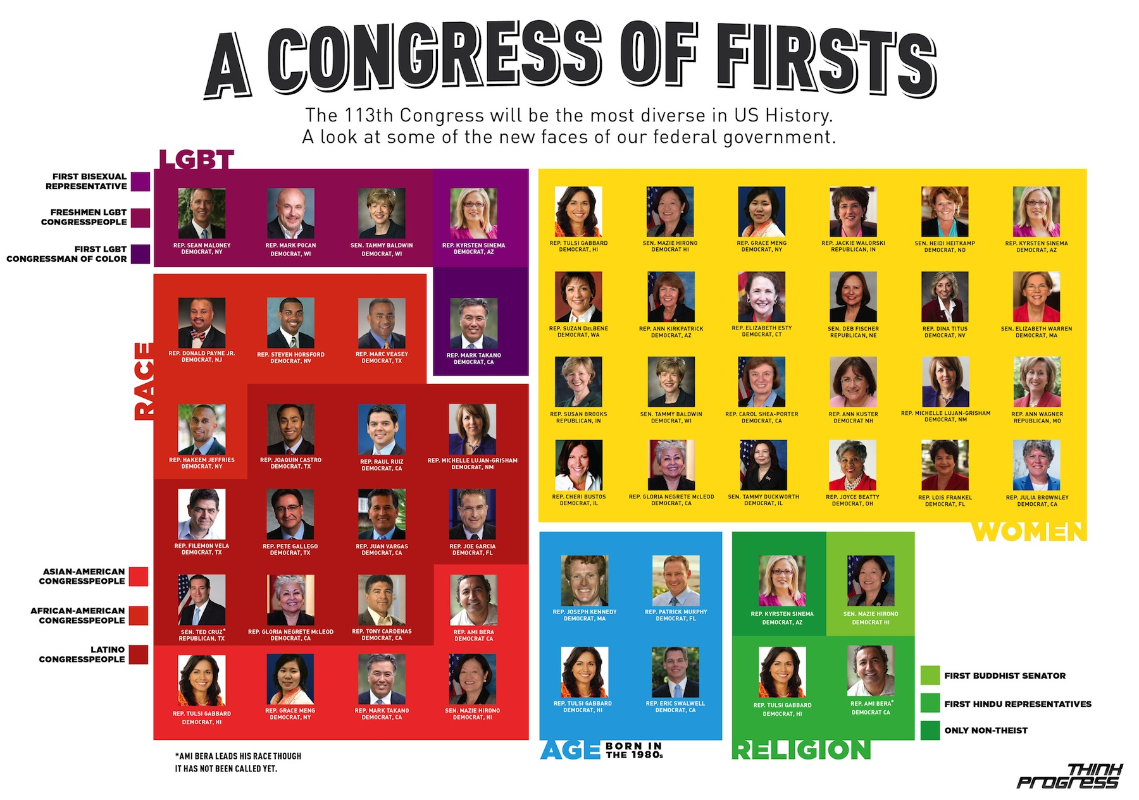
Congress Diversity Peaks -113th Congress

Slide 18
Constitutional Requirements for US Congress
 | US Senate | US House of Representatives
Age | At least 30 years | At least 25 years
Residency | Live in state he/she represents | Live in district he/she represents
Citizenship | US Citizen for at least 9 years | US Citizen for at least 7 years
Comparing the Senate and the House

Slide 19
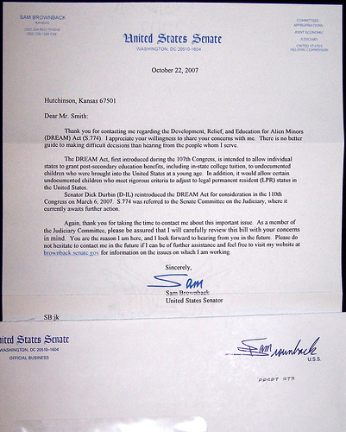
Benefits of Congress
Members receive a salary of $173,000, free office space, and trips to their home states.
They have the franking privilege
they may send job-related mail for free.

Slide 20
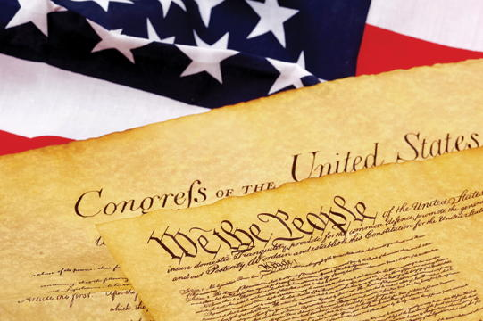
Benefits of Congress
The Constitution grants senators and representatives immunity, or legal protection, in some situations.
Even though they have some protection, they may not break the law.

Slide 21
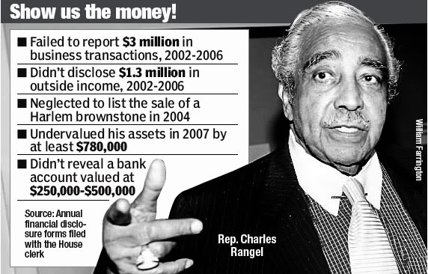
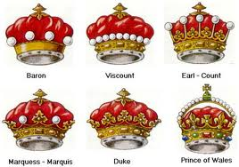
Limitations on Congress
Congress does have limitations:
expulsion-may be removed from Congress
censure-formal vote of disapproval of a legislator’s conduct
Prohibited from issuing titles of nobility
The president can veto laws passed by Congress

Slide 22
Limitations on Congress
Can’t suspend a writ of habeas corpus, which is issued by a judge to require an officer of the law to bring the prisoner into court and show reason for holding him or her in custody
Can’t issue bills of attainder, by which a person is punished without a jury trial
Can’t pass ex post facto laws, meaning laws that make a person’s act a crime after that act is committed

Slide 23
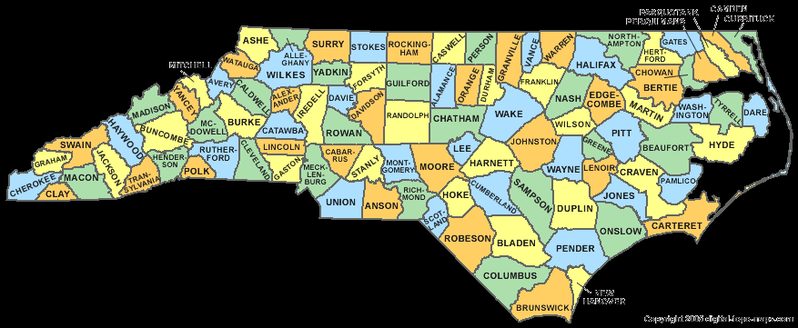
Members of Congress at Work
In representing the people who elected them, members of Congress carry out three major jobs:
Make laws
Introduce bills, work on committees, listen to input for and against bills, and then vote
Do casework–they troubleshoot for people from their home district or state who request help in dealing with the federal government.

Slide 24
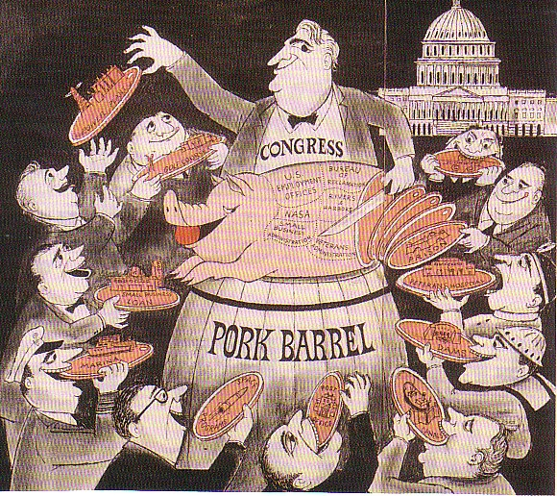
Members of Congress at Work
Congress members protect the interests of their state or district.
For example, a senator from a state with strong timber industries might seek to influence logging policies.
Members also work to gain a share of national government spending for their constituents.
A government contract can bring a lot of money to local businesses and jobs for local people.
Government projects and grants that primarily benefit the home district or state are called pork-barrel

Slide 25
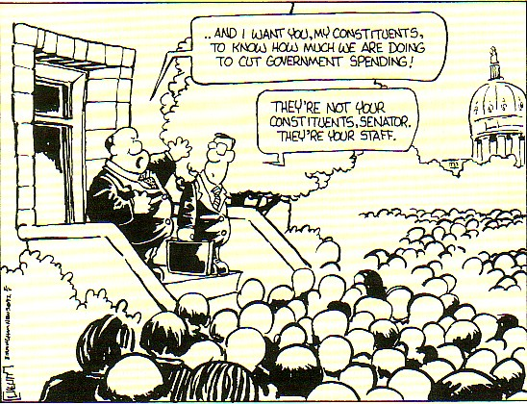
Congressional Staff: Behind-the-Scenes Helpers
Personal staff:
run the offices
gather information on issues, arrange meetings, and write speeches.
handle requests from voters.
deal with reporters and lobbyists–people hired by private groups to influence government decision makers
work for the member’s reelection
-

