Slide 1
Bell Work, Wed. 2/25
Story 1:
Problem:
Solution
Story 2:
Problem:
Solution:
Story 3:
Problem:
Solution:

Slide 2
Bill of Rights…cont. & Other Constitutional Amendments

Slide 4
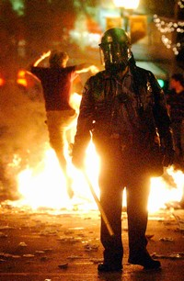
What are the Limits to First Amendment Freedoms?
The Supreme Court has decided that First Amendment freedoms may be limited to protect safety and security.
Clear and Present Danger
You may not provoke a riot.
You may not speak or write in a way that leads to criminal activities or efforts to overthrow the government.

Slide 5
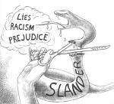
What are the Limits to First Amendment Freedoms?
You should use civil liberties responsibly and not interfere with the rights of others.
You may criticize government officials but not spread lies that harm a person’s reputation.
Doing so is a crime called slander if the lies are spoken and libel if they are printed.
Unlimited freedom is not possible in a society.
The rights of one individual must be balanced against the rights of others and of the community.

Slide 6
Are school lockers private?

Slide 7
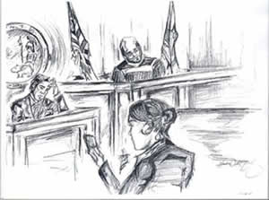
How does the Constitution Protect the Rights of the Accused?
The Fourth, Fifth, Sixth, and Eighth Amendments protect the rights of accused people.

Slide 8
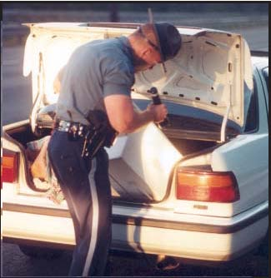
How does the Constitution Protect the Rights of the Accused?
The Fourth Amendment protects against unreasonable searches and seizures.
If police believe you have committed a crime, they can ask a judge for a search warrant–a court order allowing law enforcement officials to search a suspect’s home or business and take evidence.
Search warrants are granted only with good cause.
-
-search warrants
-”Patriot Act”
-modern technology’s ability
“big brother”

Slide 9
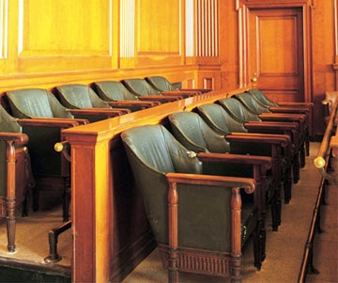
How does the Constitution Protect the Rights of the Accused?
The Fifth Amendment states that no one can be put on trial for a serious federal crime without an indictment–a formal charge by a group of citizens called a grand jury, who review the evidence.
An indictment does not mean guilt–it indicates only that the person may have committed a crime.
The Fifth Amendment also protects against double jeopardy.
Someone tried and judged not guilty may not be put on trial again for the same crime.

Slide 10
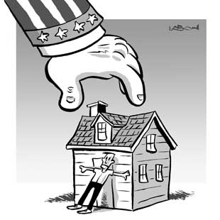
How does the Constitution Protect the Rights of the Accused?
The Fifth Amendment protects an accused person’s right to remain silent.
This prevents a person from being threatened or tortured into a confession.
The Fifth Amendment states that no one may be denied life, liberty, or property without due process, or the use of established legal procedures.
The Fifth Amendment limits eminent domain–the right of government to take private property (usually land) for public use.

Slide 11
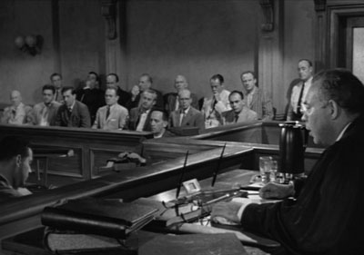
How does the Constitution Protect the Rights of the Accused?
The Sixth Amendment requires accused people to be told the charges against them and guarantees a trial by jury unless the accused chooses a judge instead.
Trials must be speedy and public with impartial jurors.
Accused people have a right to hear and question witnesses against them and call witnesses in their own defense.
Accused people are entitled to a lawyer.

Slide 12
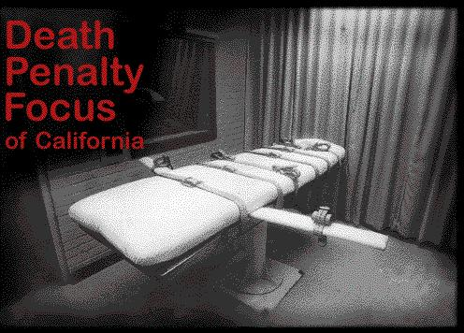
How does the Constitution Protect the Rights of the Accused?
Before trial, the accused may stay in jail or pay bail, a security deposit.
Bail is returned if the person comes to court for trial but is forfeited if the person fails to appear.
The Eighth Amendment forbids excessive bail and excessive fines.
It also forbids cruel and unusual punishment.
Punishment must fit the severity of the crime.
-legality of the death penalty
-juveniles and death penalty

Slide 13
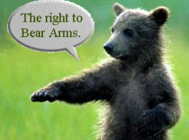
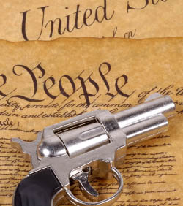
How Does the Constitution Protect Other Rights?
The Second Amendment is often debated.
Some believe it only allows states to keep an armed militia, or local army.
Others believe it guarantees the right of all citizens to “keep and bear arms.”
The courts have generally ruled that government can pass laws to control, but not prevent, the possession of weapons.

Slide 14
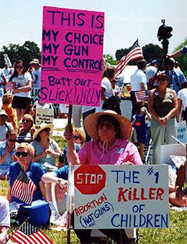
How Does the Constitution Protect Other Rights?
A well regulated militia, being necessary to the security of a free State, the right of the people to keep and bear arms, shall not be infringed.
-gun control laws?
-automatic weapons ban?
-firearm registrations?

Slide 15
How Does the Constitution Protect Other Rights?
The Third Amendment says that soldiers may not move into private homes without the owners’ consent, as British soldiers had done in colonial times.

Slide 16
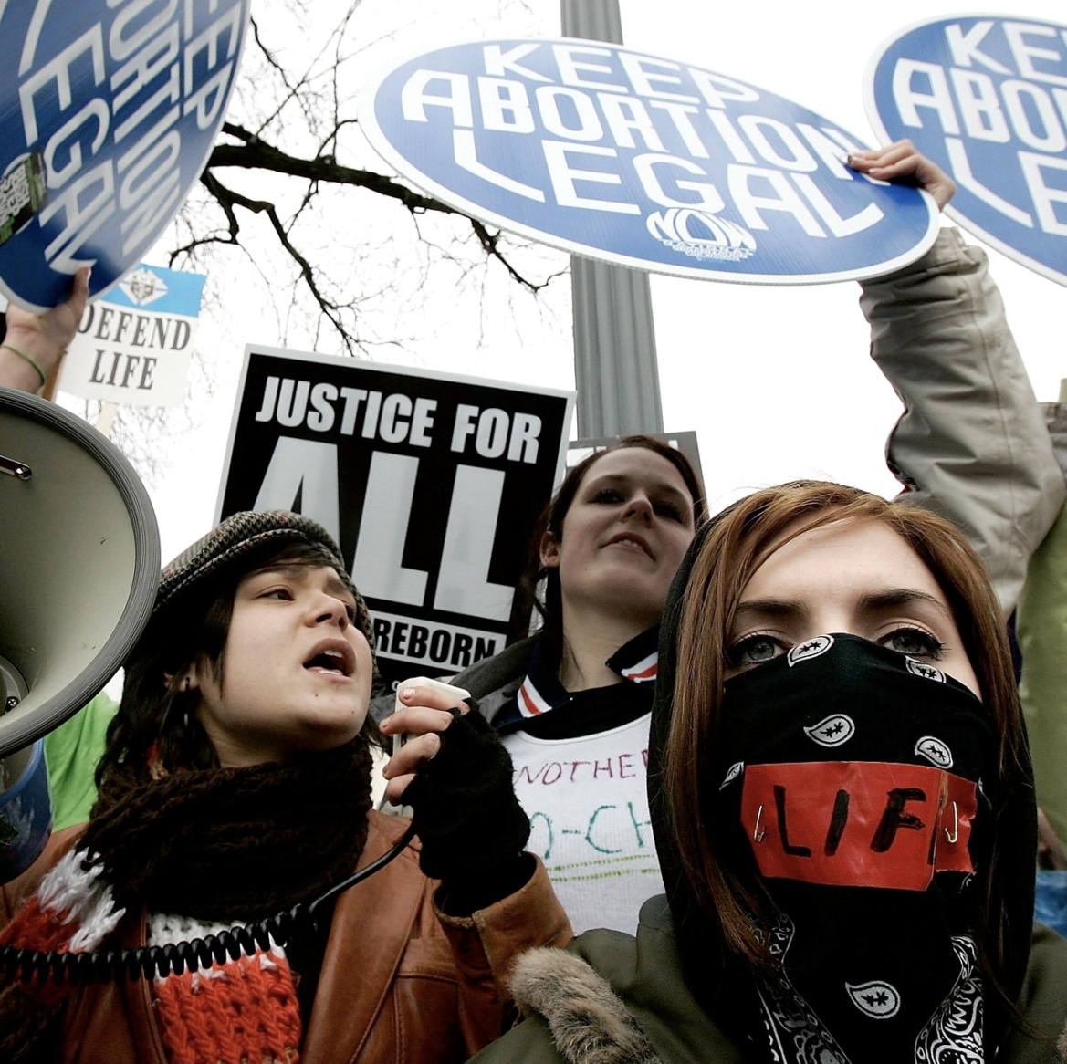
How Does the Constitution Protect Other Rights?
The Seventh Amendment concerns civil cases–lawsuits involving disagreements among people rather than crimes.
It guarantees the right to a jury trial in civil cases involving more than $20.
It does not require a jury trial, however.
The Ninth Amendment says that citizens have other rights beyond those listed in the Constitution.

Slide 17
How Does the Constitution Protect Other Rights?
The Tenth Amendment says that any powers the Constitution does not specifically give to the national government are reserved to the states or to the people.
This prevents Congress and the president from becoming too strong.
They have only the powers the people give them.
Popular sovereignty
Federalism

Slide 18
What details reveal the cartoonist’s view of the Bill of Rights?
The cartoonist expresses the Bill of Rights by portraying its major provisions as parts of the crown on the Statue of Liberty.

Slide 19
Constitutional Amendments

Slide 20
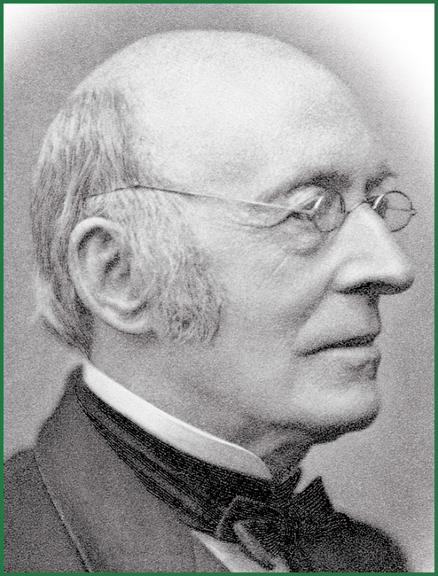
William Lloyd Garrison

Slide 21
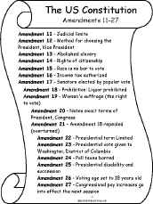
Protecting All Americans
At first, the Bill of Rights applied only to adult white males.
It also applied only to the national government, not to state or local governments.
Later amendments and court rulings made the Bill of Rights apply to all people and all levels of government.
The Civil War amendments–the 13th, 14th, and 15th–extended civil liberties to African Americans.

Slide 22
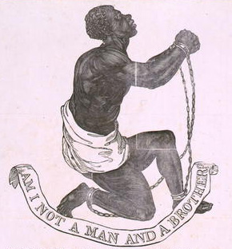
Protecting All Americans
The13th Amendment outlawed slavery, freeing thousands of African Americans.
After the Civil War, many Southern states passed “Jim Crow Laws” that limited the rights of African Americans.
Civil War Amendments

Slide 23
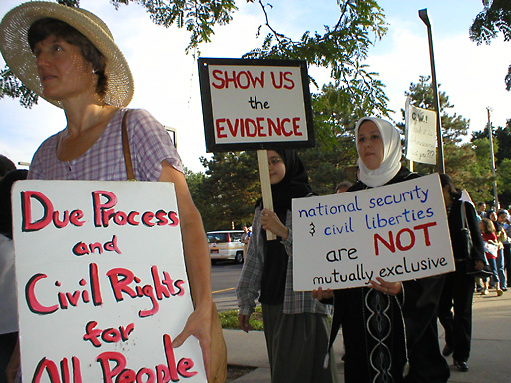
Protecting All Americans
To fix this, the 14th Amendment defines citizens as anyone born or naturalized in the United States, which included African Americans.
It required all states to grant citizens equal protection of the laws.
The Fourteenth Amendment also nationalized the Bill of Rights by forbidding state governments from interfering with the rights of citizens.

Slide 24
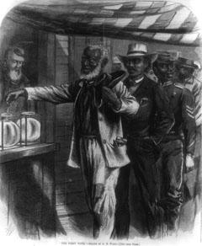
Protecting All Americans
The 15th Amendment gave African American men the right to vote.
It was intended to guarantee suffrage–the right to vote–to African Americans.
It applied only to men.

Slide 25
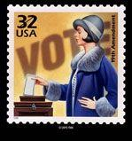
Protecting All Americans
The Constitution did not grant or deny women the right to vote.
As a result, states made their own decisions.
To fix this, the 19th Amendment gave women the right to vote in all elections.
Suffrage

Slide 26
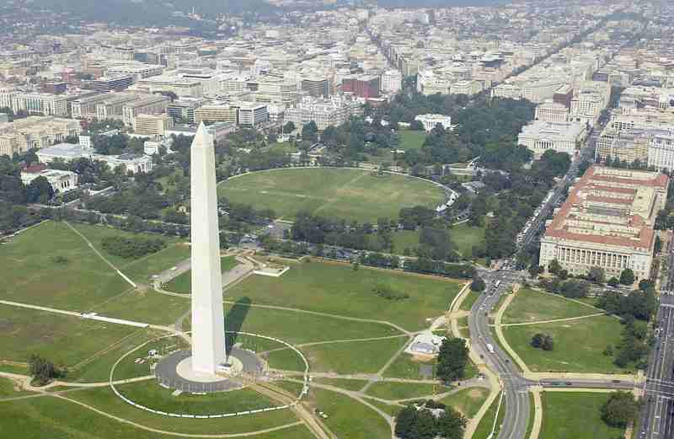
Protecting All Americans
Because Washington, D.C., is a district, not a state, its citizens could not vote in national elections.
The 23rd Amendment established the right to vote for Washington, D.C. residents.

Slide 27
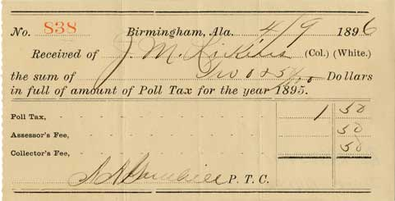
Protecting All Americans
Several Southern states required people to pay poll taxes to vote.
Because many African Americans and poor whites could not afford to pay, they could not vote.
The 24th Amendment outlawed poll taxes.

Slide 28
Protecting All Americans
The 26th Amendment guaranteed the right to vote to citizens 18 and older.
Before this amendment, most states set the minimum voting age at 21.

Slide 29
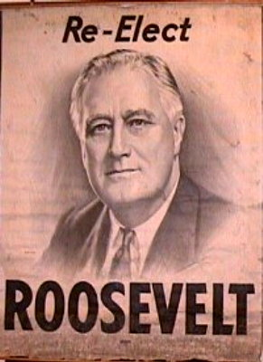
Presidential Succession
The 22nd Amendment states term limits for the office of the president.
A president can serve a maximum of ten years in office.
The 25th Amendment states the order of succession for the office of the president.
The Twenty-fifth Amendment

Slide 30
Other Amendments
11th Amendment--Places limits on suits against states
12th Amendment-Changes procedure for electing President and Vice-President
16th Amendment-Gives the authority to levy an income tax
17th Amendment-Establishes the direct election of Senators

Slide 31
Other Amendments
18th Amendment-Prohibition of Alcohol
20th Amendment-Changes the beginning of Presidential and
Congressional terms.
21th Amendment--Repeals Prohibition
27th Amendment--Places limits on Congressional pay raises until the beginning of the next term.
Prohibition Begins

