Slide 1
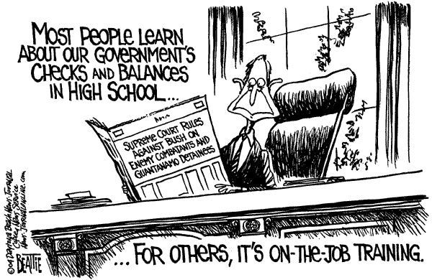

Slide 2
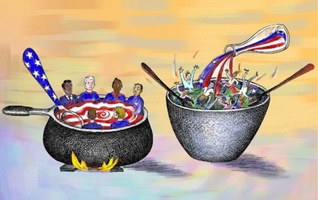
Know These Theories
Tossed salad theory
Culture in which groups maintain their unique identities within the larger group
Melting pot theory
Culture in which groups of people have lost their specific identities (assimilated into the dominant culture)

Slide 3
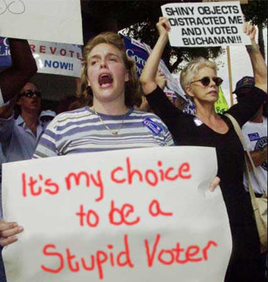
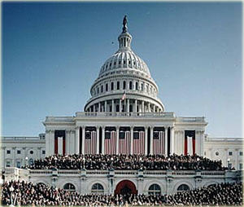
What is Civics?
Study of citizenship & govt.
Citizen
member of community w/ certain rights, duties and responsibilities
-Government
ruling authority that makes and enforces rules/ laws

Slide 4
What are the functions of govts?
Keep order – laws, courts
Provide security – police, military
Provide services – libraries, schools, etc.
Guide the community – manage economy, foreign relations, etc.

Slide 5
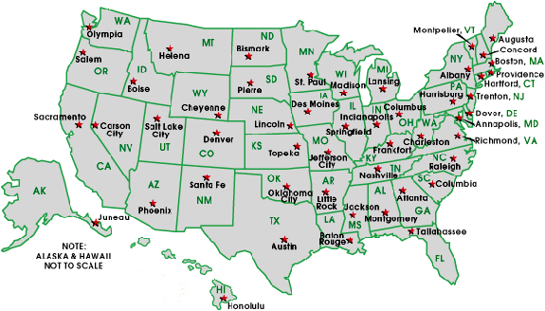
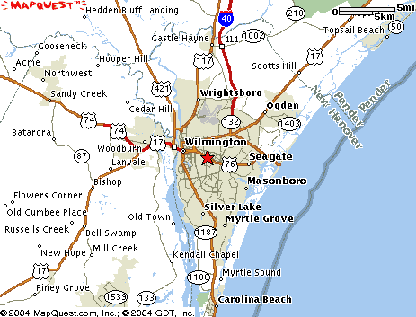
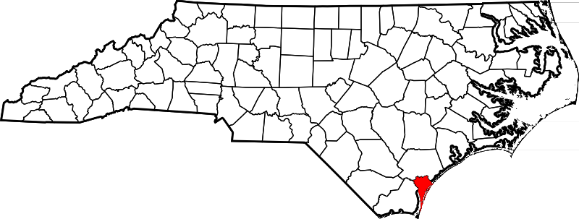
What are the 3 Levels of Govt?
National Govt. - (a.k.a. Federal)
State Govt.- (like N.C.)
Local Govt. – county, city, town, etc.

Slide 6
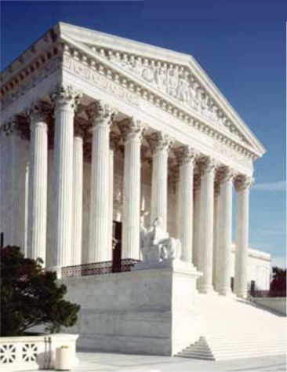
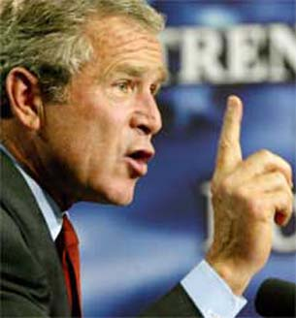
What are the 3 Branches of Govt.?
Judicial Branch: Interprets & applies laws
Fed. Courts
State Courts
Legislative Branch: Writes laws
Fed.: Congress (Senate and House of Reps )
State: General Assembly (Senate and House of Reps)
Local: City Council
Executive Branch: Enforces laws
Fed: president
State: governor
Local: mayor

Slide 7
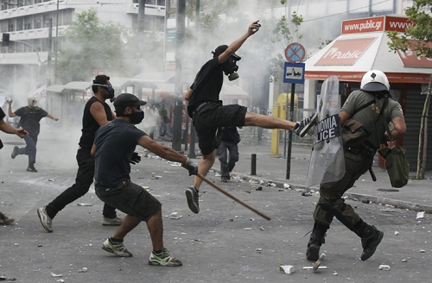
Types of Governments
1. Anarchy
Absence of government
Not recognizing a ruler
Complete individual freedom
Chaos

Slide 8
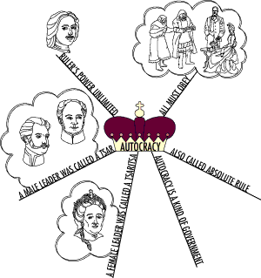
Types of Governments
2.Autocracy
One ruler with
absolute power
Unlimited executive
and legislative power
Only threat is
coup d'état

Slide 9
Types of Governments
3. Dictatorship
One ruler
Control usually taken or maintained by force/military
Allows very little freedom or opposition

Slide 10
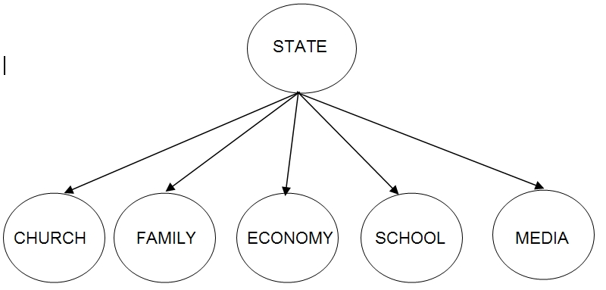
Types of Governments
4. Totalitarianism
State holds total authority over society
Controls all aspects of public and private life wherever possible (media, food, speech)

Slide 11
Types of Governments
5. Oligarchy
Government run by a small group that has all the power
Usually royalty or wealthy
Don’t last long because struggle to keep control

Slide 12
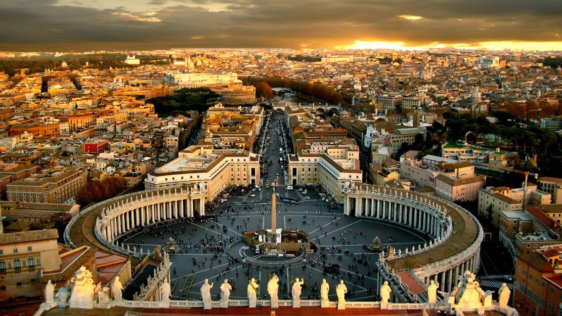
Types of Governments
6. Theocracy
Ruled by religious leaders
Their authority is to rule is divinely given and their decisions are divinely guided

Slide 13
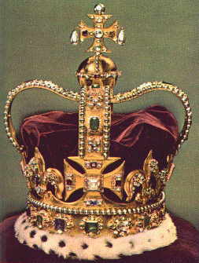
Types of Governments
7. Monarchy
Led by King/Queen
Power to rule is inherited
Limited Monarchy
King/Queen is head of state
Prime Minister is head of govt
Rules country within their constitutional limitations
Usually share power with another group in govt (ie: Parliament)
Absolute Monarchy
King/Queen is head of state & govt
Has absolute power

Slide 14
Types of Governments
8. Republic/Democracy
Rule by the consent of the people
Elect leaders to rule
Non hereditary
Direct Democracy
Each citizens has an actual say in the affairs of govt
People vote on policy initiatives directly
Switzerland
Representative Democracy
The people elect representatives to make decisions for them
Free elections ie: USA!

Slide 15
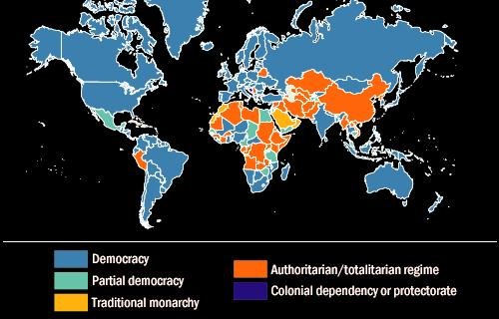

Slide 16
Identity
Any given governmental system may alter a citizen’s understanding of their respective rights, duties and responsibilities

Slide 17
Types of Governments Children’s Book Assignment

