Slide 1
Bell Work, Wed. 5/13
Where is Shell going to start drilling for oil?
Who created the first Presidential Library?
What technology are firefighters experimenting with?

Slide 2
Bell Work, Thurs. 5/14
What cities does AMTRAK’s Northeast corridor connect?
We haven’t had a category 3 hurricane or above for how many years?
What is polo known as?

Slide 3
Personal Finance Literacy
Credit, Saving and Investing

Slide 4
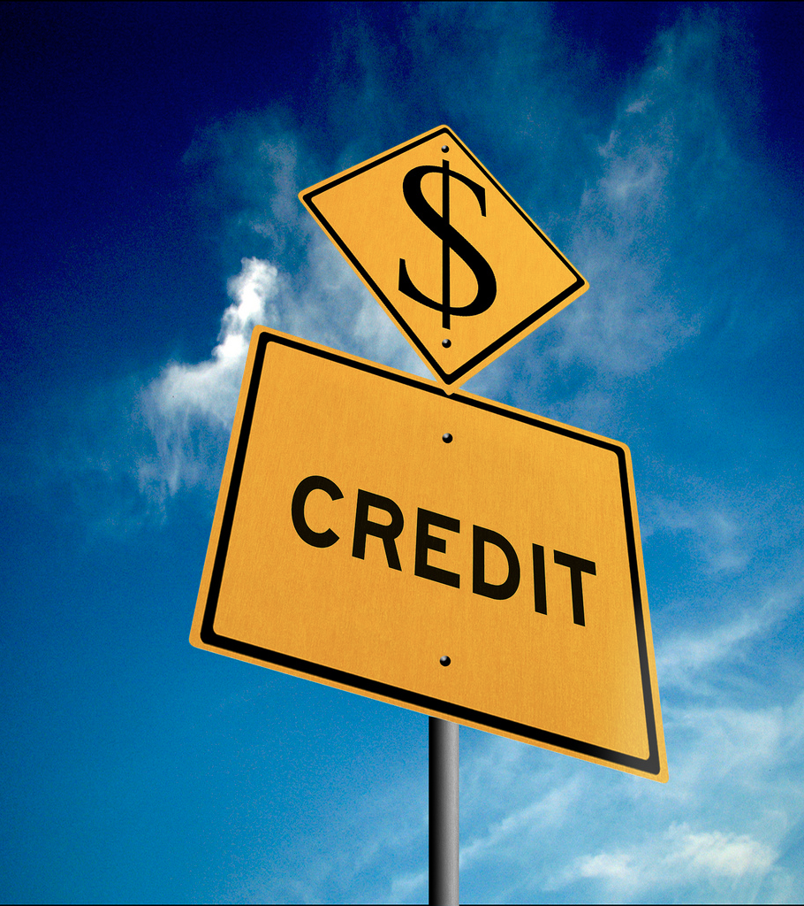
What is Credit?
Credit means someone is willing to loan money (principal) in exchange for your promise to repay it, usually with interest
  Interest: the amount you pay to use someone else’s money

Slide 5
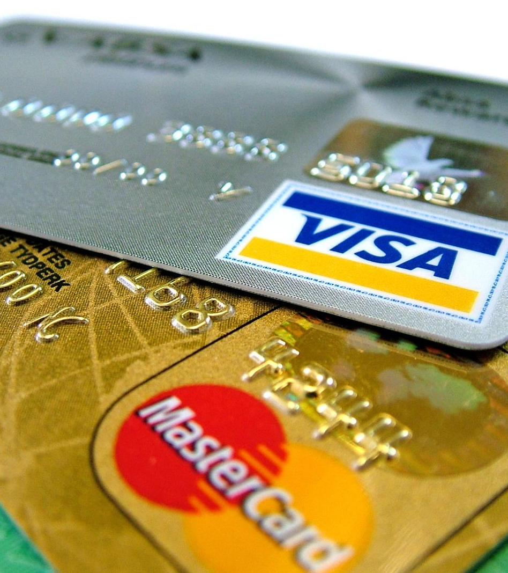
Types of Credit
Borrow from friends or relatives.
  No interest
Installment loans
  Have terms and monthly payments
Student Loans
  Delayed interest rate
Mortgage Loans
  Buy a home

Slide 6
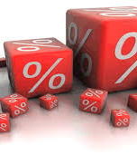
Annual Percentage Rate (APR)
Key feature when comparing credit offers
APR tells you the cost of the loan per year as a percentage of the borrowed amount

Slide 7
Credit: Rewards
Convenience
  Rather than carrying large sums of cash
Protection
  Buyer protection, easy refunds
Emergencies
  Pay for emergency expenses quickly
Opportunity to build credit
  Using credit RESPONSIBLY
Quicker gratification
  Buy expensive items while you’re paying for them
Special offers
  Buy now pay later, special interest rates
Bonuses
  Points/cash back

Slide 8
Credit: Risks
Interest
  Paying more for the item
Overspending
  Living beyond your means
Debt
  Entire amount you owe to lenders
Identity Theft
  Someone uses your personal info without your permission

Slide 9
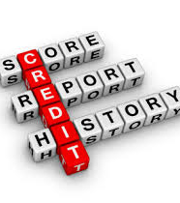
Credit Reports
Credit report: record of one’s credit history
  Personal financial transactions
Credit score
  Number that reflects credit worthiness
    Changes when your financial situation changes

Slide 10
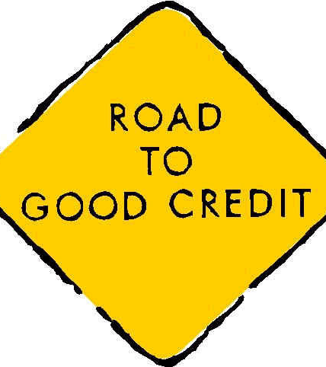
How to Build Good Credit
Always pay bills on time
Consistent savings pattern
Be choosy about your credit cards and loans
Maintain a low balance on one card and pay it off each month

Slide 11
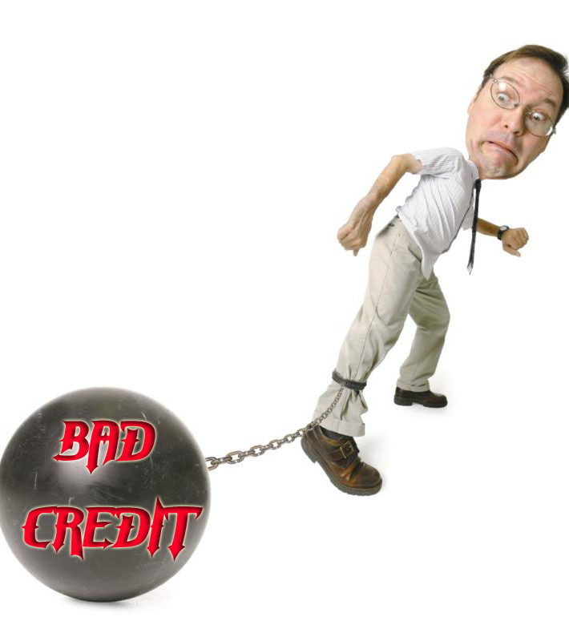
What Hurts Your Credit?
Making late payments
Bouncing checks
Having a lot of credit cards and loans
Changing credit cards frequently

Slide 12
Personal Finance Literacy
Savings and Investing

Slide 13
What’s the Difference?
Saving
  Short term goals
  Accessible when needed
  Savings accounts
    Low-risk
Investing
  Long term goals
  Not always accessible
  Higher risk, but higher payoff in the end

Slide 14
Why Save and Invest?
Time Value of Money: refers to the relationship among time, money, and rate of interest
Inflation: rise in the cost of goods over time.
  Decreases spending power of each dollar you have
The more money you have to save/invest, the more you are likely to earn
Higher rate of interest, more money gained
Sooner you invest, the more money you could earn

Slide 15
Why Save and Invest?
Simple Interest Formula
Interest=Principal x Interest Rate x Time
You put $100 in a savings account that pays 4% interest per year. How much will your $100 grow over the year?
$100 x .04 x 1 year = $4

Slide 16
How much will I earn in 5 years?10 years? 20 years?
Compound Interest Formula
Amount= Principal (1+Interest Rate) ^{Number of years compounded}
OR
A = P(1+i)^{n}
$100(1 + .o4)⁵ = $121.67

Slide 17
Types of Investments
Risk/Reward trade off:
  Safer investment, lower return
  High risk investment, higher returns
Income investments
  You will be paid in cash for owning an account or investment
  Savings account, interest is your income
Growth investments
  Buy and hope it grows over time

