Slide 1
Bell Work, Tuesday 5/12
What scale do we use to measure tornadoes?
How loud can cicadas get?
What does Dr. Jim Withers do?

Slide 2
Personal Finance Literacy
Checking

Slide 3
Why Open a Checking Account?
Safety
Don’t walk around with a lot of cash
ATM card/checks can be replaced
Convenience
Don’t need cash
Bad idea to send cash in the mail
Easy access to your account
Easier Budgeting
Track spending with a check register
Proof of Payment
“cleared” checks are a record of payment
Less impulsive spending
Cash in your pocket is too easily spent

Slide 4
Opening a Checking Account
Things to consider when opening a checking account:
Location
Branch offices, hours of operation, ATM availability
Fees
Monthly fees, per check fees, printing of checks, balance inquiry fees, ATM fees
Other fees
Overdraft charge, stop-payment fees, certified check fees
Restrictions
Minimum balance, deposit insurance, holding period for deposited checks
Special features
Direct deposit, automatic payments, overdraft protection, online banking, discounts or free checking for students, seniors or employees of certain companies

Slide 5
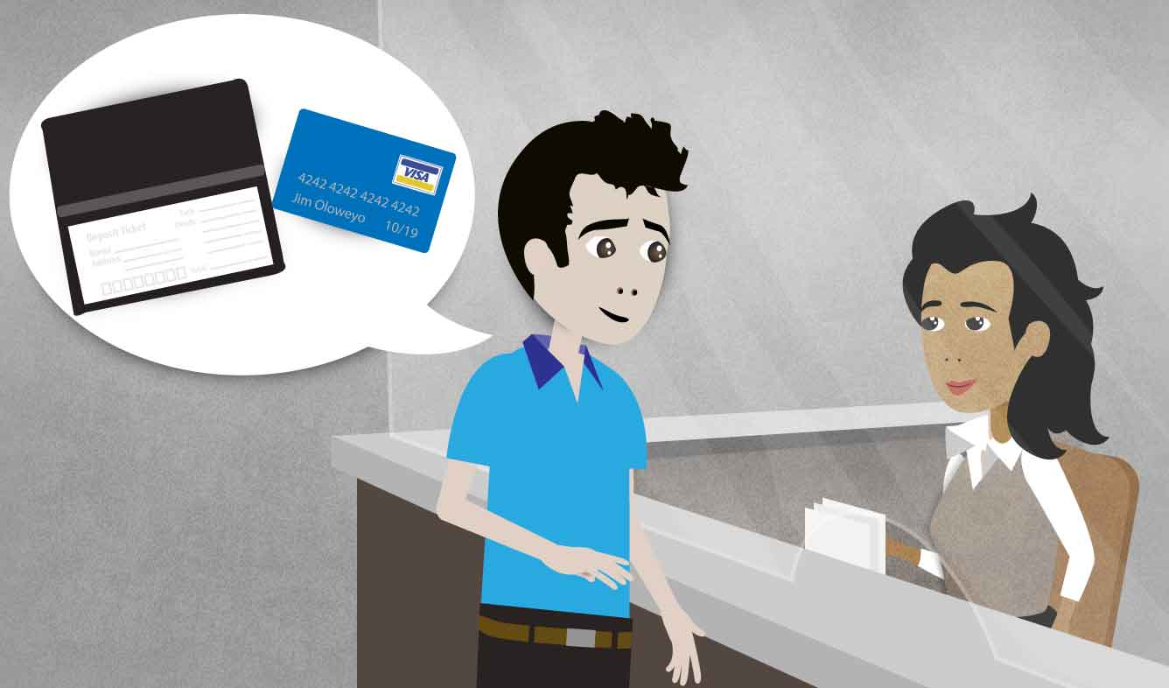
Opening a Checking Account
Once you choose a checking account, to actually “open it” you need:
2 forms of ID
Any money you want to deposit
Fill out paperwork
Receive box of checks & register in the mail

Slide 6
Check Do’s and Don’ts
Do’s
Always write checks in ink
Keep unused checks in a place where other will not have easy access to them
Check your statement regularly
Don’ts
Write checks for money you don’t have
“bounced” check
Endorse a check (sign the back) you plan on depositing later

Slide 7
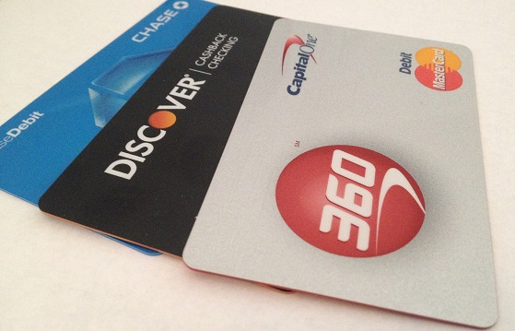
ATM/Check/Debit Cards
An alternative to writing checks
Pros:
Less to carry around
Faster transactions
Cons
Memorize and protect your PIN
Reporting lost or stolen cards

