Slide 1
Bell Work, Monday 5/11
What has the terror threat level been raised to on military bases?
What is VE Day?
Who built the modular robotic vehicle?

Slide 2
Personal Finance Literacy
Intro to Financial Planning

Slide 3
True or False?
Teens get most of their money from part time jobs.
False. 55% of teens report getting money from parents/guardians; 43% from gifts; 28% from odd jobs; 25% from part time jobs; 21% from allowance; 6% from a full time job; 2% from their own business.

Slide 4
True or False?
2. Most teens who are 18 or 19 years old have a checking account.
True. 64% of teens 18-19 years old have a checking account.

Slide 5
True or False?
3. 90% of high school students rely on their parents for information about money.
True.

Slide 6
True or False?
4. On average, American teens spend less than $10 billion a year.
False. A recent survey showed that American teen spending exceeded $169 billion in one year.

Slide 7
What is Financial Planning?
Answer the following questions:
1. What is an item you would like to have, but cannot currently afford?
2. Assuming you are starting with no money and you cannot count on anyone else to simply give it to you, how will you go about saving enough for the item?
3. How long do you think it will take you to save enough money to buy the item?
4. What are some other expenses you need to consider while saving up? Will you need to make any sacrifices?

Slide 8
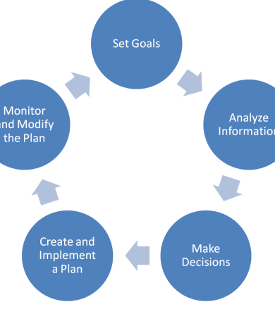
What is Financial Planning?
Financial planning: a process of setting goals, developing a plan to achieve them and putting the plan into action.
There are 5 steps to create and maintain a financial plan.

Slide 9

Step 1: Set Goals
Goal-setting with regards to financial planning involves thinking about needs and wants in the short, intermediate, and long-term.

Slide 10
Needs vs. Wants
Needs: very basic things we must have to survive
Examples: Food, shelter, clothes
Wants: things that make life more interesting and fun, but you could live without them if you had to
Examples: Designer clothes, going out to eat, TV

Slide 11
Goals
Short term: less than 3 months
Intermediate: 3 months to a year
Long term: A year or longer
Delayed gratification: Giving up something you want now to get something better in the future
Instant gratification: buying something as soon as you see it
  Credit card debt

Slide 12

Step 2: Analyze Information
Find out where your finances currently stand
Measure your cash flow
  How much money you are receiving, spending and saving.
  Income: money received
  Expenditures: money spent

Slide 13
Step 3: Make Decisions
6 Decision Making Steps
1. Identify your goal
2. Establish your criteria
  Identify your expectations in advance
3. Examine your options
4. Weigh pros and cons
  How do your options meet your criteria?
5. Make your decision
  Which option best meets your criteria
6. Evaluate results
  Did you make the right choice? Was your choice worth the cost?
Decision making involves a trade-off known as opportunity cost

Slide 14

Step 4: Create & Implement a Plan
Step 5: Monitor & Modify the Plan
Make sure you are staying on track
  Review plans and progress
  Plans are not set in stone

Slide 15
Family Scenarios
Think and write about what types of financial decisions your “family” might need to make given the circumstances on you card.
Identify at least 2 potential unexpected events that might impact financial planning.

