Slide 1
Bell Work, Tues. 5/26
1. What area of the US is experiencing flooding?
2. What was the goal of the PATRIOT Act?
3. What do we believe elephants have the ability to do?

Slide 2
Types of Businesses

Slide 3
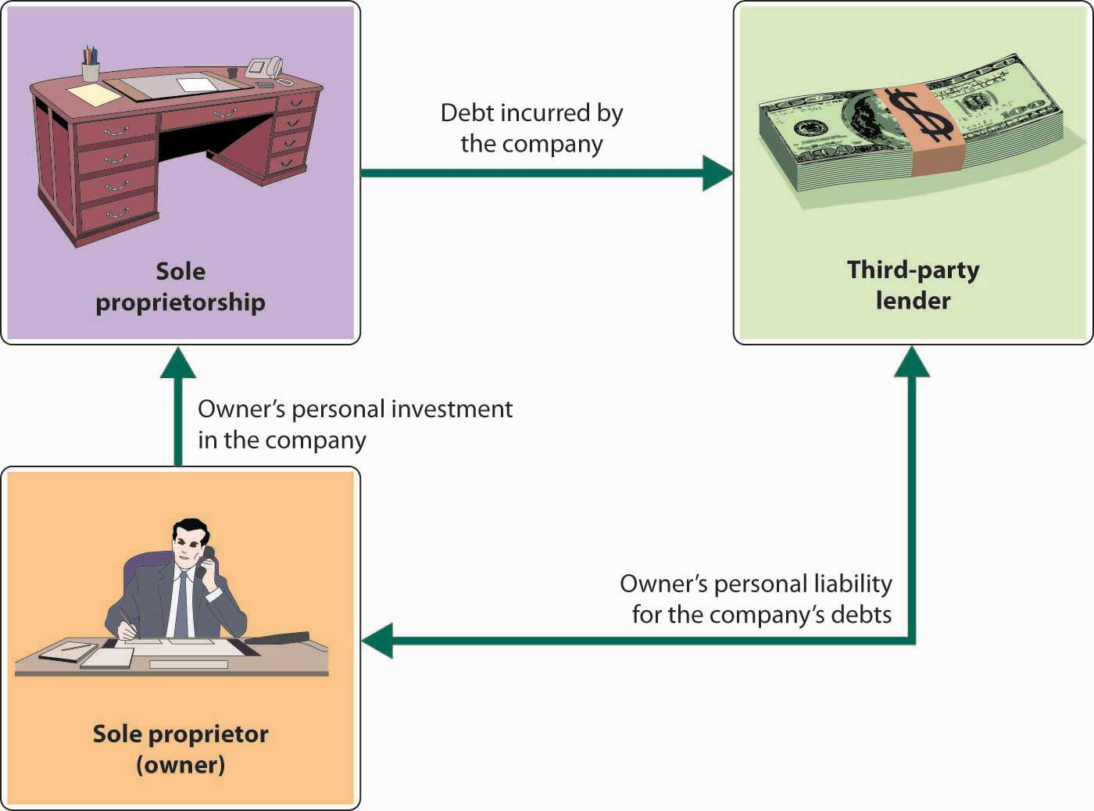
Sole Proprietorships
-business owned by a single person or a married couple
-3/4 of all businesses are sole proprietorships
-Disadvantages:
Unlimited liability
-the owner is financially responsible for all debts of the business.

Slide 4
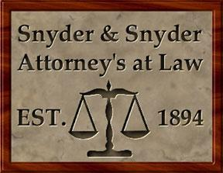
Partnerships
-business owned by two or more people
-Advantages
-pool resources and capital

Slide 5
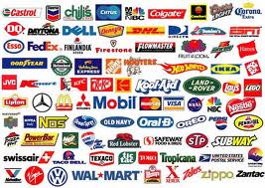
Corporations
-business that has a great many owners
-sell stocks to investors
-pay dividends to shareholders

Slide 6
Corporations
-Limited liability
-the ability of a corporation to protect its shareholders by placing only the amount of capital they have invested at risk
-Incorporation---legal process of forming a corporation through state government

Slide 7
Non-Profit Organizations
-business that is organized to provide a service and not to make large profits for the owners
-many are charities or service groups

Slide 8
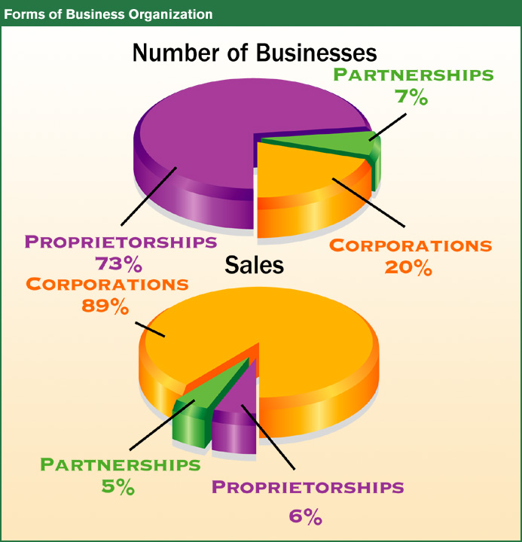

Slide 9
Government Involvement in the Economy
Business and Labor

Slide 10
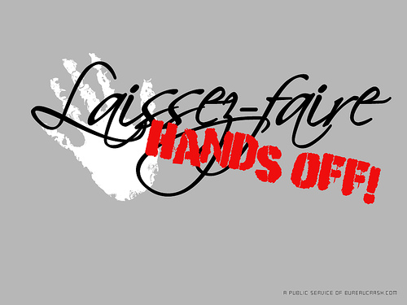
I. A Brief History…
A. Nation’s Beginnings (1700s)
-Laissez-Faire Economics-idea that the government will stay out of the interests of people and businesses
-Founding fathers appreciated Adam Smith’s Wealth of Nations which emphasized as little gov’t involvement as possible
B. Age of Industrialization (mid-late 1800s)
-by using certain business techniques a few men became very successful, taking control of entire industries

Slide 11
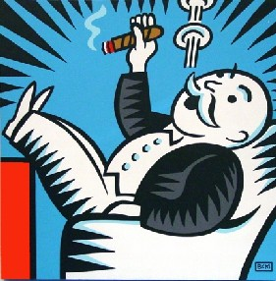
Regulating Big Business
-monopoly: business which controls the supply (and eventually prices) of a particular product
-merger: 2 or more businesses join together to form one business
-trust: several businesses join together to make decisions as one
-after Progressive Mov’t Congress began to pass laws making these activities illegal
-Sherman Anti-Trust Act, 1890
-Clayton Act, 1914
-big business is now regulated by the Federal Trade Commission
Keeping Competition (FTC)

Slide 12
II. Various Structures in a Market Economy
Monopolies
-a few are allowed because of the high cost of producing, impediments, or copyright issues
-examples:
a. public utilities (water, electric)
b. Pfizer
*their prices are regulated by government

Slide 13
Other Market Structures
Six movie studios own 87% of industry
TV and High Speed Internet Disney, CBS, Viacom, Comcast, Hearst Corporation, Time Warner, and News Corporation.
Four wireless providers AT&T Mobility, Verizon Wireless, T-Mobile, Sprint Nextel) control 89% of the cellular telephone service market.
Healthcare insurance in the United States consists of very few insurance companies
B. oligopoly-only a few firms that make up an industry
-each company is interdependent on the other because there are so few competitors
if one drops their price what will the other be forced to do?

Slide 14
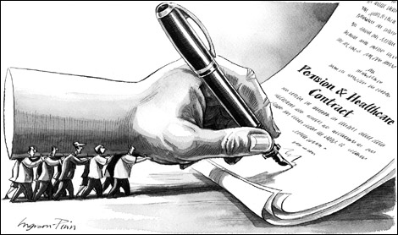
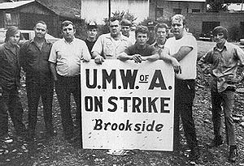
Labor Unions
-an organized association of workers, often in a trade or profession, formed to protect and further their rights and interests.
-techniques used:
-collective bargaining
-mediation and arbitration
-Strikes, picketing, sit-downs, slowdowns
-court injunctions

Slide 15
Gov’t as Mediator
-National Labor Relations Board: an independent agency charged w/ conducting elections for labor union representation and w/ investigating and remedying unfair labor
-allowed certain union activities and banned others
-Taft-Hartley Act, 1947 put limits on union activities
-several states have passed Right to Work Laws- prevent unions from forcing workers to join.
Right to Work States

Slide 17
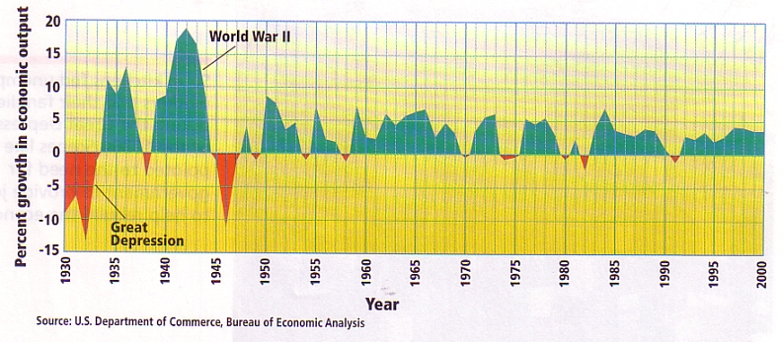
Business Cycle
The periodic and cyclical ups and downs of the economy
There are economic indicators of how the U.S. is doing (what phase we’re in on the business cycle)

Slide 18
1. Economic Output
Gross Domestic Product-the value of all final goods and services produced in a nation in a given year
Final goods: goods sold to their users
Real GDP- converts annual output into constant dollars by taking out inflationary increase in prices

Slide 19
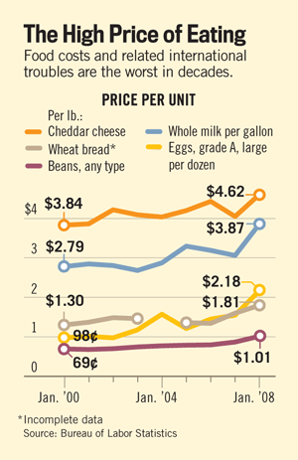
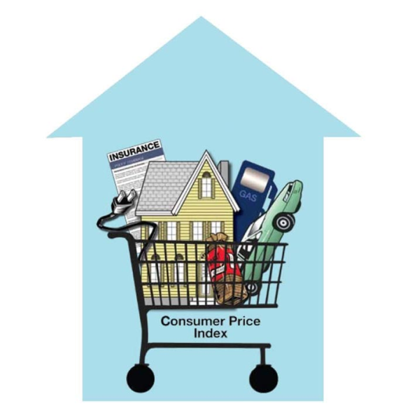
2. Prices of Goods/Services
Inflation-a general increase in the cost of goods and services
Consumer Price Index-- Survey of many goods and services that are compared to the same goods and services over time to measure the increase or decrease in prices

Slide 20
3. Unemployment Rate
The percentage of people in the civilian labor force who are not working, but are looking for jobs.
Civilian labor force: everyone 16 or older that is working or looking for work.
Employed: working part time or full time.
Current Rate of Unemployment

Slide 21
4. Others
Stock Market
Bear Market: prices are down
Bull Market: prices are going up
Standard of living (leisure time, luxury items being purchased)
Housing Market
Business Starts

Slide 22
Business Cycle Phases
(contraction)

Slide 23
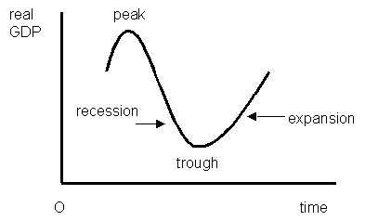
A. Expansion Period
Economy is growing
Real GDP (production) is growing
Unemployment rate is usually falling
B. Peak Period
Highest point of expansion

Slide 24
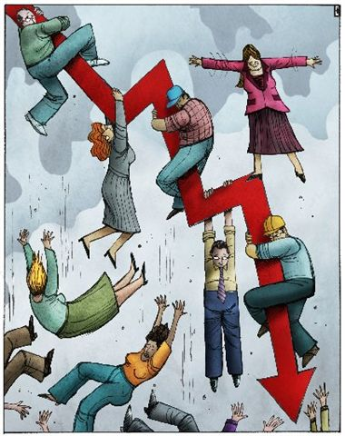
C. Contraction/Recession Period
-
Economy is starting to decline from its peak activity
Real GDP (production) decreases for 6 consecutive months
Unemployment rate usually increases
Depression: an extended period of contraction/recession
D. Trough Period
Economy has reached its lowest point of recession

Slide 25
Relationships Between Indicators
Research what the Real GDP, Inflation Rate, and Unemployment Rates have been for each year between 2015 and 2005.
Make a chart from the data.
Write a paragraph describing the relationship between the 3 economic indicators during the 10 year period.

