Slide 1
Bell Work, Thurs. 5/21
1. What is North Korea doing with nuclear weapons?
2. Ramadi is the capital of what province?
3. List 2 uses for graphene.
Notes:
Graphine (chicken wire made out of carbon)—space elevator and desalinization and fast processors

Slide 2
Demand

Slide 3
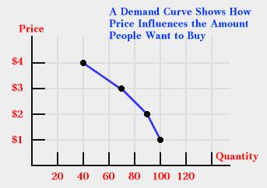
Demand
Demand
The amount of a particular good or service consumers want to buy
Law of demand-
as the price of a good increases the amount demanded will decrease and as price decreases then demand will increase
The demand curve slopes downward
This shows that people are normally willing to buy less of a product at a high price and more at a low price.
Price
Demand

Slide 4
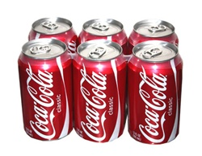
a. Diminishing Marginal Utility
Go away
usefulness
-the law of demand says that a lower price will increase demand but this is limited
-eventually the amount of satisfaction or usefulness of a product decreases as more and more are consumed
-Ex.—You can only enjoy so many soft drinks before you can’t drink anymore no matter how low the price becomes

Slide 5
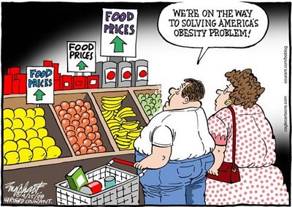
b. Elasticity
-Is the degree to which a change in price affects the demand for the product
-Elastic Demand
-a change in the price does affect the quantity demanded
-Inelastic demand
-change in the price does NOT affect the quantity demanded

Slide 6
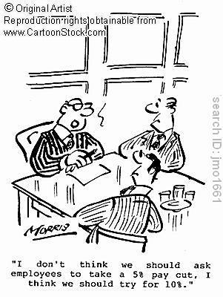
c. Income Changes
--A change in either direction to a person’s purchasing power (income level) will change their demand for goods and services
-The availability of higher paying jobs is not as high as what it was before the recession (2008). How will that affect demand for high price items?
Two types of income:
-personal income: an individual's total earnings from wages, investments, and other ventures
-disposable income: total personal income minus taxes

Slide 7
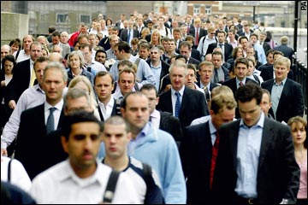
d. Change in Number of Consumers
-Faster growth areas may face higher levels of demand
-Areas of the country who are losing population will face lower demand for goods

Slide 8
e. Consumer Tastes change
-Because consumers have many choices of where to spend their money, the popularity of items will change demand
-Advertising industry
-Some items become high demand items for a short while and then very little demand
http://www.youtube.com/watch?v=EdRMVhlNP5I

Slide 9
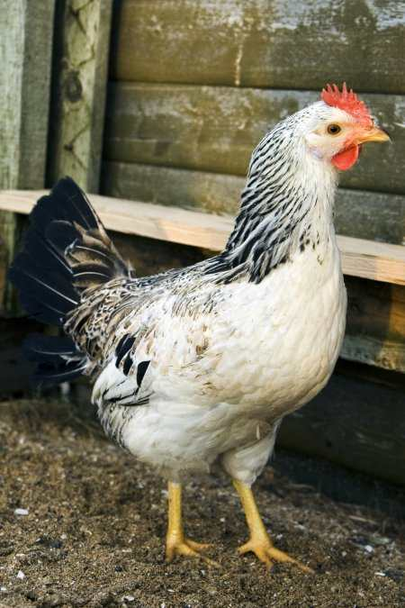
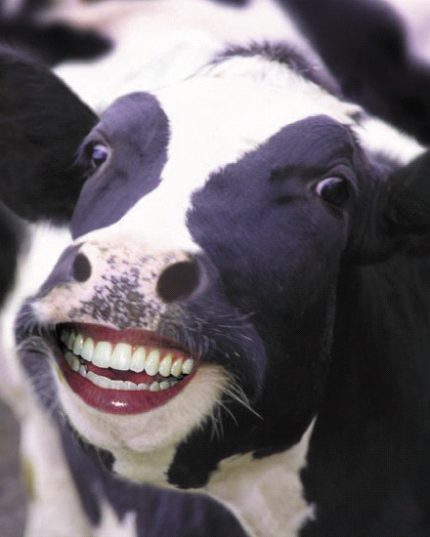
f. Substitute Goods
-substitute goods are goods that can be used in place of another product
ex.—chicken or beef
-if a good experiences a price change then the substitute good will face a demand change
ex—chicken price increases, demand for beef increases

Slide 10
g. Complementary Goods
-complementary goods are goods that work with another product
ex-Iphone and devices
-a change in the demand for one will many times affect the demand for the other as well

Slide 11
Changes in Demand
Change in the quantity demanded due to a price change occurs ALONG the demand curve
An increase in the Price of Widgets from $3 to $4 will lead to a decrease in the Quantity Demanded of Widgets from 6 to 4.

Slide 12
Changes in Demand
Several factors will change the demand for the good (shift the entire demand curve)
As an example, suppose consumer income increases. The demand for Widgets at all prices will increase.

Slide 13
Changes in Demand
Demand will also decrease due to changes in factors other than price.
As an example, suppose Widgets become less popular to own.

Slide 14
Supply

Slide 15
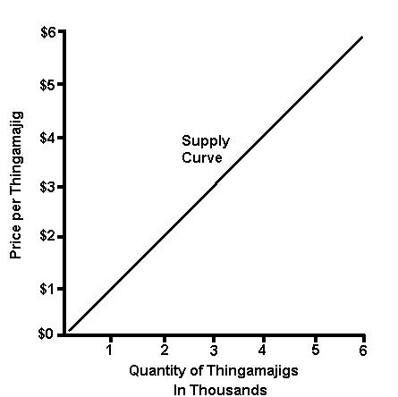
Supply
-Supply
-the amount of a particular good/service that producers will supply at a given price
-Law of Supply
-as the price of a good/service increases then producers will supply more of the product and as the price decreases they will supply less.
Unlike a demand curve, a supply curve normally slopes upward.
This reflects the fact that suppliers are generally willing to offer more of a product at a higher price and less at a lower price
Producer
Price
Supply
Reminder: Law of Demand=Consumer

Slide 16
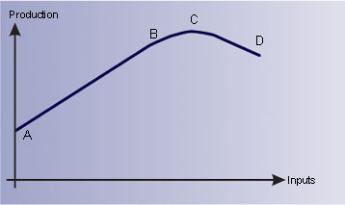
Diminishing Marginal Returns
Goes away
profit
-the law of supply says that producers will supply more at a higher price but this is limited
-the producer can only produce so much of the product before its cost is more than the profit received from its sale
-Ex.—your corn business is booming…what do you do if you want to produce more corn?
Notes:
Another example is a factory that has a fixed stock of capital, or tools and machines, and a variable supply of labor. As the firm increases the number of workers, the total output of the firm grows but at an ever-decreasing rate. This is because after a certain point, the factory becomes overcrowded and workers begin to form lines to use the machines. The long-run solution to this problem is to increase the stock of capital, that is, to buy more machines and to build more factories.

Slide 17
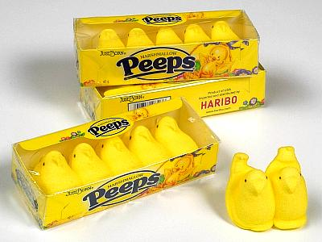
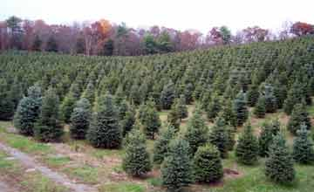
Elasticity
-Elasticity
-Is the degree to which a change in price affects the supply for the product
-Elastic Supply
-a change in the price does affect the quantity supplied –(easily able to produce more)
-Inelastic Supply
-change in the price does NOT affect the quantity supplied –(hard to produce more)
Which of these is inelastic in the amount that can be supplied?

Slide 18
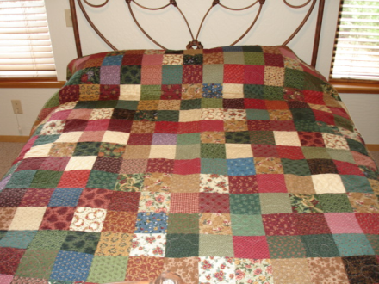
Productivity
-Productivity
-the amount of a good/service than can be produced in a given time
-Increases in productivity allow producers to make more of a product in a given time and at the same price which decrease cost and increases profits
-better technology is a major focus of increasing productivity
Wal-Mart
$64.76
Home made
$700

Slide 19
Cost of Resources
-The cost of the materials that go into goods and services can affect the production costs which affect the amount which can be supplied at each price level
-Examples
-higher wages lowers supply
-cheaper resources increase

Slide 20
Company Expectations
-Producers as well as consumers make economic plans. A company that expects record sales or few sales will adjust its supply levels
-Economic forecasts by the government become very important to large producers

Slide 21
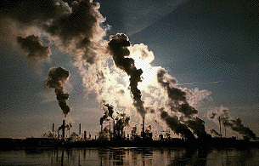
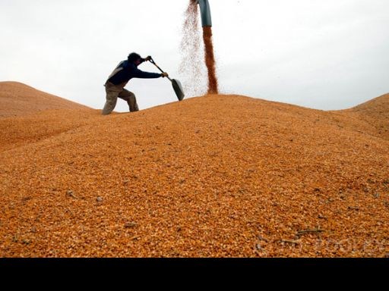
Government Regulations/Policies
-Governments can affect suppliers in many ways
1. Gov’t subsidies can help some producers cut costs to increase supply levels while fewer subsidies cause production costs to rise and less is supplied
2. minimum wage requirements
3. taxation
4. Gov’t agencies limiting amount of pollution/exhaust

Slide 22
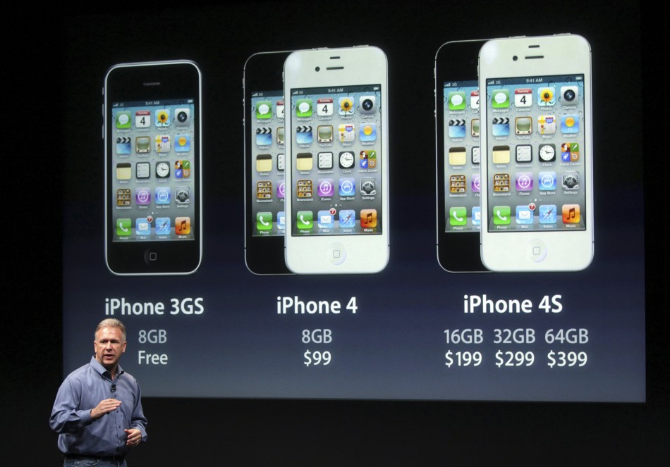
Alternative Products
-Supply can also be affected by other products that producers could supply
-If price falls for one product then they will supply less and shift production to another type product

Slide 23
Changes in Supply
Change in the quantity supplied due to a price change occurs ALONG the supply curve
If the price of Widgets fell to $2, then the Quantity Supplied would fall to 4 Widgets.

Slide 24
Changes in Supply
Several factors will change the demand for the good (shift the entire demand curve)
As an example, suppose that there is an improvement in the technology used to produce widgets.

Slide 25
Changes in Supply
Supply can also decrease due to factors other than a change in price.
As an example, suppose that a large number of Widget producers go out of business, decreasing the number of suppliers.

Slide 26
Supply and Demand at Work
A surplus is the amount by which the quantity supplied is higher than the quantity demanded.
A surplus signals that the price is too high
A shortage is the amount by which the quantity demanded is higher than the quantity supplied.
A shortage signals that the price is too low.

Slide 27
Supply and Demand at Work
Suppose that the price in the Widget market is $4.
At $4, Quantity demanded will be 4 Widgets
Surplus
At $4, Quantity supplied will be 8 Widgets.
At $4, there will be a surplus of 4 Widgets.

Slide 28
Supply and Demand at Work
Suppose that the price in the Widget market is $2.
At $2, Quantity supplied will be 4 Widgets
At $2, Quantity demanded will be 8 Widgets.
At $2, there will be a shortage of 4 Widgets.
Shortage

Slide 29
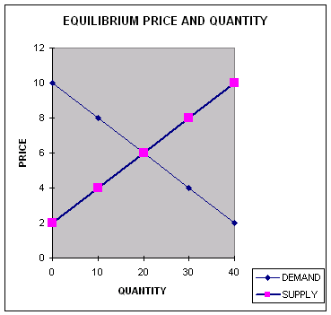
Supply and Demand at Work
Over time, a surplus forces the price down and a shortage forces the price up until supply and demand are balanced.
The point where they achieve balance is the equilibrium price.
At this price, neither a surplus nor a shortage exists.

Slide 30
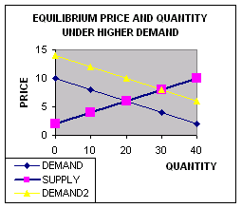
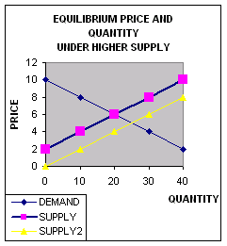
Supply and Demand at Work
Once the market price reaches equilibrium, it tends to stay there until either supply or demand changes.
When that happens, a temporary surplus or shortage occurs until the price adjusts to reach a new equilibrium price.

