Slide 1
Bell Work, Tues. 5/19
What does President Obama’s executive order prohibit?
What is the name of the first warm-blooded fish?
What does Robert Lee’s organization do?

Slide 2
Different Types of Economies
Objective 8.01

Slide 3
Foreign Trade
Market Economies
The way a society answers the basic economic questions of what to produce, how to produce, and for whom to produce determines its economic system.
In a pure market economy, also called capitalism, these decisions are made in free markets by the interaction of supply and demand.
In a market economy, private citizens–not the government–own the factors of production: natural resources, capital, labor, and entrepreneurship.

Slide 4

Market Economies
Driven by the desire to earn a profit, businesses make their own decisions regarding what to produce, how to produce, and for whom to produce.
At the same time, consumers make their own decisions about what to buy.
Supply and demand interact in the market to set prices, and producers and consumers base their decisions on price.

Slide 5
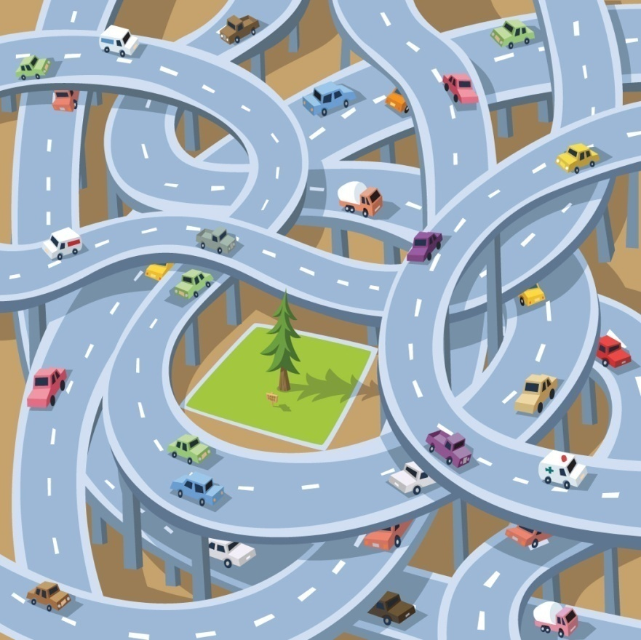
Market Economies
A market economy is decentralized–decisions are made by all the people,
not just a few.
No one coordinates these decisions.
In the United States, the government plays several important roles in the economy.
It provides public goods.
It regulates businesses to make sure markets stay competitive.
It works to reduce negative externalities and increase positive externalities.

Slide 6
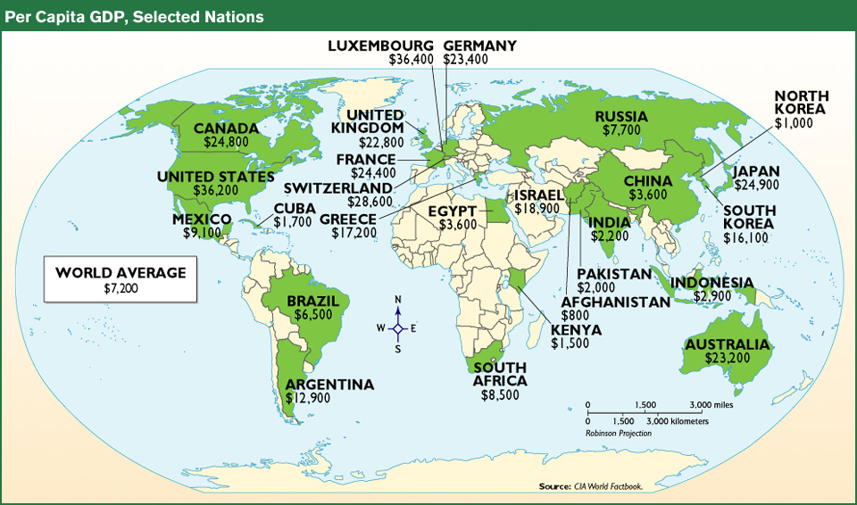
Per Capita GDP
(Gross Domestic Product)
Dividing GDP by a country’s population yields the country’s per capita GDP.
By expressing GDP in terms of each person, we can compare one nation’s economic success to another without regard to the size of the two economies.
Most countries with high per capita GDPs have market economies.

Slide 9
Command Economies
In a pure command economy, the central government makes the major economic decisions.
Individuals have few choices and little influence over the economy.
This system has also been called a controlled economy, socialism, or communism.
In a command economy, the government owns most productive resources, especially land and capital.
The government makes the three basic economic decisions.

Slide 10
Command Economies
It tells producers what to produce, how to produce, and for whom to produce.
The government fixes the wages of workers and sets prices.
Government planning agencies control different parts of the economy, such as agriculture and steel production.

Slide 11
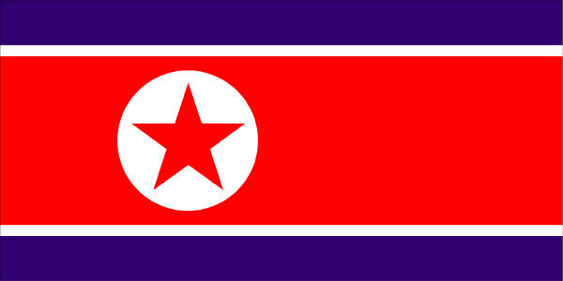
Command Economies
Command economies can be very inefficient, resulting in slower growth and lower per capita GDPs than market economies.
The two leading command economies are Cuba and North Korea.

Slide 12

Mixed Economies
A mixed economy combines basic elements of a pure market economy and a command economy.
Most countries have a mixed economy that combines private ownership of property and individual decision making with government intervention and regulations.
In the United States, individuals make decisions based on market phenomena.
However, the governments make laws to protect private property and regulate areas of business.

Slide 13
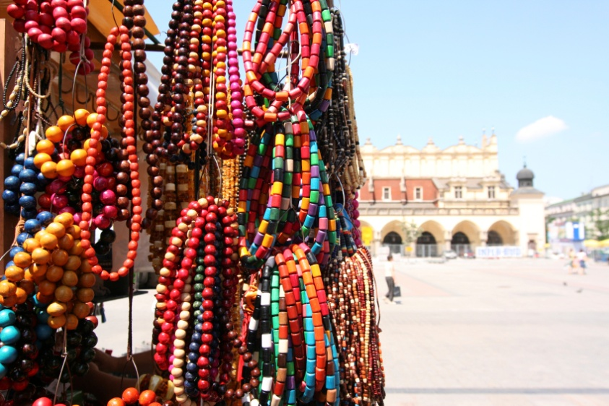
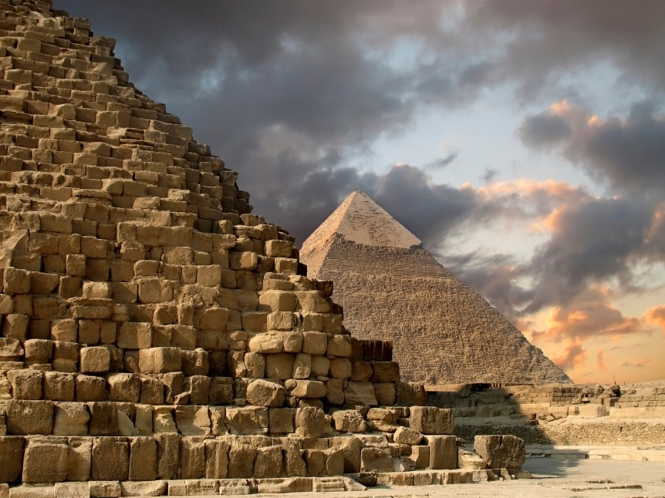
Traditional Economy
A traditional economy is an economy based on custom and habit
Generation after generation provide the same type of work
Barter is often the medium of exchange
Due to globalization, the number of traditional economies is decreasing.

Slide 14
Factors of Production Activity
1. Cut out the boxes– don’t lose any!
2. Organize the boxes based on what business you think the productive resource would be used in. Your options are: Restaurant, Bank, School, or Textile Factory
3. Then, organize the boxes based on what factor of production each would fall under. Your choices are: Natural Resource, Labor, Capital, and Entrepreneurship
4. On poster paper, glue the boxes organized by business & factor of production. You can make a chart, a web, or another form of graphic organizer.

